Slide 1
Network Applications
Mr. E.SURESH BABU_{M.TECH(CSE).,(Ph.D.)}
Associate Professor
DST-FIST Sponsored Department
College of Engineering
K L University, Vaddeswaram
I hear and I forget. I see and I remember. I do and I understand.

Slide 2


Outline
Conceptual And Implementation Aspects Of Network Applications
Application-layer Concepts
Network services required by applications,
Clients And Servers Concepts
Transport-layer Interfaces.
Background Information- Network Programming
Brief Look At Network Programming Using Sockets.
Applying Sockets using Python,
Building the Python's modules for Networked Applications.

Slide 3

User Oriented Level: Application Layer

Slide 4
Network Application
The network applications have been the driving force behind the Internet’s success motivating people in
Homes, Schools, Governments, and Businesses to make the Internet an integral part of their daily activities.
The Internet does not provide services. Instead, the Internet only provides communication, and application programs provide all services.

Slide 5
Network Applications
Internet Applications include the
Classic Text-based Applications(1970s -1980s): Text Email, Remote Access To Computers, File Transfers
Killer application (mid-1990s): The World Wide Web, Web Surfing, Search, and Electronic Commerce.

Slide 6
Network Applications
Internet Applications include the
Voice And Video Applications(2000) :
Voice-over-IP (VoIP) and video conferencing over IP such as Skype;
User-generated video distribution such as YouTube;
Movies on demand such as Netflix.

Slide 7
Network Applications
The emergence of a new generation (2010)
Social Networking Applications, such as Facebook and Twitter,

Slide 8
Creating a Network Applications

Slide 9
Application Layer:
The application layer is responsible for creating set of applications running on the End Hosts.
User write Applications Programs that run on (different) end systems
Communicate over network
E.g., Web Server software communicates with Browser Software

Slide 10
Application Layer:
The application layer is responsible for providing services to the user.
No need to write software for network-core devices
Network-core devices do not run user applications

Slide 11

















Application Layer:
Application
Transport
Network
Data Link
Physical
Application
Transport
Network
Data Link
Physical
Application
Transport
Network
Data Link
Physical

Slide 12
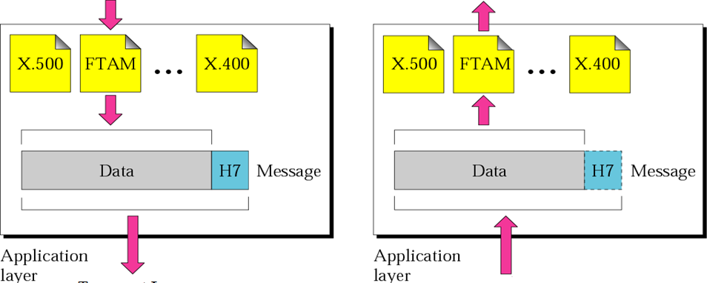
Application Layer:

Slide 13
Application Layer:
The Application Layer is a particularly good place to start our study of protocols.
Some of the better-known Application layer protocols are
✦ DNS (Domain Name System) for resolving Internet domain names.
✦ HTTP (Hypertext Transfer Protocol) which is Web’s application layer protocol
✦ FTP (File Transfer Protocol) for file transfers.
✦ SMTP (Simple Mail Transfer Protocol) for e-mail.
✦ NFS (Network File System) for file sharing in UNIX networks.
✦ Telnet for terminal emulation.

Slide 14
Application Architectures

Slide 15
Application Architecture
The Network Architecture is fixed and provides a specific set of services to applications. (e.g., the five-layer Internet architecture )
The application architecture are is designed by the application developer and dictates
how the application is structured over the various end systems.

Slide 16
Application Architecture
In Application Architecture, There are Two predominant architectural paradigms used in modern network applications:
The Client-Server Architecture
The Peer-to-Peer (P2P) Architecture (Self Study)

Slide 17
The Client-Server Architecture

Slide 18
Client/Server Model
Client-Server Model used by applications to establish the communication
One application acts as a SERVER
Starts execution first
Awaits contact from the client
The other application becomes a CLIENT
Starts after server is running
Initiates contact

Slide 19
Client/Server Model
Client/Server
Client/Server

Slide 20
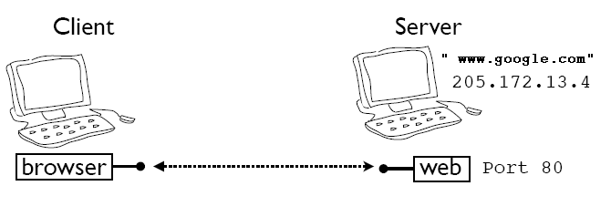
Client/Server Model
Client-Server means doing different things with different people
Servers wait for incoming connections and provide a service (e.g., web, mail, etc.)
Clients make connections to servers

Slide 21
Client/Server Model
Important Concept: Once communication has been established, data (e.g., requests and responses) can flow in either direction between a client and server

Slide 22
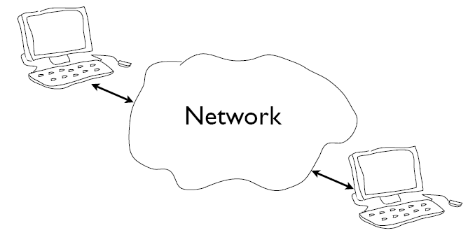
Logical Communication : Client/Server Model
”www.google.com?”
“12.3.4.15”

Slide 23
Client/Server Concepts : Example
Suppose Client sends a request message (e.g., HTTP)
GET /index.html HTTP/1.0
Server sends back a response message
HTTP/1.0 200 OK
Content-type: text/html
Content-length: 48823
<HTML>
...
The exact format depends on the application

Slide 24
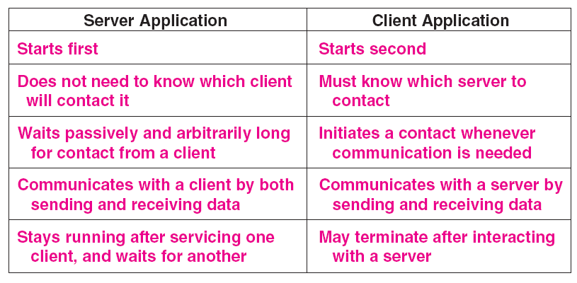
A Summary Of The Client-server Model.

Slide 25
Recall the Internet Layering Model
Host
Host
HTTP message
HTTP
HTTP
TCP segment
TCP
TCP
router
router
IP packet
IP packet
IP packet
IP
IP
IP
IP
Ethernet
interface
Ethernet
interface
SONET
interface
SONET
interface
Ethernet
interface
Ethernet
interface

Slide 26
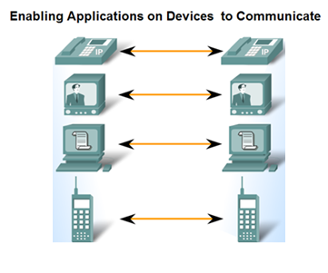
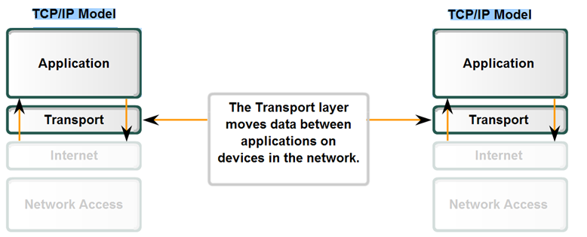
Application-to-Transport Interface

Slide 27
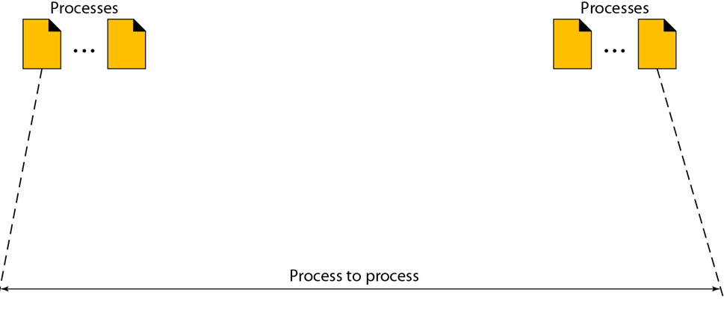

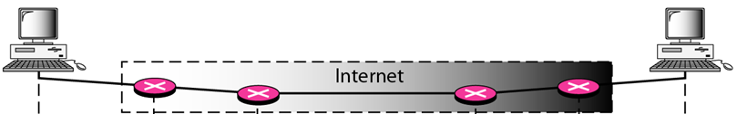

Process-to-Process Communication
The transport layer is responsible for process-to-process delivery or Application-to-Application Delivery.

Slide 28
Two Basic Internet Communication Paradigms
The Internet supports two basic communication paradigms
A Stream Paradigm (TCP)
A Message Paradigm (UDP).

Slide 29
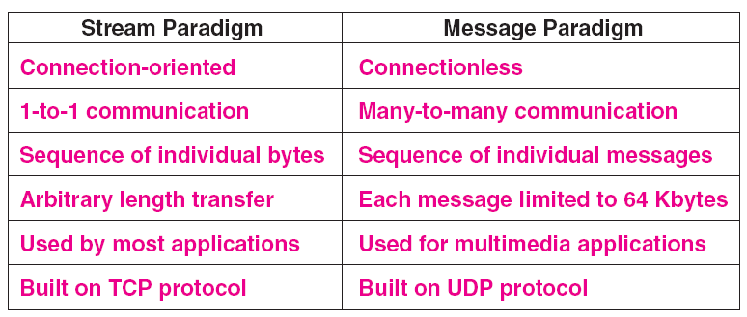
The Two Paradigms That Internet Applications Use.

Slide 30
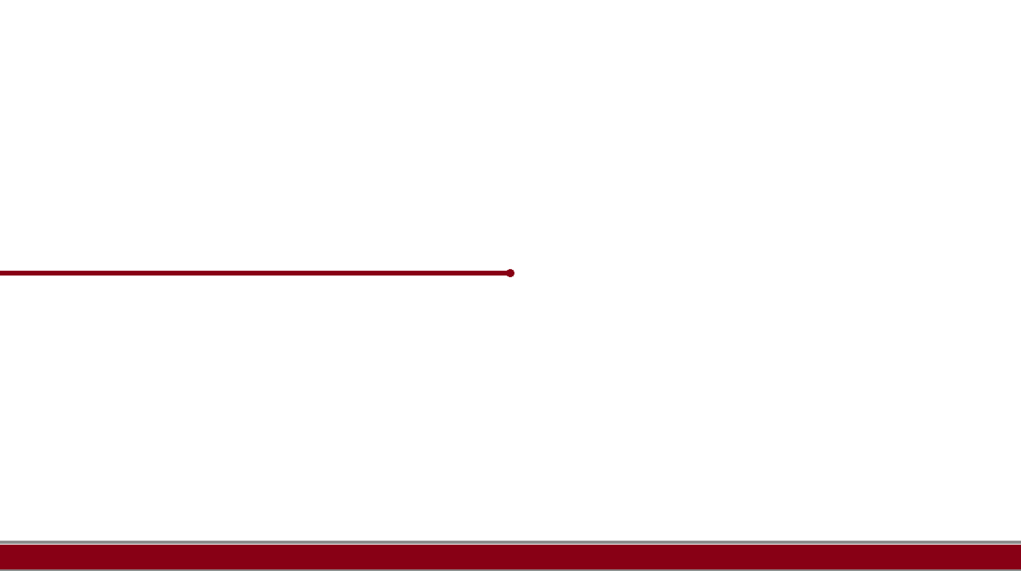
Addressing: Port Numbers

Slide 31
Addressing: Port Numbers
One of the specific responsibilities of transport layer protocol is to create a process-to-process communication;
To accomplish the process-to-process communication
Transport layer protocol uses port numbers.
Port numbers provide end-to-end addresses at the transport layer

Slide 32
Addressing: Port Numbers
Port Numbers play a important role in the TCP and UDP protocols.

Slide 33
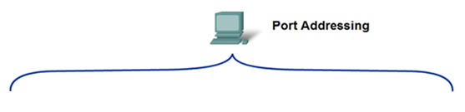



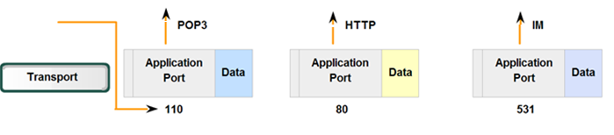
Addressing: Port Numbers
Applications

Slide 34
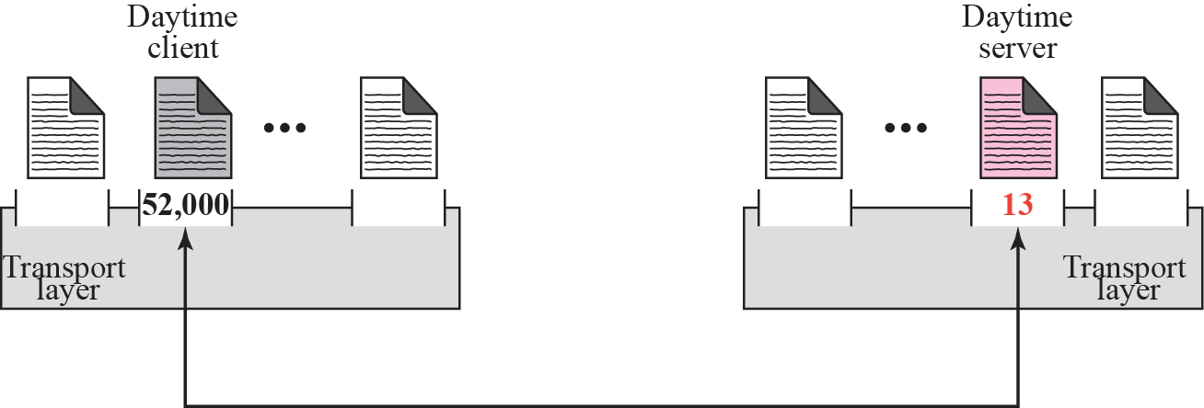
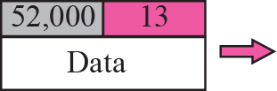
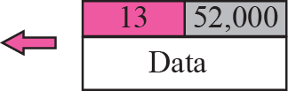
Addressing: Port Numbers

Slide 35
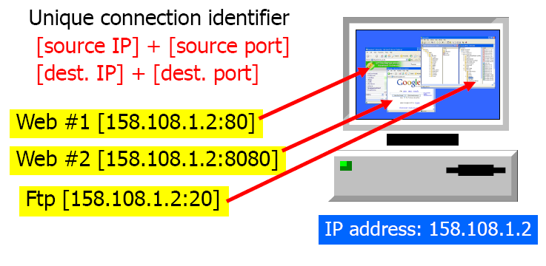
Port Address Example

Slide 36
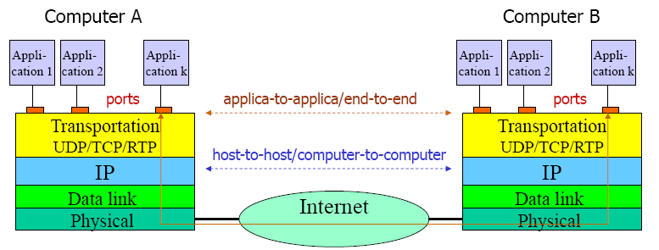
Addressing

Slide 37
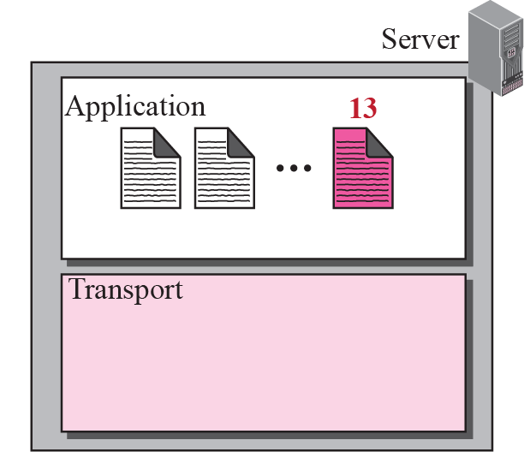
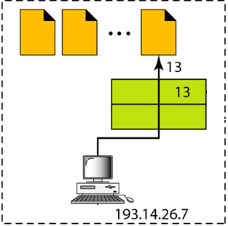

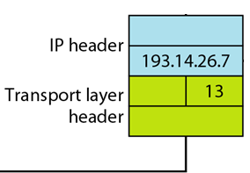

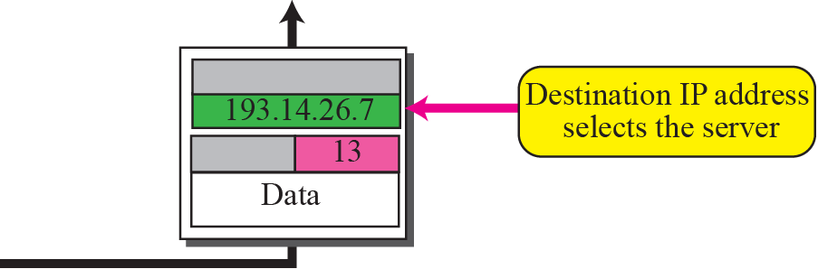
IP addresses Versus Port Numbers

Slide 38
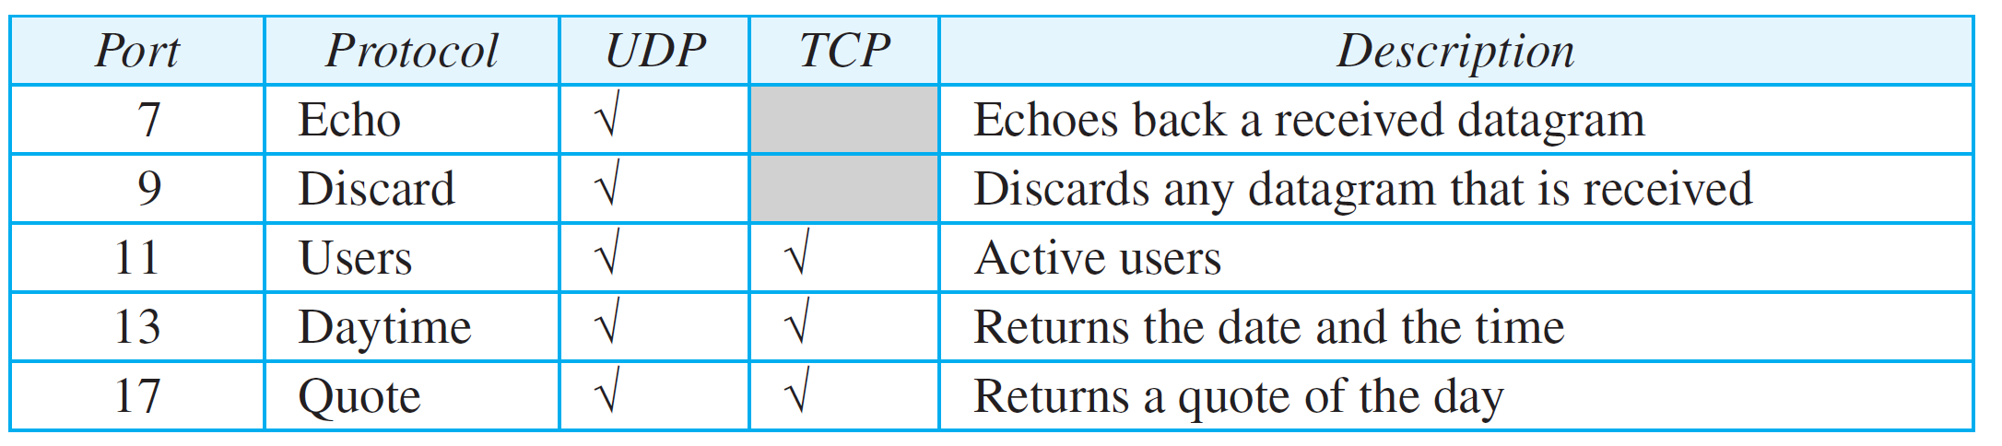
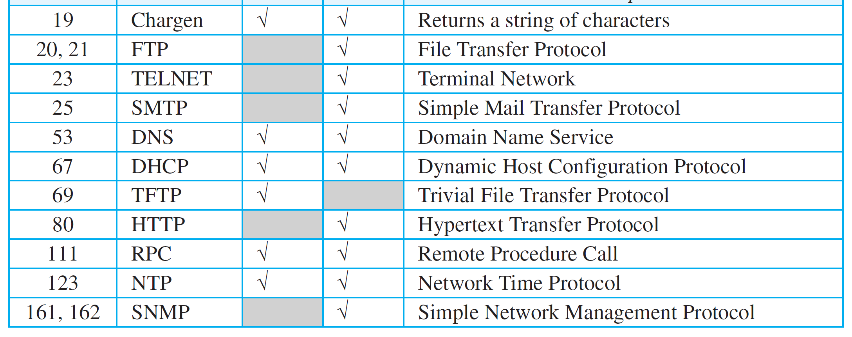
Some Well-Known Ports

Slide 39
Addressing: Socket Address

Slide 40
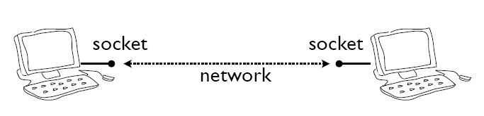

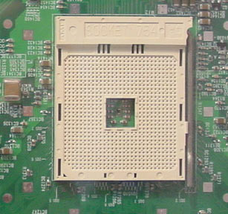
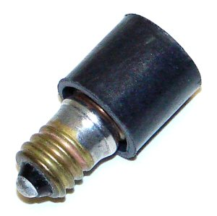
What is Socket?
Sockets are computer networking data structures which embody the concept of the "Communication Endpoint“
Each Endpoint of a network connection is always represented by a host and port #

Slide 41
Purpose…
Socket API is the programming interface you need to use for transmitting and receiving messages
Socket API help you
To send and receive the messages,
Act as a buffer,
Provides an interface between user and lower layers.
Host Or
Server
Host Or
Server
Controlled By
App Developer
Process
Process
Socket
Socket
TCP With
Buffers,
Variables
TCP With
Buffers,
Variables
Internet
Controlled
By OS

Slide 42

Socket Representation
Host Or
Server
Host Or
Server
Controlled By
App Developer
Process
Process
Socket
Socket
TCP With
Buffers,
Variables
TCP With
Buffers,
Variables
Internet
Controlled
By OS
Application
Socket
Application
Controlled By
App Developer
Process
Process
Transport
Transport
Network
Network
Controlled
By OS
Link
Internet
Link
Physical
Physical

Slide 43
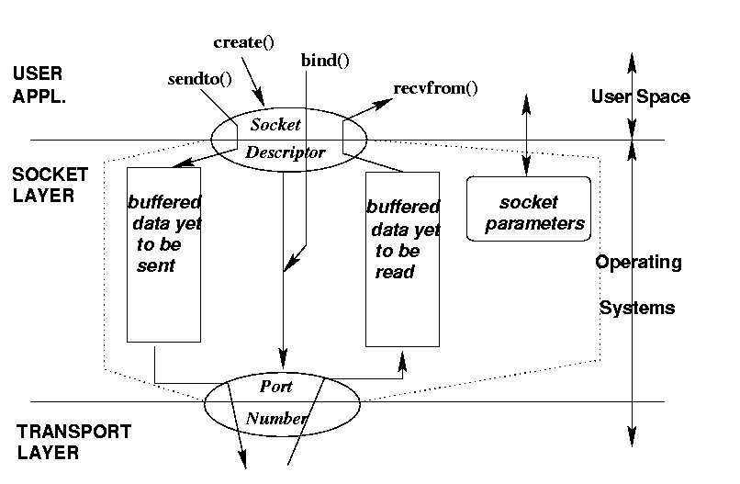
Socket: Conceptual View

Slide 44
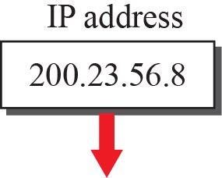
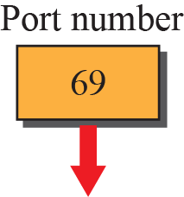
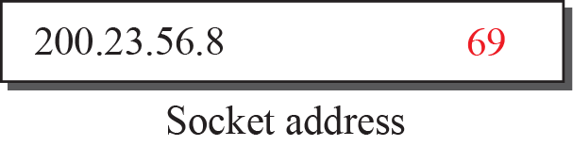
Port Address : Socket Address (Host-Port Pair)
In Python, you write it out as a tuple (host,port)
("www.python.org",80)
("205.172.13.4",443)

Slide 45
Two Essential Types of Sockets
SOCK_STREAM
  TCP
  Reliable Delivery
  In-order Guaranteed
  Connection-oriented
  Bidirectional
SOCK_DGRAM
  UDP
  Unreliable Delivery
  No Order Guarantees
  Connection Less
App
D1
App
3
3
2
D2
2
1
1
socket
socket
Dest.
D3

Slide 46
Network Programming With
Socket API

Slide 47
Network Programming And The Socket API
Network Programming is a general term
refers to the creation of client and server applications that communicate over a network
Programmer uses an Application Program Interface (API)
Set of functions
Include control as well as data transfer functions (e.g., establish and terminate communication)

Slide 48
Network Programming And The Socket API
Network Programming defined by the operating system; not part of the Internet standards
Socket API has become a de facto standard for Internet communication
The client and the server uses Socket API.
Each endpoint is a running program

Slide 49
Network Programming And The Socket API
Client/Server Socket API will interact with the networking features of their host operating system.
A socket API gives the application code
To access the network interface and
Makes convenient calls to transmit and receive data.

Slide 50
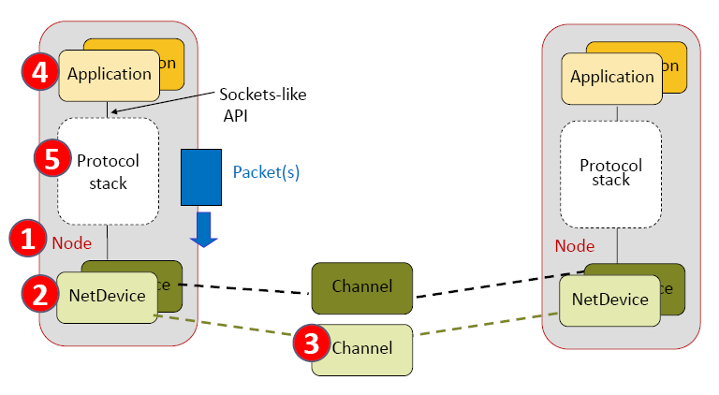
Network Communication using Socket API

Slide 51
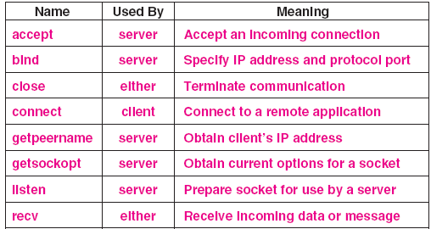
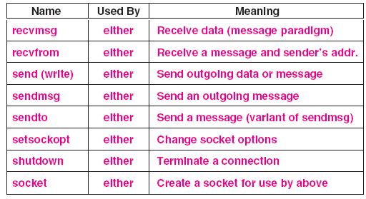
Summarizes Key Functions In The Socket API.

Slide 52
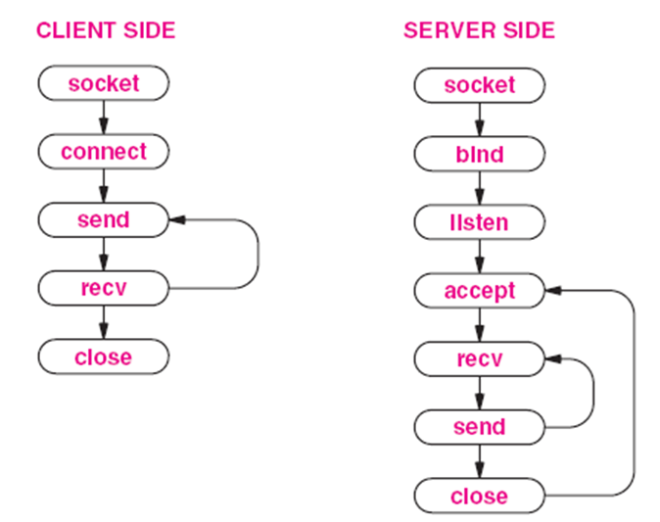
Socket Calls In A Client And Server(Stream Message )

Slide 53
Python Networking

Slide 54
Python Networking
Apply Python concept to implement client-server architecture, sockets, and networking.
The primary module for Python Networking is Socket Module.
Socket() function is found within this module to create socket objects.

Slide 55
Python Networking
Network programming is a major use of Python
Python standard library has wide support for network protocols
Writing network programs in Python tends to be substantially easier than in C/C++

Slide 56
Basics of Socket in Python
To Create a Socket, Use the socket.socket() function,
import socket
s = socket.socket(addr_family, type)
The socket_family is either AF_UNIX or AF_INET,
The socket_type is either SOCK_STREAM or SOCK_DGRAM.

Slide 57
Basics of Socket in Python
Address Families
Socket types
socket.AF_INET Internet protocol (IPv4)
socket.AF_INET6 Internet protocol (IPv6)
socket.SOCK_STREAM Connection based stream (TCP)
socket.SOCK_DGRAM Datagrams (UDP)

Slide 58
Basics of Socket in Python
Example :
from socket import *
s = socket(AF_INET,SOCK_STREAM)
from socket import * : Import all the names used in the socket

Slide 59
Socket Types
Almost all code will use one of following
from socket import *
s = socket(AF_INET, SOCK_STREAM)
s = socket(AF_INET, SOCK_DGRAM)

Slide 60
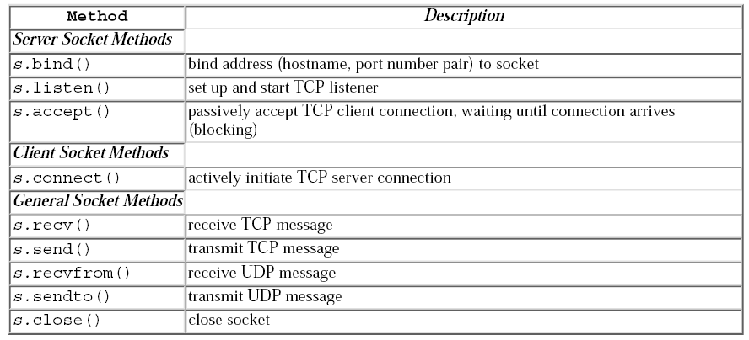
Common Socket Methods

Slide 61
Example: Echo Client-Server Program in Python

Slide 62
Client Side :
Echo Client that will talk to the Echo Server
import socket
The client must import the socket module

Slide 63
Client Side :
Echo Client that will talk to the Echo Server
import socket
host = 'localhost'
port = 50000
Set the host name and port number variables

Slide 64
Client Side :
Creates a socket.
s = socket.socket(socket.AF_INET, socket.SOCK_STREAM)
Creates a socket.

Slide 65
Client Side :
Connect() method to connect to the server.
s.connect((HOST, PORT))
Client Connects to the Server

Slide 66
Client Side :
Connect() method to connect to the server.
s.connect((HOST, PORT))
Client Connects to the Server (Note : Server must Accept it)

Slide 67
Client Side :
The send() method transmits data to the server.
Client uses the recv() method to get data back from the server,
s.send('Hello, world')
data = s.recv(size)

Slide 68
Client Side :
Close the socket and print out the data that was received.
s.close()
print 'Received:', data

Slide 69
Client Side : Final
#!/usr/bin/env python
"""
A simple echo server
"""
import socket
host = ''
port = 50000
size = 1024
s = socket.socket(socket.AF_INET, socket.SOCK_STREAM)

Slide 70
Client Side : Final
s.bind((host,port))
s.listen(backlog)
while 1:
client, address = s.accept()
data = client.recv(size)
if data:
client.send(data)
client.close()

Slide 71
Server Side :
Simple Echo Server
import socket
The Server must import the socket module

Slide 72
Server Side :
By setting the host name to the empty string, it tells the bind() method to fill in the address of the current machine.
This is an easy way of setting up a server so that runs on whichever host you use.
host = ''
port = 50000
size = 1024

Slide 73
Server Side :
Creates a socket.
s = socket.socket(socket.AF_INET, socket.SOCK_STREAM)
This creates a socket object, stored in s, that will use TCP and IPv4.

Slide 74
Server Side :
Bind Method
s.bind((host,port))
This binds the socket to the host name (the current host) and the port number

Slide 75
Server Side :
Listen Method
s.listen(backlog)
Listen tells the operating system to keep a backlog of five connections.

Slide 76
Server Side :
Data Transfer
while 1:
client, address = s.accept()
data = client.recv(size)
if data:
client.send(data)
client.close()
This infinite while loop accepts a client: The accept() method accepts an incoming connection (a client).

Slide 77
Server Side :
Data Transfer
while 1:
client, address = s.accept()
data = client.recv(size)
if data:
client.send(data)
client.close()
Reads a single message: The socket recv() method takes the maximum amount of data, in bytes

Slide 78
Server Side :
Data Transfer
while 1:
client, address = s.accept()
data = client.recv(size)
if data:
client.send(data)
client.close()
Echoes that message back to the client. : The socket send() method sends data back to the client

Slide 79
Server Side :
Data Transfer
while 1:
client, address = s.accept()
data = client.recv(size)
if data:
client.send(data)
client.close()
This socket close() method will close the socket.

Slide 80
Server Side : Final
#!/usr/bin/env python
"""
A simple echo server
"""
import socket
host = ''
port = 50000
backlog = 5
size = 1024
s = socket.socket(socket.AF_INET, socket.SOCK_STREAM)

Slide 81
Server Side : Final
s.bind((host,port))
s.listen(backlog)
while 1:
client, address = s.accept()
data = client.recv(size)
if data:
client.send(data)
client.close()

Slide 82
Example: TCP/IP Client and Server Program in Python

Slide 83

TCP Communication Model
Socket()
Server
Client
Bind()
Socket()
Listen()
Connect()
Accept()
Write()
[Blocked]
Read()
Read()
[Blocked]
[Blocked]
Write()
When Interaction Is Over, Server Loops To Accept A New Connection

Slide 84
TCP Echo Server Side :
import socket
import sys
# Create a TCP/IP socket
sock = socket.socket(socket.AF_INET, socket.SOCK_STREAM)

Slide 85
TCP Echo Server Side :
# Bind the socket to the port
server_address = ('localhost', 10000)
print >> sys.stderr, 'starting up on %s port %s' % server_address
sock.bind(server_address)

Slide 86
TCP Echo Server Side :
# Listen for incoming connections
sock.listen(1)
while True:
# Wait for a connection
print >>sys.stderr, 'waiting for a connection'
connection, client_address = sock.accept()

Slide 87
TCP Echo Server Side :
try:
print >>sys.stderr, 'connection from', client_address # Receive the data in small chunks and retransmit it
while True:
data = connection.recv(16)
print >>sys.stderr, 'received "%s"' % data
if data:
print >>sys.stderr,'sending data back to the client'

Slide 88
TCP Echo Server Side :
connection.sendall(data)
else:
print >>sys.stderr, 'no more data from', client_address
break
finally:
# Clean up the connection
connection.close()

Slide 89
TCP Echo Client Side :
import socket
import sys
# Create a TCP/IP socket
sock = socket.socket(socket.AF_INET, socket.SOCK_STREAM)
# Connect the socket to the port where the server is listening
server_address = ('localhost', 10000)
print >> sys.stderr, 'connecting to %s port %s' % server_address
sock.connect(server_address)

Slide 90
TCP Echo Client Side :
try:
# Send data
message = 'This is the message. It will be repeated.'
print >>sys.stderr, 'sending "%s"' % message
sock.sendall(message)
# Look for the response
amount_received = 0
amount_expected = len(message)

Slide 91
TCP Echo Client Side :
data = sock.recv(16)
amount_received += len(data)
print >>sys.stderr, 'received "%s"' % data
finally:
print >>sys.stderr, 'closing socket'
sock.close()

Slide 92
Outline
Conceptual And Implementation Aspects Of Network Applications
Application-layer Concepts
Network services required by applications,
Clients And Servers Concepts
Transport-layer Interfaces.
Background Information- Network Programming
Brief Look At Network Programming Using Sockets.
Applying Sockets using Python,
Building the Python's modules for Networked Applications.

Slide 93
Thank You

