Slide 1
Introduction to Python
Mr. E.SURESH BABU_{M.TECH(CSE).,(Ph.D.)}
Associate Professor
DST-FIST Sponsored Department
College of Engineering
K L University, Vaddeswaram
I hear and I forget. I see and I remember. I do and I understand.

Slide 2


Outline
Review of Python

Slide 3

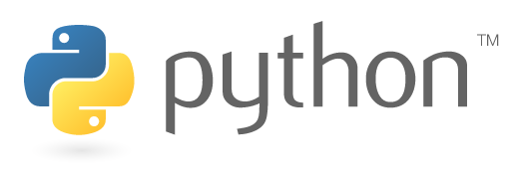
Review of Python
If the implementation is hard to explain, it's a bad idea.
If the implementation is easy to explain, it may be a good idea

Slide 4
History of Python

Slide 5
History of Python
Python 1: 1994
Python 2: 2000
Python 3: 2008
Specifically, we’re using
Python 3.5.2
Guido Van Rossum

Slide 6
Programmers Are More
Important Than Programs

Slide 7
“Hello World” in Java
public class HelloWorld {
public static void main(String[] args) {
System.out.println("Hello World!”);
}
}

Slide 8
“Hello World” in C++
#include <iostream>
using namespace std;
int main() {
cout << "Hello World!" << endl;
}

Slide 9
“Hello World” in Python
print("Hello world!")

Slide 10
Introduction to Python

Slide 11
Review of Python
Python is one of those rare languages which is simple and powerful.
Using Python, You can concentrate the solution to the given problem rather than syntax and structure of the language (C++ or Java)

Slide 12
Features of Python
Python
Easy to learn,
Powerful programming language.
Efficient high-level data structures
Simple and Effective Approach (object-oriented programming.)

Slide 13
Features of Python
Python
High Level Language
Portable and Interpreted
Embeddable
Extensible
Extensive Libraries

Slide 14
Features of Python
Python
Supports Elegant Syntax and Dynamic Typing
Free and Open-Source
Ideal language for scripting
Rapid Application development in many areas on most platforms.

Slide 15
Interactive Interpreter

Slide 16
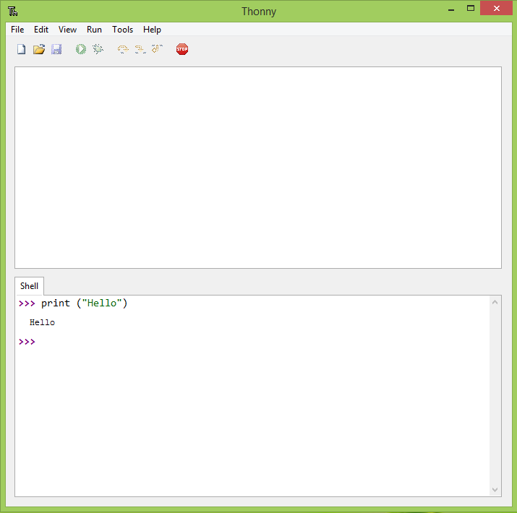
Interactive Interpreter

Slide 17
Comments
# Single line comments start with a '#‘
"""
Multiline strings can be written
using three "s, and are often used
as comments
"""

Slide 18
Variables

Slide 19
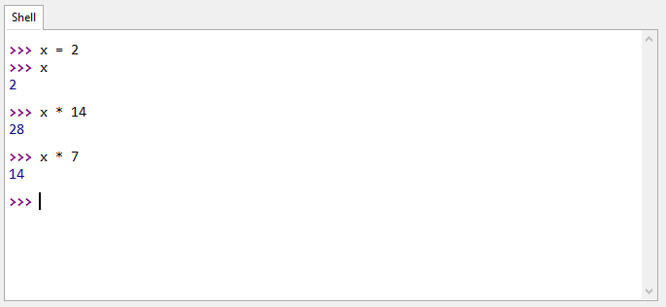
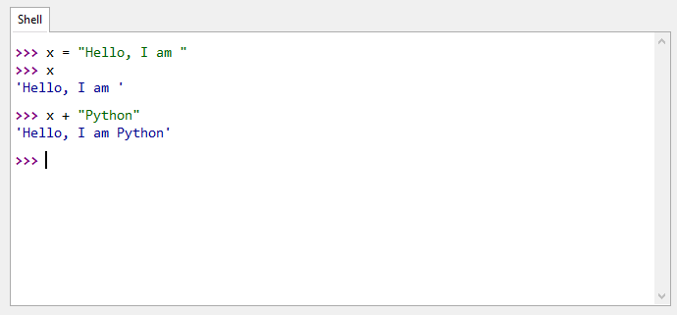
Variables
x = 2
x * 7 >>> 14
x = "Hello, I'm "
x + "Python!" >>> "Hello, I'm Python"
No Semi Colon

Slide 20
Data Types

Slide 21
Where’s My Type?
In Java or C++
int x = 0;
In Python
x = 0;

Slide 22
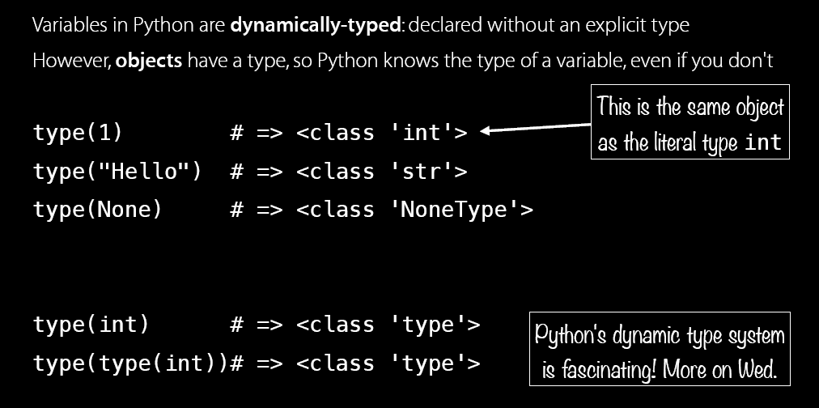
Where’s My Type?

Slide 23
Numbers and Math

Slide 24
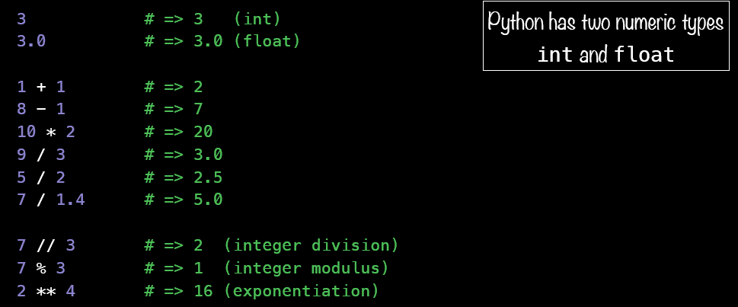
Where’s My Type?

Slide 25
Control Flow

Slide 26
Control Flow

Slide 27
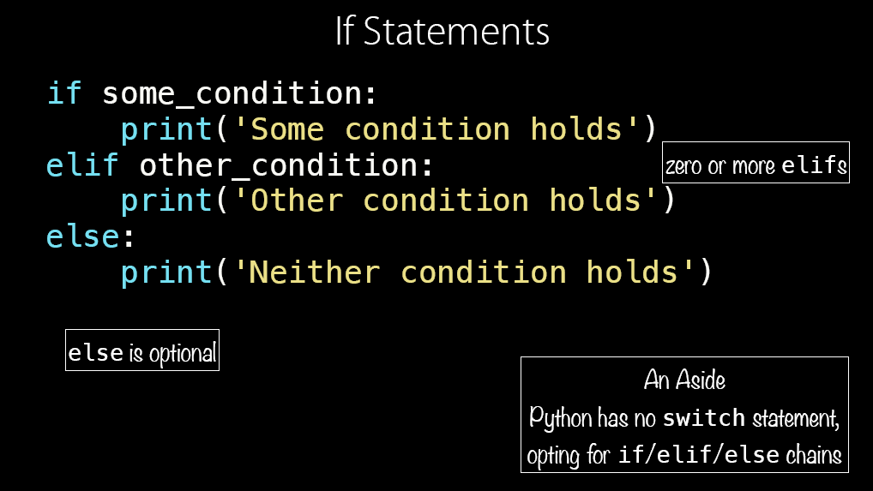
Control Flow

Slide 28
Control Loops

Slide 29
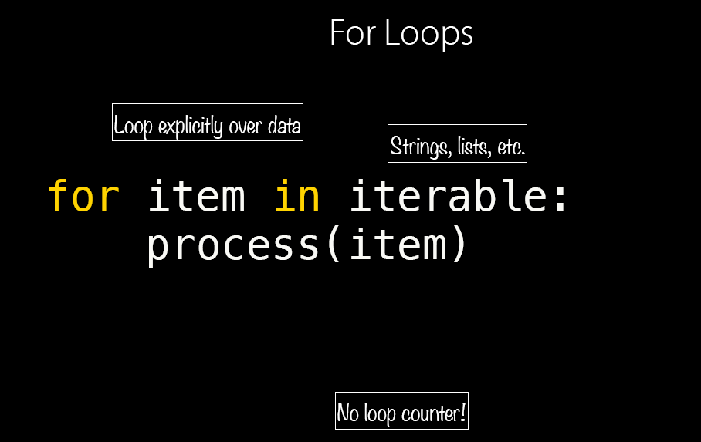
Control Loops

Slide 30
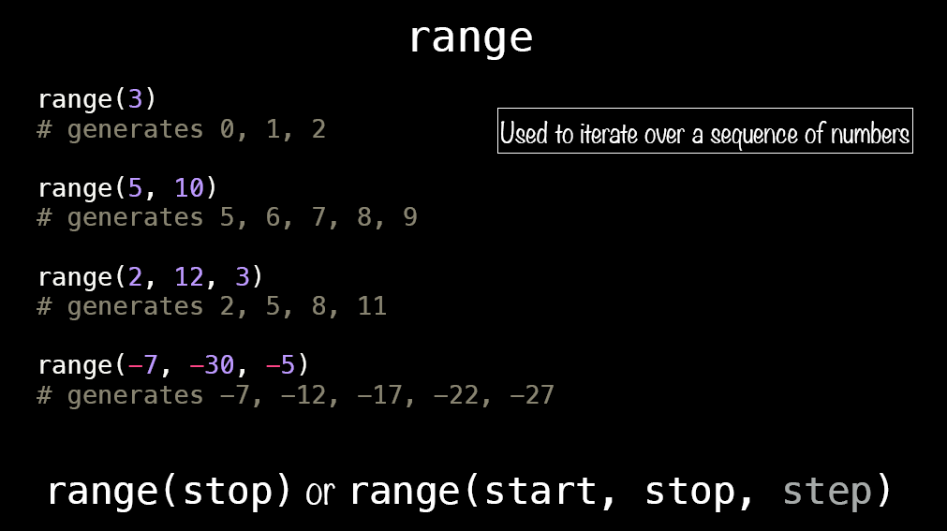
Control Loops

Slide 31
Functions

Slide 32
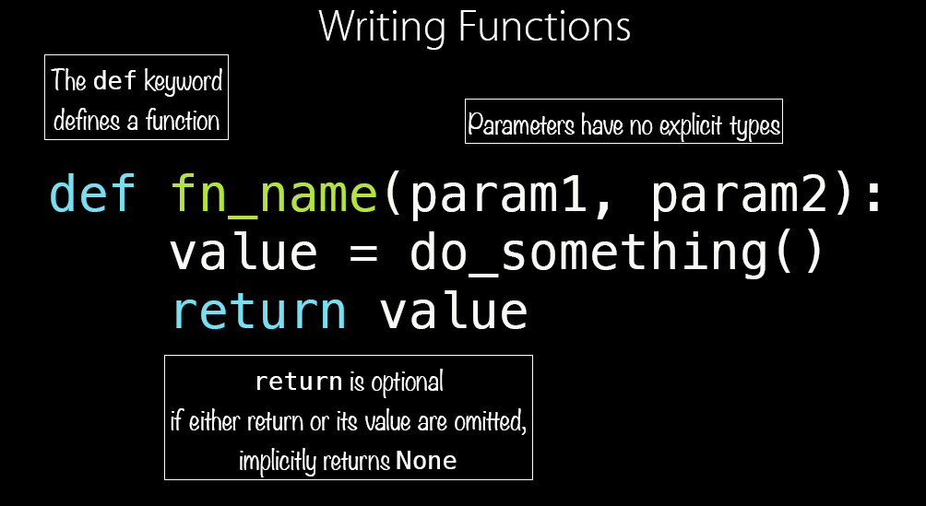
Functions

Slide 33
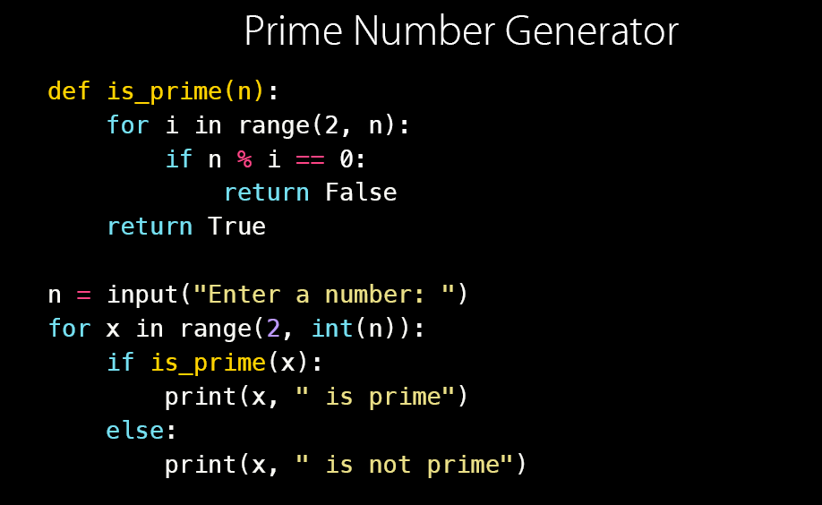
Functions : Example

Slide 34
Thank You

