Slide 1
EMBEDDED
NETWORKING

Slide 2
EMBEDDED NETWORKING Syllabus
EMBEDDED COMMUNICATION PROTOCOLS: Embedded Networking: Introduction – Serial/Parallel Communication - Serial communication protocols-RS232 standard-RS485- Synchronous serial protocols – serial peripheral interface (SPI) – Inter Integrated Circuits (I2C)-PC Parallel port programming – ISA/PCI bus protocols-Fire wire.

Slide 3
EMBEDDED NETWORKING Syllabus
USB AND CAN BUS: USB bus – Introduction – Speed identification on the bus – USB states- USB bus communication: Packets-Data flow types-Enumeration – Descriptors-PIC18 Microcontroller USB interface – C Programs – CAN bus - Introduction - Frames - bit stuffing – types of errors- nominal bit timing-PIC controller CAN Interface – A simple application with CAN.

Slide 4
EMBEDDED NETWORKING Syllabus
ETHERNET BASICS: Elements of a network – Inside Ethernet – Building a network: Hardware options – Cables, Connections and network speed- Design choices: Selecting components- Ethernet controllers- Using the internet in logical and internet communications- Inside the Internet protocol

Slide 5
EMBEDDED NETWORKING Syllabus
EMBEDDED ETHERNET: Exchanging messages using UDP and TCP – Serving web pages with Dynamic data – Serving web pages that respond to user input – Email for Embedded Systems – Using FTP – Keeping Devices and Network Secure.

Slide 6
EMBEDDED NETWORKING Syllabus
WIRELESS EMBEDDED NETWORKING:
Wireless sensor networks – Introduction – Applications – Network Topology – Localization – Time Synchronization – Energy efficient MAC protocols – SMAC – Energy efficient and robust routing – Data centric routing

Slide 7
EMBEDDED NETWORKING Syllabus
TEXT BOOKS:
Frank Vahid, Givargis, “Embedded Systems Design : A unified Hardware/Software Introduction”, Wiley Publications
Jan Axelson, “Parallel Port Complete”, Penram publications
Dogan Ibrahim, “Advanced PIC microcontroller projects in C”, Elsevier 2008.
Jan Axelson, “Embedded Ethernet and Internet complete”, Penram publications.
Bhasker Krishnamachari, “Networking wireless sensors”, Cambridge press 2005.

Slide 20
Introduction to EMBEDDED NETWORKING
A network can be defined as a group of computers and other devices connected in some ways so as to be able to exchange data.
In its broadest sense, a network consists of two or more entities, or objects, sharing resources and information.
Each of the devices on the network can be thought of as a node; each node has a unique address.
Some networks also provide names that humans can more easily remember than numbers.

Slide 21
Family Network
Most people belong to a family network in which related people share their resources and information.
This sharing is bi-directional because even the youngest family members share information of some sort.
Peer Network
Outside the family, there is a community that offers a wider array of resources than the typical family can provide.

Slide 22
This type of information/resource sharing can be as simple as loaning a hammer to a neighbour, car-pooling with work associates, or helping a friend with his or her homework.
All of these activities involve sharing, or trading, resources. This kind of network is represented by a two-way relationship, a give and take among equals or peers.
Restaurant Network: The Client and the Server
For instance, when you go to dinner at a restaurant, you become a customer, or client, enjoying the food and drink prepared and served to you by the restaurant.

Slide 23
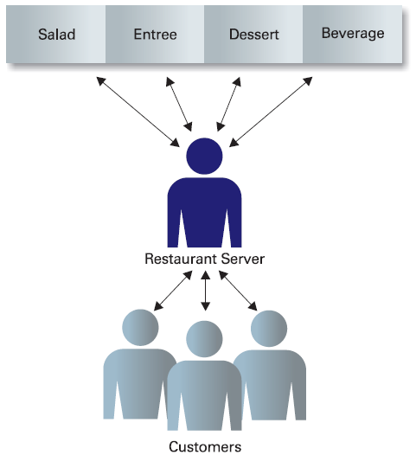
On the other hand, the waiter works as a server, controlling and providing his customers with access to resources in the form of placing orders for and delivering food items.

Slide 24
Contact Network
Anyone who has looked for a job knows that one of the best ways to find a job is to network. That is, create a list of friends and associates who will help you find the perfect job.
The more people you meet and get to know, the better your chances of obtaining work.
As you develop and nurture your career, this contact network will serve you best because your role in it will change as you gain more experience.

Slide 25
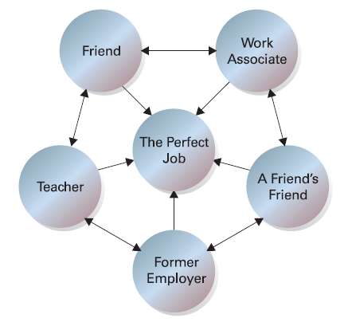

Slide 26
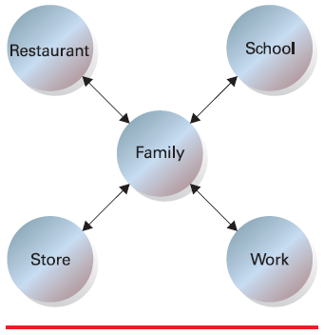

Slide 27
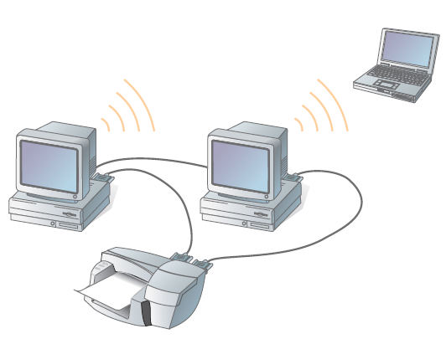
Computer Networks
A computer network consists of two or more computing devices that are connected in order to share the components of your network (its resources) and the information you store there, as shown in figure.

Slide 28
The first computer, yours, is commonly referred to as your local computer. It is more likely to be used as a location where you do work, a workstation, than as a storage or controlling location, a server.
As more and more computers are connected to a network and share their resources, the network becomes a more powerful tool, because employees using a network with more information and more capability are able to accomplish more through those added computers or additional resources.

Slide 29
Types of Networks
There are two principle kinds of networks:
Wide Area Networks (WANs) and
Local Area Networks (LANs).
Wide Area Networks (WANs)
-Cover cities, countries, and continents.
-Based on packet switching technology
-Examples of WAN technology: Asynchronous Transfer Mode (ATM),
Integrated Services Digital Network (ISDN)

Slide 30
Local Area Networks (LANs)
Cover buildings or a set of closely related buildings.
Examples of LAN technology: Ethernet, Token Ring, and Fibber
Distributed Data Interconnect (FDDI).
Ethernet LANs: based on a bus topology and broadcast communication
Token ring LANs: based on ring topology
FDDI LANs: use optical fibbers and an improved token ring mechanism
based on two rings flowing in opposite directions.

Slide 31
Network Plan
Networking computers first and tracking the connections later can quickly become confusing and unmanageable as you try to find which computer communicates with and shares resources with which other computers.
Example:
In your family network, would you want your parents or guardians to know your every thought?
You have your information-sharing plan in your head, and it is important to keep track of it so you don’t make a mistake and share something where it was not intended.

Slide 32
A network plan, therefore, is a formally created product that shows all the network’s components and the planned connections between them.
Your plan should show what types of information are stored where, and who is allowed to use each type.
Information Management
Your network plan should help you manage the information gathered, stored, and shared between your users.
A networking plan could tell you that as specific types of sensitive data (like medical, personal, or payroll information) are gathered or grouped.

Slide 33
Those data should be stored higher in the hierarchical structure (ranked from most sensitive to least sensitive), and this can save you time in the end.
Information’s Importance
Some information is more important or more sensitive than the rest.
It is usually obvious in real filing cabinet systems, because the top drawer is usually where the most sensitive information is stored, and it is locked.

Slide 34
For example, credit card or Social Security numbers are information that should be given the highest level of security—access to that information is given only to a limited number of people in a company.
On the other hand, some information, such as Web pages, newsletters, and product information, is created for everyone to see, even outside a company.
The figure shows how this kind of information is organized into a hierarchy of information, where the most detailed information is found at the top and the more general, less secure information is located at the bottom.

Slide 35
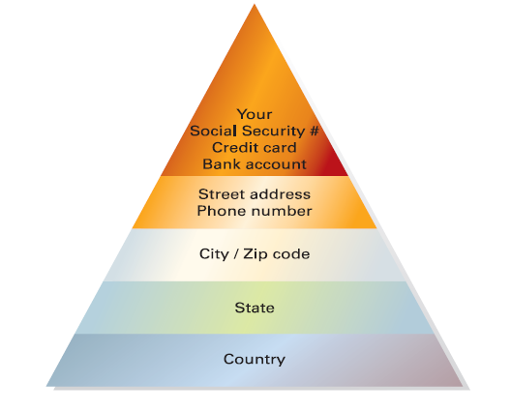

Slide 36
Identifying the Benefits of Networks
In the early days of the personal computer (PC), during the late ’70s and early ’80s, often a PC was used as a stand-alone computer and operated independently from other computers.

Slide 37
When, over the span of just those few years, their use proliferated and more PCs were found relatively close to each other, users began sharing information.
The information was either printed out or copied from one computer to another using backup or storage devices, such as tapes, disks, or other digital storage media.
The printout or the storage device was then physically carried to another computer where the information was re-entered or copied from the portable media into the next computer.
This process was referred to as a sneaker net because users actually had to walk from computer to computer.

Slide 38
Once computers were connected by networks, information sharing increased dramatically.
Sharing Information

Slide 39
Sharing Resources
In the sneaker net era, users spent huge amounts of time attempting to share their resources. They had to physically distribute files that others needed.
The ability to share resources was another reason networks were created, and it is still one of the main purposes for using networks.
Many companies start with multiple stand-alone computers.
Not too long after the initial computer purchase, however, additional components that attach to a computer, called peripherals, like printers, scanners, and speakers, are purchased and are connected to that computer to expand its use

Slide 41
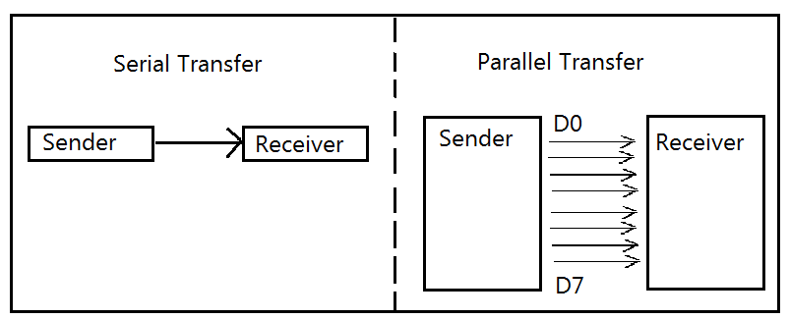
Serial & Parallel Communications
Serial communication vs Parallel Communication

Slide 42
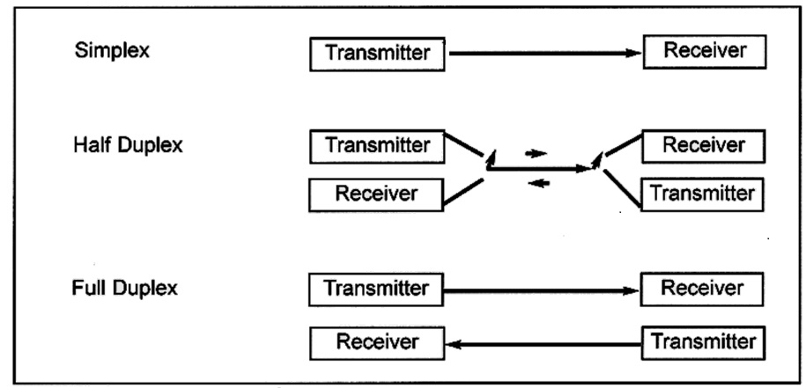

Slide 43
Synchronous and Asynchronous transmissions
Synchronous and Asynchronous transmissions are two different methods of transmission synchronization.
Synchronous transmissions are synchronized by an external clock, while Asynchronous transmissions are synchronized by special signals along the transmission medium

Slide 44
Synchronous vs. Asynchronous
Synchronous data transfer: sender and receiver use the same clock signal
Supports high data transfer rate
Needs clock signal between the sender and the receiver
Requires master/slave configuration

Slide 45
Synchronous vs. Asynchronous
Asynchronous data transfer: sender provides a synchronization signal to the receiver before starting the transfer of each message
Does not need clock signal between the sender and the receiver .
Slower data transfer rate

Slide 46
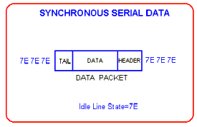
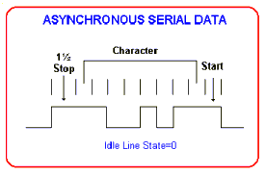
Synchronous vs. Asynchronous

Slide 47
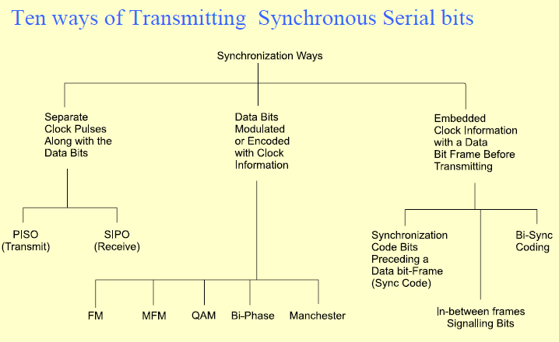

Slide 48
Synchronous Frame
The header field is used to convey address information (sender and receiver), packet type and control data.
The data field contains the users data (if it can't fit in a single packet, then use multiple packets and number them). Generally, it has a fixed size.
The tail field contains checksum information which the receiver uses to check whether the packet was corrupted during transmission.

Slide 49
Asynchronous Frame
Start and Stop bits

Slide 50
There are several popular types of serial communications. Here are a few worth noting:
RS232. Peer-to-peer (i.e. communications between two devices)
RS485. Multi-point (i.e. communications between two or more devices)
USB (Universal Serial Bus). Replaced RS232 on desktop computers.
CAN (Controller Area Network). Multi-point. Popular in the automotive industry.

Slide 51
SPI (Serial Peripheral Interface). Developed by Motorola. Synchronous master/slave communications.
I2C (Inter-Integrated Circuit).Developed by Philips. Multi-master communications.

Slide 52
BAUD RATE
BIT RATE
Baud Rate = bits transferred/second
baud rate INCLUDES start, stop, and parity
“bit rate” refers to JUST data bits transferred per second (may include parity)
baud rate > bit rate

Slide 53
RS 232 Protocol
RS232 is a standard developed by Electronic Industry Association (EIA).
Serial communication is the most simplistic form of communication between two devices. It’s what started networking!
RS-232 is a standard by which two serial devices communicate:
The connection must be no longer than 50 feet.
Transmission voltages are –15V and +15V.
It is designed around transmission of characters (of 7 bits of length).

Slide 54
One important aspect of RS-232 is that it is an asynchronous form of communication.
Asynchronous communication is important because it is efficient; if no data needs to be sent, the connection is “idle.” No additional CPU overhead is required for an idle serial line.
Logical Voltages
Logical 1 is –15VDC.
Logical 0 is +15VDC.
When the connection is idle, the hardware ties the connection to logical 1.

Slide 55
How Can You Transmit Data?
RS-232 communication is dependent on a set timing speed at which both pieces of hardware communicate.
In other words, the hardware knows how long a bit should be high or low.
RS-232 also specifies the use of “start” and “stop” bits.
Every time a character is sent, the same communication occurs:
Start bit sent.
Seven data bits sent.
Parity bit
Stop bit sent.

Slide 56
This communication is dependent on the fact that both devices are sampling the bits at the same rate.
The start bit is a logical 0 sent on the line to tell the other device to start sampling.
Remember, the logical 0 is +15VDC.
The stop bit is a logical 1. –15VDC.
A stop bit is always sent (per RS-232 standards).
The transmission rate of serial devices is called baud. It is the number of changes in the signal per second.

Slide 57
Common Serial Settings
Most settings are read in the following form:
Bits per second
Number of data bits
Parity
Number of Stop bits
Most everything comes out of the box with 9600,8,none,1. Including most Internet related devices like routers.
Another common (old-school) setting is 9600,7,even,2.

Slide 58
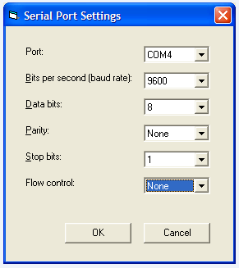

Slide 59
Line Sampling & Framing
RS-232 hardware samples the line multiple times during a single bit transmission.
If the samples do not all have the same voltage, a framing error occurs.
A framing error should only occur if one device is sending faster than the other device is set to receive.
An intentional frame error can be caused by sending a BREAK.

Slide 60
Wiring RS-232
RS232 is used to connect DTE(Data Terminal equipment) & DCE ( Data Communication Equipment)
DTE may be PC, Serial Printer or a plotter. DCE can be a modem, mouse or a scanner.
The RS-232 specification denotes usage of a 25 pin cable, where each pin has a specific usage.
However, most devices never need to use all of the pins, so the cabling requirements for specific devices may vary.
Many common serial devices (modems for example), use a 9 pin serial connection.

Slide 61
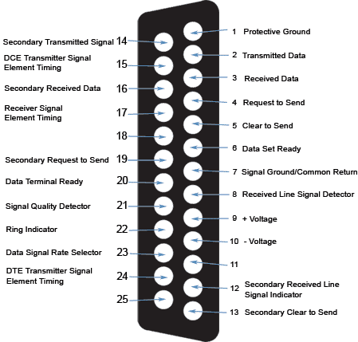
RS-232 DB25 Pin Out
DB-25M
Function
Abbreviation
Pin #1
Chassis/Frame Ground
GND
Pin #2
Transmitted Data
TD
Pin #3
Receive Data
RD
Pin #4
Request To Send
RTS
Pin #5
Clear To Send
CTS
Pin #6
Data Set Ready
DSR
Pin #7
Signal Ground
GND
Pin #8
Data Carrier Detect
DCD or CD
Pin #9
Transmit + (Current Loop)
TD+
Pin #11
Transmit - (Current Loop)
TD-
Pin #18
Receive + (Current Loop)
RD+
Pin #20
Data Terminal Ready
DTR
Pin #22
Ring Indicator
RI
Pin #25
Receive - (Current Loop)
RD-

Slide 63
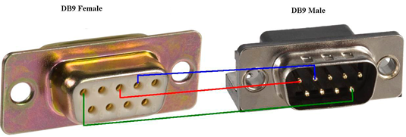
RS-232 DB9 Pin Out
DB-9M
Function
Abbreviation
Pin #1
Data Carrier Detect
CD
Pin #2
Receive Data
RD or RX or RXD
Pin #3
Transmitted Data
TD or TX or TXD
Pin #4
Data Terminal Ready
DTR
Pin #5
Signal Ground
GND
Pin #6
Data Set Ready
DSR
Pin #7
Request To Send
RTS
Pin #8
Clear To Send
CTS
Pin #9
Ring Indicator
RI

Slide 64
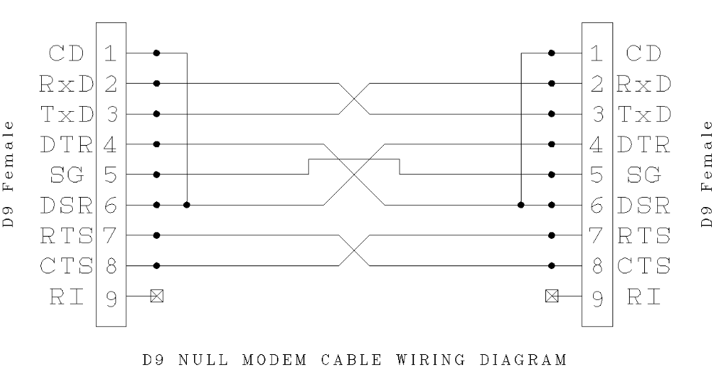

Slide 65
COM port and Modem Handshaking signals
When a modem connects, modem sends data carrier detect DCD signal at an instance T₀.
Communicates data set ready (DSR) signal at an instance T₁ when it receives the bytes on the line.
Receiving computer (terminal) responds at an instance T₂ by data terminal ready (DTR) signal.
After DTR, request to send (RTS) signal is sent at an instance T₃

Slide 66
COM port and Modem Handshaking signals
Receiving end responds by clear to send (CTS) signal at an instance T₄
After the response CTS, the data bits are transmitted by modem from an instance T₅ to the receiver terminal.
Between two sets of bytes sent in asynchronous mode, the handshaking signals RTS and CTS can again be exchanged. This explains why the bytes do not remain synchronized during asynchronous transmission.

Slide 67
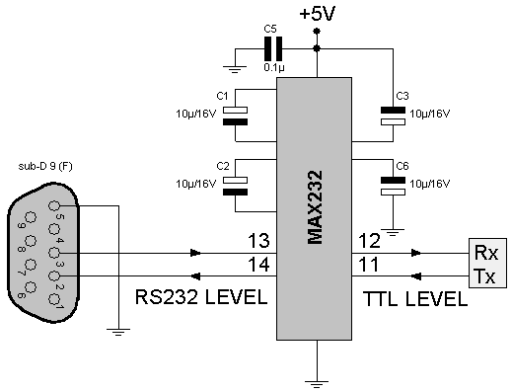
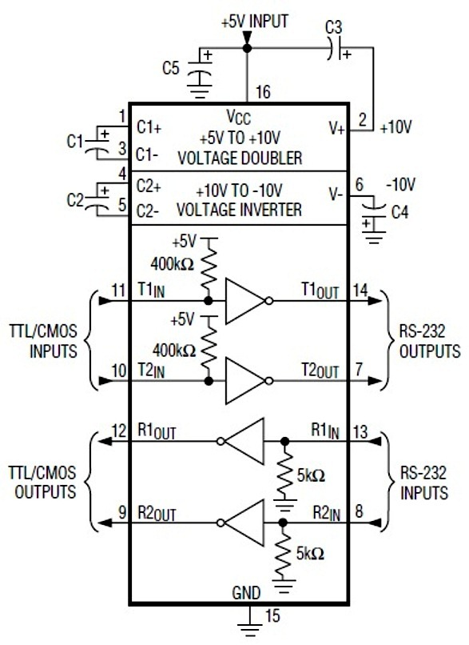
TTL vs RS232

Slide 68
RS 485 Protocol
What is RS-485?
RS-485 is a EIA standard interface which is very common in the data acquisition world
RS-485 provides balanced transmission line which also can be shared in Multi drop mode.
It allows high data rates communications over long distances in real world environments.

Slide 69
RS 485 Properties
Bi-directional half-duplex data : The flow of serial data is transmitted simultaneously in one direction only, data in the other direction requires switching transceiver.
Symmetrical channel : To send / receive data using two equivalent signal wires.
Differential (balanced way to transfer data) : In this method of data transmission at the output of the transceiver varies the potential difference, with the transfer of "1" potential difference between the AB positive for the transfer of "0" potential difference between the AB negative.

Slide 70
RS 485 Properties
Multipoint : Enables multiple receivers and transceivers connected to one line of communication.
Low impendency output transmitter. The buffer amplifier of the transmitter has a low impedance output that can send a signal to many receivers.
The zone is not sensitivity to the signal When the differential signal between the level of contacts AB does not exceed ± 200mV, it is considered that the signal line is absent. This increases the noise immunity of data transmission

Slide 71
Specifications of RS 485
Permitted number of transceivers (drivers) 32
The maximum length of link 1200 m (4000ft)
Maximum speed 10 Mb/s
Minimum output driver ±1,5 V
The maximum output drivers ±5 V
Maximum short-circuit current driver 250 mA
Output Impedance Driver 54 Ohm
Impedance Driver 12 k Ohm
Allowable total input resistance 375 Ohm
The range of insensitivity to the signal from ±200 mV
The level of logical one (Uab) >+200 mV
The level of logical zero (Uab) <-200 mV

Slide 72
How fast can RS-485 be?
RS-485 was designed for greater distance and higher baud rates than RS-232.
According to the standard, 100kbit/s is the maximum speed and distance up to 4000 feet (1200 meters) can be achieved.
The maximum speed, for RS232 according to the standard, is 20kbit/s.

Slide 73
RS-485 Line Driver
Balanced Line Drivers
Voltage produced by the driver appears across a pair of signal wires that transmit only one signal. Both wires are driven opposite.
RS-485 driver has always the “Enable” direction control signal.
Differential system provides noise immunity, because much of the common mode signal can be rejected by the receiver. So ground shifts and induced noise signals can be nullified.

Slide 74
RS-485 Network
RS-485 provides Half-Duplex, Multi drop communications over a single twisted pair cable.
The standard specifies up to 32 drivers and 32 receivers can share a multi drop network
Terminator resistors avoid reflected signal

Slide 75
RS-485 Network
MASTER
SLAVE-1
SLAVE-2
SLAVE-3

Slide 76
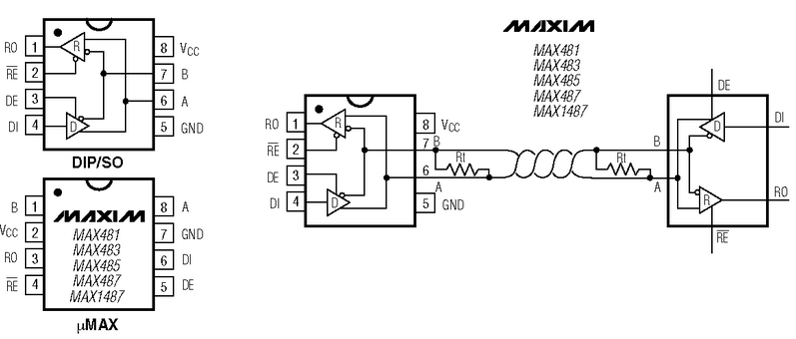

Slide 77
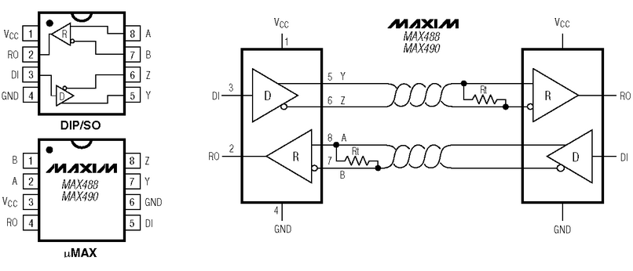

Slide 78
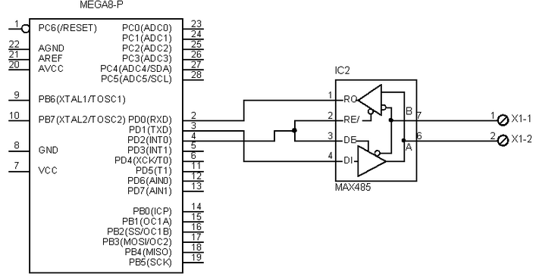

Slide 79
RS-485 Half-duplex
Data logic uses Half-Duplex configurations for Data Collecting and Master/Slave layouts.
Usually we talk about Multidrop network
TX
ENABLE
RX
Slave 1
RTX485+
RTX485-
TX
ENABLE
RX
TX
ENABLE
RX
Slave 2
485GND
Master
TX
ENABLE
RX
Slave N

Slide 80
RS-485 Full-duplex
TX485+
TX485-
TX
ENABLE
RX
TX
ENABLE
RX
RX485+
RX485-
485GND
Other device
Scanner

Slide 81
RS-232 vs RS-485
The architectural difference between RS-232 and RS-485 is that 232 is a bi-directional point to point link, whereas 485 is a single channel bus.
Electrically, each 232 signal uses a single wire with symmetric voltages about a common ground wire. 485 uses two wires to carry the single signal differentially.
The big difference to the software is that only one device on a 485 bus can transmit at a time, while there is not similar limitation on RS232 because is a peer-to-peer link .

Slide 82
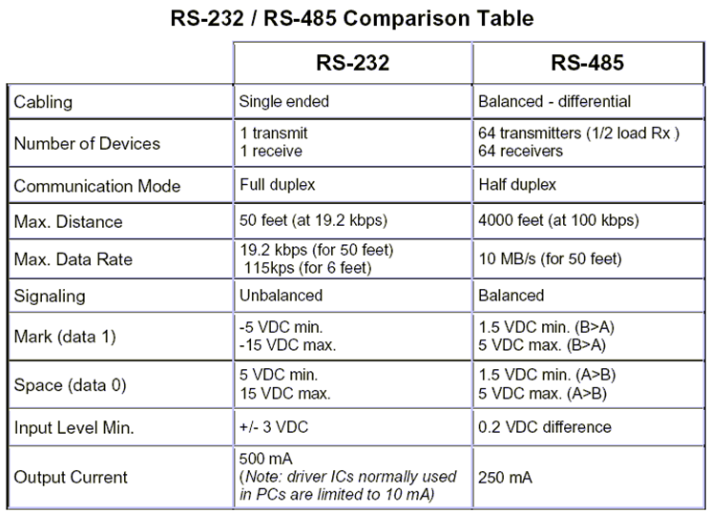
RS-232 vs RS-485

Slide 83
SPI (Serial Peripheral Interface) Protocol
Developed by Motorola also known as Micro Wire (National Semiconductor), QSPI (Queued),Micro wire Plus
It is a full-duplex protocol that functions on a master-slave paradigm that is ideally suited to data stream application.
Synchronous Serial Communication
Primarily used for serial communication between a host processor and peripherals.
Can also connect 2 processors via SPI

Slide 84
SPI works in a master slave configuration with the master being the host microcontroller for example and the slave being the peripheral.

Slide 85
Concept of Master and Slave
Master
The component that initiates the transfer
The component that controls the transfer
Slave
The component that responds to the transfer

Slide 86
SPI Signals
The SPI bus specifies four logic signals.
SCLK - Serial Clock (output from master)
MOSI - Master Output, Slave Input (output from master)
MISO - Master Input, Slave Output (output from slave)
SS - Slave Select (active low; output from master)
Alternative naming conventions
SCK, CLK - Serial Clock (output from master)
SDI, DI, SI - Serial Data In
SDO, DO, SO - Serial Data Out
SSEL - Slave Select

Slide 87
Master / Slave concept Slave Select (Chip Select)
Master sends out active low chip select signal SS1, then slave 1 responds.
Master sends out active low chip select signal SS2, then slave 2 responds
Master sends out active low chip select signal SS3, then slave 3 responds
There is only one master, and number of slaves depends on the number of chip select lines of the master.

Slide 88
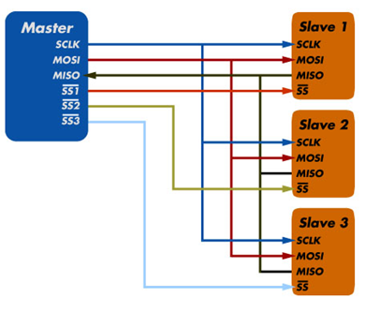
Master / Slave concept Master to Slave data movement
Master sends out information to slave along MOSI wire
Slave receives information from the master along MOSI wire
Information (bits) is clocked by SCLK signal (1-bit, 1 clock tick)

Slide 89
Master / Slave concept Slave to Master data movement
Master receives information from slave along MISO wire
Slave sends information to the master along MISO wire
Information (bits) is clocked by SCLK signal (1-bit, 1 clock tick)

Slide 90
Basic serial data transfer
MASTER
SLAVE
MOSI
7
6
5
4
3
2
1
0
0
1
2
3
4
5
6
7
SCLK
SS
MISO
The registers within the master and slave act like shift registers shifting one bit on every cycle of the SCLK.

Slide 91
Data transfer details
Most SPI interfaces have two configuration bits, called clock polarity (CPOL) and clock phase (CPHA).
CPOL determines whether the shift clock's idle state is low (CPOL=0) or high (CPOL=1).
CPHA determines on which clock edges data is shifted in and out (for CPHA=0, MOSI data is shifted out on falling edge, MISO data is shifted in on rising edge).
As each bit has two states, this allows for four different combinations, all of which are incompatible with each other.
For two SPI devices to talk to each other, they need to be set to use the same clock polarity and phase settings.

Slide 92
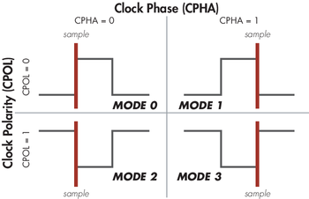
SPI Data Transfer Modes
These four modes are the combinations of CPOL and CPHA.
Modes 0 and 3 are the most common.
With SPI modes 0 and 3, data is always latched in on the rising edge of SCK and always output on the falling edge of SCK.
SPI-mode | CPOL | CPHA
0 1 2 3 | 0 0 1 1 | 0 1 0 1

Slide 93
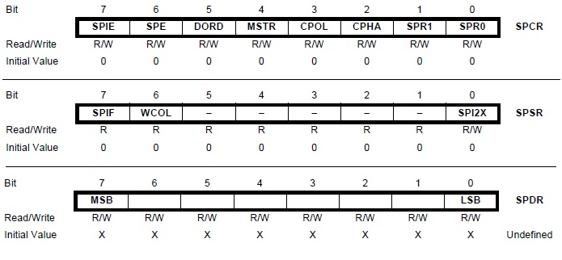
SPI Registers
In general there are 3 Programmable SPI registers:
-SPCR control register
-SPSR status register
-SPDR data register

Slide 94
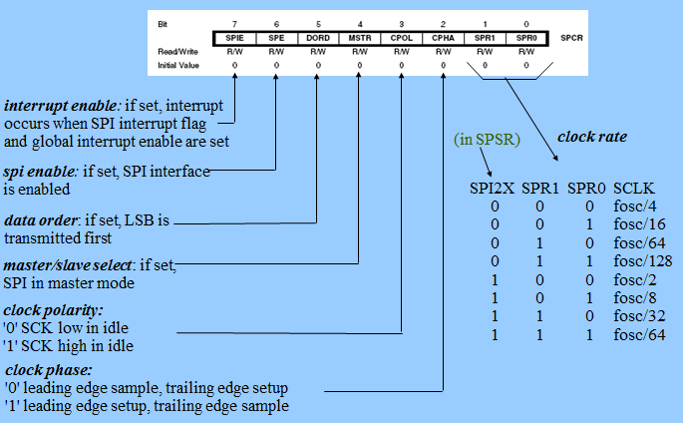
SPI Control Register (SPCR)

Slide 95
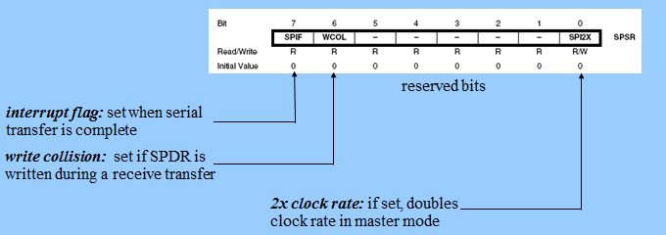
SPI Status Register (SPSR)

Slide 96
SPI Data Register (SPDR)

Slide 97
Example SPI devices
25LC020A - 2K SPI Bus Serial EEPROM
TC77-5.0 - Thermal Sensor with SPI Interface
MCP3201 - 2.7V 12-Bit A/D Converter with SPI Serial Interface
MCP4822 - 12-Bit DAC with Internal VREF and SPI Interface
MCP41010 - Single/Dual Digital Potentiometer with SPI Interface
MCP6S92 - Single-Ended, Rail-to-Rail I/O, Low-Gain PGA
MCP23S08 - 8-Bit I/O Expander with Serial Interface

Slide 98
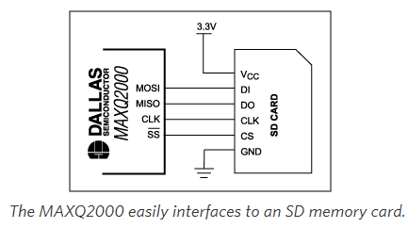
Example of SPI Connections

Slide 99
Advantages and drawbacks
SPI is a very simple communication protocol.
Data can be shifted at very high rates in full duplex mode
The exchange itself has no pre-defined protocol. This makes it ideal for data-streaming applications
Data can be transferred at high speed, often into the range of the Tens of MHz
The flipside is that there is no acknowledgment, no flow control, and the master may not even be aware of the slave's presence / or absence. (You could do “some” handshaking via software)

Slide 100
I2C Protocol
What is the I²C Bus and what is it used for?
Bus characteristics
I²C Bus Protocol
Data Format
Typical I²C devices
Example device

Slide 101
I2C Introduction
Developed and patented by Philips for connecting low speed peripherals to a motherboard, embedded system or cell phone
The name stands for “Inter - Integrated Circuit Bus”
A Small Area Network connecting ICs and other electronic systems
Multi-master, two wire bus , up to 100 Kbits/sec
One data line (SDA)‏
One clock line (SCL)
Two wires carry information between a number of devices
Master controls clock for slaves
Each connected slave has a unique 7-bit address

Slide 102
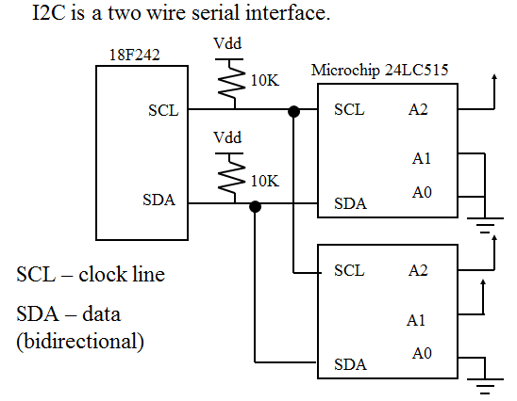
I²C (Inter-Integrated-Circuit) Bus

Slide 103
I2C Protocol
Transfers are byte oriented, MSB first
Start: SDA goes low while SCL is high
Master sends address of slave (7-bits) on next 7 clocks
Master sends read/write request bit
0-write to slave
1-read from slave
Slave ACKs by pulling SDA low on next clock
Data transfers now commence
Today, a variety of devices are available with I²C Interfaces
Microcontroller, EEPROM, Real-Timer, interface chips, LCD driver, A/D converter

Slide 104
What is I²C used for?
Data transfer between ICs and systems at relatively low rates
“Classic” I²C is rated to 100K bits/second
“Fast Mode” devices support up to 400K bits/second
A “High Speed Mode” is defined for operation up to 3.4M bits/second
Reduces Board Space and Cost By:
Allowing use of ICs with fewer pins and smaller packages
Greatly reducing interconnect complexity
Allowing digitally controlled components to be located close to their point of use

Slide 105
I²C Features
Multiple receivers do not require separate select lines as in SPI
At start of each I²C transaction a 7-bit device address is sent
Each device listens – if device address matches internal address, then device responds
SDA (data line) is bidirectional, communication is half duplex
SDA, SCLK are open-drain, require external pull-ups
Allows multiple bus masters (will discuss this more later).

Slide 106
I²C Bus Characteristics
Includes electrical and timing specifications, and an associated bus protocol
Two wire serial data & control bus implemented with the serial data (SDA) and clock (SCL) lines
For reliable operation, a third line is required: Common ground
Unique start and stop condition
Slave selection protocol uses a 7-Bit slave address
The bus specification allows an extension to 10 bits
Bi-directional data transfer
Acknowledgement after each transferred byte
No fixed length of transfer

Slide 107
I²C Bus Characteristics (cont’d)
True multi-master capability
Clock synchronization( procedure to sync then clocks of two or more devices )
Arbitration procedure (procedure to insure that only one master has control of their bus at any instant)
Transmission speeds up to 100Khz (classic I2C)
Max. line capacitance of 400pF, approximately 4 meters (12 feet)
Allows series resistor for IC protection
Compatible with different IC technologies

Slide 108
I²C Bus Definitions
Master:
Initiates a transfer by generating start and stop conditions
Generates the clock
Transmits the slave address
Determines data transfer direction
Slave:
Responds only when addressed
Timing is controlled by the clock line

Slide 109
I²C Bus Configuration Example

Slide 110
I²C Hardware Details
Devices connected to the bus must have an open drain or open collector output for serial clock and data signal
The device must also be able to sense the logic level on these pins
All devices have a common ground reference
The serial clock and data lines are connected to Vdd(typically +5V) through pull up resistors
At any given moment the I2C bus is:
Quiescent (Idle), or
in Master transmit mode or
in Master receive mode.

Slide 111
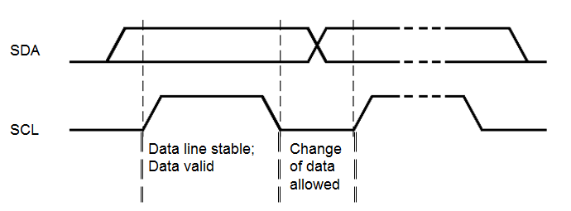
Bit Transfer on the I²C Bus
In normal data transfer, the data line only changes state when the clock is low

Slide 112
Start and Stop Conditions
[
A transition of the data line while the clock line is high is defined as either a start or a stop condition.
Both start and stop conditions are generated by the bus master
The bus is considered busy after a start condition, until a stop condition occurs
START:
- SDA : HIGH -> LOW
- SCL : HIGH
STOP:
- SDA : LOW -> HIGH
- SCL : HIGH

Slide 113
I²C Addressing
Each node has a unique 7 (or 10) bit address
Peripherals often have fixed and programmable address portions
Addresses starting with 0000 or 1111 have special functions:-
0000000 Is a General Call Address
0000001 Is a Null Address
1111XXX Address Extension
1111111 Address Extension – Next Bytes are the Actual Address

Slide 114
First Byte in Data Transfer on the I²C Bus
R/W
0 – Slave written to by Master
1 – Slave read by Master
ACK – Generated by the slave whose address has been output.

Slide 115
I²C Bus Connections
Masters can be
Transmitter only
Transmitter and receiver
Slaves can be
Receiver only
Receiver and transmitter

Slide 116
Acknowledgements
Master/Slave receivers pull data line low for one clock pulse after reception of a byte
Master receiver leaves data line high after receipt of the last byte requested
Slave receiver leaves data line high on the byte following the last byte it can accept

Slide 117
Acknowledgements
From Slave to Master Transmitter:
After address received correctly
After data byte received correctly
From Slave to Master Receiver:
Never (Master Receiver generates ACK)
From Master Transmitter to Slave:
Never (Slave generates ACK)
From Master Receiver to Slave:
After data byte received correctly

Slide 118
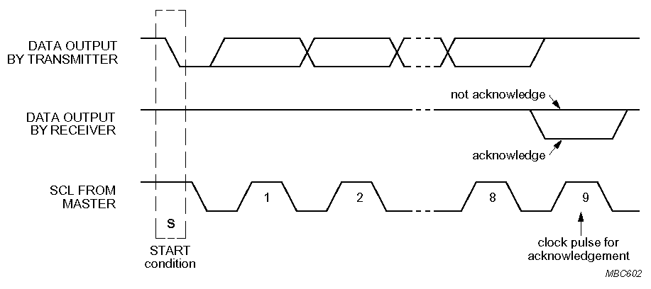
Negative Acknowledge
Receiver leaves data line high for one clock pulse after reception of a byte
Transmitter releases SDA line during 9th clock pulse.
Not acknowledgement (NACK) from receiver

Slide 119
Negative Acknowledge (Cont’d.)
From Slave to Master Transmitter:
After address not received correctly
After data byte not received correctly
Slave Is not connected to the bus
From Slave to Master Receiver:
Never (Master Receiver generates ACK)
From Master Transmitter to Slave:
Never (Slave generates ACK)
From Master Receiver to Slave:
After last data byte received correctly

Slide 120
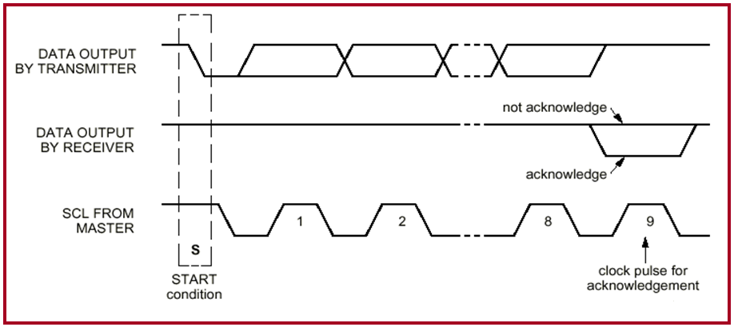
ACK
ACK
- TX : SDA=1
- RX : SDA=0
NACK
- TX : SDA=1
- RX : SDA=1

Slide 121
Acknowledge (ACK) and Not Acknowledge (NACK)
The acknowledge takes place after every byte.
The acknowledge bit allows the receiver to signal the transmitter that the byte was successfully received and another byte may be sent.
The master generates all clock pulses, including the acknowledge ninth clock pulse.

Slide 122
Acknowledge (ACK) and Not Acknowledge (NACK)
The Acknowledge signal is defined as follows:
The transmitter releases the SDA line during the acknowledge clock pulse so the receiver can pull the SDA line LOW and it remains stable LOW during the HIGH period of this clock pulse
When SDA remains HIGH during this ninth clock pulse, this is defined as the Not Acknowledge signal. The master can then generate either a STOP condition to abort the transfer, or a repeated START condition to start a new transfer.

Slide 123
Acknowledge (ACK) and Not Acknowledge (NACK)
There are five conditions that lead to the generation of a NACK:
No receiver is present on the bus with the transmitted address so there is no device to respond with an acknowledge.
The receiver is unable to receive or transmit because it is performing some real-time function and is not ready to start communication with the master.
During the transfer, the receiver gets data or commands that it does not understand.
During the transfer, the receiver cannot receive any more data bytes.
A master-receiver must signal the end of the transfer to the slave transmitter.

Slide 124
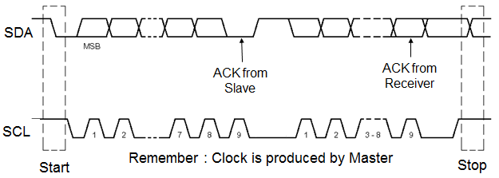
Data Transfer on the I2C Bus
Start Condition
Slave address + R/W
Slave acknowledges with ACK
All data bytes
Each followed by ACK
Stop Condition

Slide 125
Data Transfer on the I2C Bus

Slide 126
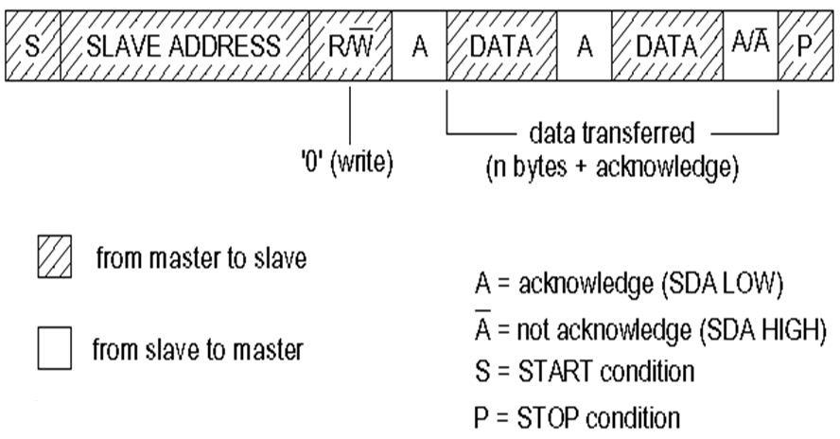
Data Formats
Master writing to a Slave

Slide 127
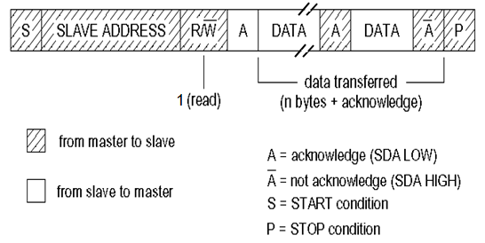
Data Formats Cont’d.
Master reading from a Slave : Master is Receiver of data and Slave is Transmitter of data.

Slide 128
Data Formats Cont’d.
Combined Format
A repeated start avoids releasing the bus and therefore prevents another master from taking over the bus

Slide 129
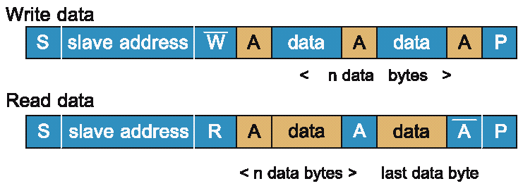
Data Formats

Slide 130
Application Specific Protocols
Examples of application specific protocols based on the I²C interface are:
SMBus™, the System Management Bus, used in personal computers (and servers) for low speed system management applications
IPMI™, the Intelligent Platform Management Interface, used to monitor the system health and manage systems (mostly servers) remotely.
PMBus™, the Power Management Bus, used by advanced digitally controlled power supply units to monitor, configure and control power.

Slide 131
I2C Interface Examples
A few examples of devices using the I²C interface :
1Mbit Serial EEPROMS: 24xx1025
18-bit delta sigma ADCs: MCP3421
16-bit delta sigma ADCs: MCP3425
12-bit SAR ADCs:MCP3221
12-bit D/A: MCP4725
Integrated Temperature Sensor (+/-0.5C): MCP9803
I/O Expander 8/16-bit: MCP23016/MCP2308

Slide 132
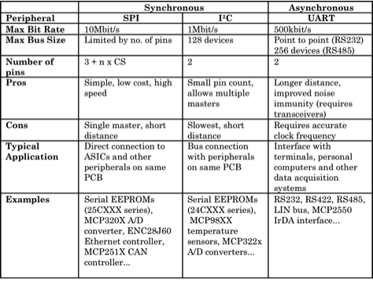
Comparison between Synchronous & Asynchronous

Slide 133
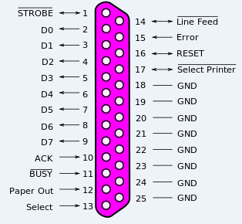
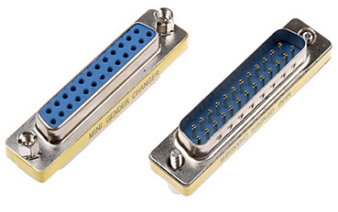
PC Parallel Port Programming
A parallel port is a type of interface found on computers (personal and otherwise) for connecting peripherals. In computing, a parallel port is a parallel communication physical interface. It is also known as a printer port or Centronics port.

Slide 134
Parallel Port
Computers are equipped with at least one parallel printer port card.
This parallel port can be used as a general input-output device used for manipulating interfaced hardware.
The printer port is designated as LPT 1, LPT 2 & LPT 3(Line Printer Terminal).
Parallel (printer) port as a general-purpose set of digital input and output port for interfacing devices.
8-bit digital input/output (I/O) register if an enhanced parallel port is being used otherwise it is just an output register

Slide 135
Parallel Port Cont.…
The parallel port in the original IBM PC is sometimes called the SPP, for Standard Parallel Port
The SPP transfers 8 bits at once to a peripheral, using a protocol similar to that used by the Centronics interface.
Centronics was a printer manufacturer that ceased to exist many years ago.
Port Configuration I/O Port address
LPT 1 378H to 37AH
LPT 2 278H to 27AH

Slide 136
Standard Parallel Port Overview
The parallel port contains no intelligence and is just a set of latches and buffers together with some address decoding circuitry.
Software outputs instructions that explicitly set & reset bits in the latches--these are used to generate all control signals.
Parallel port
pin number
D0 - D7
D0
2
Data
Register
Port 378
D7
9
ERROR
15
Status
Reg.
SLCT
13
PE
12
Port 379
ACK
10
BUSY
11
IRQ7
IRQ EN
STROBE
1
Port 37A
Control
Reg.
AUTO FD
14
INIT
16
SLCT IN
17

Slide 137
Parallel Port Addresses & Names
The standard parallel port uses three contiguous addresses, usually in one of these ranges:
378h, 379h, 37Ah
278h, 279h, 27Ah
3BCh, 3BDh, 3BEh
On newer systems the parallel port base address is most often at 378h, but all three addresses are reserved for parallel ports.
Addresses:
The 1st address (e.g. 378h) is the port’s base address, also called the Data register or just the port address.
The 2nd address (e.g. 379h) is the port’s Status register
The 3rd address (e.g. 37Ah) is the Control register.

Slide 138
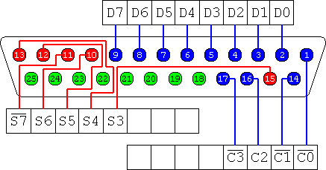
Parallel (Printer) Port
8 output pins accessed via the DATA Port (pins 2 to 9)
5 input pins (one inverted) accessed via the STATUS Port (pins 10, 11, 12, 13, 15)
4 output pins (three inverted) accessed via the CONTROL Port (pins 1, 14, 16, 17)
The remaining 8 pins are ground (pins 18 to 25)

Slide 139
Parallel (Printer) Port
Note: high TTL level = 2.4V to 5V
low TTL level = 0V to 0.8V (normally 0V)
An OUT instruction to port address 378H (278H) and 37A (27A) can write the data directly to the connector pins.
An IN instruction to port address 378H (278H) [if an enhanced parallel port is in use] and 379H (279H) can read the data directly from the connector pins.

Slide 140
Parallel (Printer) Port
Standard Parallel Port registers & connector signals.
Two output registers
Output to 278/378/3BC Hex (Data Reg)
Output to 27A/37A/3BE Hex (Control Reg)
Three input registers
Input from 278/378/3BC Hex (Data Reg) READ BACK
Input from 279/379/3BD Hex (Status Reg) READ ONLY
Input from 27A/37A/3BE Hex (Control Reg) READ BACK
I/O available through a 25-pin, D-type female connector.
The use of loopbacks for testing the SPP.
Passive Loopback: Connector on which some output pins have been wire connected to some input pins.

Slide 141
Parallel Port Signal Description
Pin 2-9: Data 0 - Data 7 (Data Reg. bit 7:0)
Sends data BYTES to the external device on these lines.
Note: These are Bi-directional on later designs and an extra bit (C5) is implemented in the Control Register.
Pin 1: STROBE# (Data strobe - Ctrl Reg bit C0-)
Control Line output that when set low (> 0.5 uS) by software (e.g writing 1 to bit C0-) causes the external device (e.g. printer) to latch the data byte on pins 2-9 (WRITE SIGNAL).
Data is sent to the printer when STROBE# is asserted.

Slide 142
Parallel Port Signal Description
Pin 14: AUTO FD# (Auto Feed - Ctrl Reg bit C1-)
Control Line output that when set low causes the printer to advance the paper 1 line for each Carriage Return (0Dh).
Pin 16: INIT# (Initialize - Ctrl Reg bit C2+)
Control Line output that when set low (> 50 uS) by software causes the printer to be initialized and placed on-line (~reset command --Clears the printers buffers).

Slide 143
Parallel Port Signal Description
Pin 17: SLCTIN# (Select Printer- Ctrl Reg bit C3-)
Control Line output that when set low by software causes the printer to be selected by the host computer.
Many printers fix this signal internally to ground or provide a DIP switch so that the printer is always selected.
Pin 11: Busy (Status Reg bit S7-)
Status Line input set high when external device is busy and cannot accept data (stops flow of data to printer).
Don’t send any more data!

Slide 144
Parallel Port Signal Description
Pin 10: ACK# (Acknowledge - Status Reg bit S6+)
Status Line input set low (~0.5 uS) when external device has properly received a data byte & is ready for more data.
If bit C4 =1 (IRQ Enable), will interrupt CPU when ACK# transitions 1 to 0. (Used with interrupt-driven device drivers)
Pin 12: PE (Paper End - Status Reg bit S5+)
Status Line input set high when external device has an “out of paper” or similar condition.

Slide 145
Parallel Port Signal Description
Pin 13: SLCT (Select - Status Reg bit S4+)
Status Line input set high when external device has been selected (i.e. is “on-line” or ready to receive data).
Pin 15: Error# (Status Reg bit S3-)
Status Line input set low when external device has encountered an error condition (e.g. print head jammed).

Slide 146
Parallel Port Signal Description
“Compatibility mode” data transfer to a printer is limited to 40-300 Kbps due to the multiple I/O cycles required for software handshaking.
Write data to Data Register (e.g. 378h)
Read Status (e.g. 379h) to check printer not busy (-S7 = 1).
e.g. - Check for BUSY Pin 11 = 0 (-S7=1).
If not busy, write to Control Register (e.g 37Ah) to assert the STROBE# line (Pin 1 = 0).
e.g. - Write “1” to Control Reg bit -C0 (STROBE#).
Wait approx. 5 microseconds, then write to Control Register (e.g 37Ah) to dessert the STROBE# line (Pin 1 = 1).
e.g. Write “0” to Control Reg bit -C0 (STROBE#).
Note: EPP & ECP ports increase throughput by using hardware instead of software to check Busy & Strobe.

Slide 147
Parallel Port Loopbacks & Testing
A PASSIVE LOOPBACK CONNECTOR is a connector on which some of the output pins have been wire connected to some of the input pins so that when placed on the board's parallel port connector, data sent out is received back by the same port.

Slide 148
Parallel Port BIOS Support
Parallel port support by the ROM BIOS is limited.
Call INT 17h with AH=0 to print a character.
AL= Character, DX = Printer to be used (0-2)
BIOS maintains a time-out counter for each printer port.
Call INT 17h with AH=1 to initialize the printer.
Writes 0Ch to the Ctrl Reg - Asserts SLCT_IN# & INIT#
Reads the Status Registers.
Call INT 17h with AH=2 to get printer port status.
e.g. Error (Parallel pin 15 - ERROR*)
e.g. Printer selected/on-line (Parallel pin 13 - SLCT)

Slide 149
Parallel Port BIOS Support
IRQ7 (LPT1) or IRQ5 (LPT2): May be generated to indicate when the printer becomes ready.
Many printers do not generate this interrupt, and it’s usually not enabled.
Historically there is no ROM BIOS support for hardware interrupt-driven parallel support operation, but some Operating System & Parallel Port transfer programs use it.

Slide 150
Port Programming
8-bit I/O if an enhanced parallel port is being used otherwise it is just an output port at address 378H (278H)
Example:
PASCAL: port[$0378] := 255; // outputs 11111111 to pins 2 to 9
C: outportb(0x378,255); // outputs 11111111 to pins 2 to 9

Slide 151
379H (279H) Status register

Slide 152
Example:
PASCAL:
data := port[$0379] ;
reads port 379H i.e. reads the TTL levels of pins 13,12,10 & 11 respectively and places the corresponding values at the higher nibble of variable “data”.
C:
data = inportb(0x379);
reads port 379H i.e. reads the TTL levels of pins 13,12,10 & 11 respectively and places the corresponding values at the higher nibble of variable “data”.

Slide 153
37AH (27AH) Control register

Slide 154
Example:
PASCAL:
Port[$037A] = 4;
outputs 0100 to pins 17,16,14 & 1 respectively i.e. pin 17 is low, pin 16 is high, pin 14 is low and pin 1 is low.
C:
outportb(x037A,4);
outputs 0100 to pins 17,16,14 & 1 respectively i.e. pin 17 is low, pin 16 is high, pin 14 is low and pin 1 is low.

Slide 155
Enhanced Ports - IEEE 1284 Standard
The "IEEE Std. 1284 - 1994 Standard Signaling Method for a Bi-directional Parallel Peripheral Interface for Personal Computers" is fully backward compatible with all existing parallel port peripherals and printers.
IEEE Std. 1284 provides for high speed bi-directional communication between the PC and an external peripheral that can communicate 50-100 times faster that the original parallel port.
The 1284 standard defines 5 modes of data transfer (Compatibly, Nibble, Byte, EPP, & ECP)

Slide 156
Enhanced Ports - IEEE 1284 Standard
IEEE-1284 standard & EPP/ECP Bi-directional modes.
Compatibility Mode: "Centronics" or standard mode.
Nibble Mode: 4 bits at a time using status lines for data.
Byte Mode: 8 bits at a time using data lines.
EPP: Enhanced Parallel Port - used primarily by non-printer peripherals: CD ROM, tape drives, etc.
ECP: Extended Capability Port - used primarily by the new generation of printers/scanners and other peripherals that transfer large bi-directional data blocks.

Slide 157
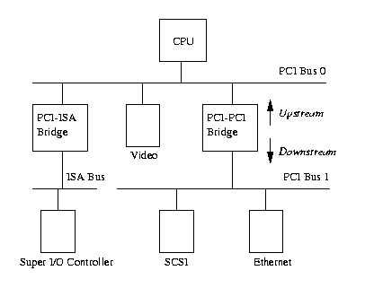
Peripheral Component Interconnect (PCI)
PCI based System

Slide 158
Block diagram of a PCI bus system

Slide 159
Latest Generation of PCI Chipsets

Slide 160
Bus Cycles
INTA sequence (0000)
special cycle (0001)
I/O read access (0010)
I/O write access (0011)
memory read access (0110)
memory write access (0111)
configuration read access (1010)
configuration write access (1011)
memory multiple read access (1100)
dual addressing cycle (1101)
line memory read access (1110)
memory write access with invalidation (1111)

Slide 161
Configuration Address Space
Manufacturer ID
allocated by PCI SIG
Unit ID, revision
identifies unit
Class code
type of PCI unit

Slide 162
PCI Address Space
Peripheral devices have their own memory space
PCI :PCI I/O, PCI Memory (device driver) PCI Configuration Space ( initialization)
ISA I/O, ISA Memory (device driver)
PCI Configuration Header
Allow system to identify and control the device
Every PCI slot has it’s PCI Configuration Header in an offset that is related to it’s slot on the board

Slide 163
PCI Configuration Header
Vender Identification
Device Identification
Status
Command
Class Code
SCSI(Small Computer System Interface): 0x0100
Base Address Register
Interrupt Pin (PCI device interrupt pin)
Interrupt Line (route interrupt to proper handler)

Slide 164
Status and Command Registers
Status:
PER: Parity error
SER: System error
MAB: Master abort
TAB: Target abort received
STA: Target abort signaled
DEVTIM: DEVSEL timing
00=fast 01=medium 10=slow 11=reserved
DP: Data parity error
FBB: Fast back-to-back cycles supported/unsupported

Slide 165
Status and Command Registers
Command:
BEE: Fast back-to-back cycles (Back-to-Back Enable)
SEE: SERR Enable
WC: Wait cycle control
PER: Parity error (Parity Error Response)
VPS: VGA palette snoop
MWI: Memory write access with invalidation
SC: Special cycle
BM: Bus master
MAR: Activate/deactivate Memory address area
IOR: Activate/deactivate I/O address area

Slide 166
Base Address Registers
PRF: Prefetching not possible/prefetching possible
Type: Positioning type
00=any 32-bit address, 01=less than 1M, 10=any 64-bit address, 11=reserved
AD: Address decoding and expansion ROM deactivated/activated

Slide 167
The PCI Express Bus
Point to point protocol
x1, x2, x4, x8, x12, x16 or x32 point-to-point Link
Differential Signaling

Slide 168
Low Cost PCI Express System

Slide 169
PCI Express High-End Server System

Slide 170
PCI Express Properties
Packet Based Protocol
Bandwidth and Clocking
2.5 Gbits/sec/lane/direction
8b/10b encoding
250 Mbytes/sec/lane/direction
Address Spaces
Memory
I/O
Configuration (extended from 256 Bytes to 4 Kbytes)

Slide 171
PCI Express Properties
Quality of Service (QoS)
deterministic latencies and bandwidth
Traffic Classes (TCs)
TCs can move through the fabric with different priority
Virtual Channels (VCs)
Each Traffic Class is individually mapped to a Virtual Channel

Slide 172
PCI Express Transactions
Transactions
memory read / write
I/O read / write
configuration read / write
new transaction type: Message transactions
Transaction Model
posted (split transaction communication)
non-posted

Slide 173
PCI Express Properties
Interrupt Handling
Virtual wires
Power Management
device power states: D0, D1, D2, D3-Hot and D3-Cold
D0 is the full-on power state
D3-Cold is the lowest power state.
Link power states: L0, L0s, L1, L2 and L3
Hot Plug Support
PCI Compatible Software Model

Slide 174
PCI Express Topology

Slide 175
Non-Posted Memory Read Originated by CPU and Targeting an Endpoint

Slide 176
PCI Express Device Layers

Slide 177
Transaction Layer Packets

Slide 178
Electrical Physical Layer Showing Differential Transmitter and Receiver

Slide 179
PCI I/O and PCI Memory Address
PCI configuration code turns on using Command field
Linux drivers read/write PCI I/O and PCI memory addresses

Slide 180
PCI-ISA Bridges
The PCI specification copes with this by reserving the lower regions of the PCI I/O and PCI Memory address spaces for use by the ISA peripherals in the system and using a single PCI-ISA bridge to translate any PCI memory accesses to those regions into ISA accesses

Slide 181
PCI-PCI Bridges
PCI-PCI bridges only pass a subset of PCI I/O and PCI memory read and write requests downstream
Linux device drivers only access PCI I/O and PCI Memory space via these windows

Slide 182
PCI-PCI Bridges: PCI I/O and PCI Memory Windows
A cycle is just an address as it appears on the PCI bus
Type 0 Configuration Cycle
Bits 31:11 of the Type 0 configuration cycles are treated as the device select field

Slide 183
PCI-PCI Bridges: PCI I/O and PCI Memory Windows
Type 1 PCI Configuration cycles contain a PCI bus number and this type of configuration cycle is ignored by all PCI devices except the PCI-PCI bridges

Slide 184
Type 1 PCI Configuration Cycles
The primary bus interface being the one nearest the CPU
Secondary bus interface being the one furthest away
Subordinate bus number is the highest numbered PCI bus downstream of the PCI-PCI bridge
Ignore it if the bus number specified is not in between the bridge's secondary bus number and subordinate bus number (inclusive),
Convert it to a Type 0 configuration command if the bus number specified matches the secondary bus number of the bridge,
Pass it onto the secondary bus interface unchanged if the bus number specified is greater than the secondary bus number and less than or equal to the subordinate bus number.

Slide 185
IEEE 1394 / FireWire
Originally Created by Apple and standardized as IEEE1394 in 1995
Was intended to be used as a desktop LAN solution for their new generation of Macs
But when released into the IEEE working group developed into an interconnect that could integrate both entertainment and consumer electronics.

Slide 186
Features
Fast transfer of data
Lots of devices on the bus
Ease of use
Hot pluggable
Provide power through the cable
Plug-and-play
Low cabling cost
Low implementation cost

Slide 187
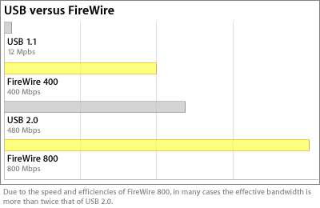
Performance

Slide 188
Standards
Currently there are three main standards and hundreds of IEEE recommendations.
For an idea of the enormity of the field check the IEEE website:
http://www.1394ta.org/Technology/Specifications/specifications.htm
Three standards:
IEEE 1394
IEEE 1394a
IEEE 1394b

Slide 189
Standards
Three standards:
IEEE 1394
Original Standard, release in 1995
Supports transfer rates of 100,200,400Mbps
IEEE 1394a
Fixed interoperability problems that were left out of the spec for IEEE 1394
Added performance enhancements into the spec over the original
IEEE 1394b
Enhanced transfer rates for 800 , 1600, 3200Mbps
Separated the Standard from the Protocol

Slide 190
Types of Transfers
Isochronous –
Broadcast in a one-one one-many fashion
No error correction or re-transmission
Uses up-to 80% of the available bandwidth
Asynchronous –
Targets a specific node at a specific address
Error Checking and Re-Transmission
No Guarantee on the amount of bandwidth

Slide 191
4 Level Protocol Stack
Physical Layer
Used for configuration of the bus
Electrical Signaling
Mechanical Connectors / Cabling
Arbitration Mechanism
Serial Encoding / Decoding
Link Layer
Checking and Appending CRCs
Determines the type of transaction
Handles Isochronous transactions
Transaction Layer
Handles Asynchronous transactions (request/response)
Serial Bus Management Layer
Removed from the 1394b standard

Slide 192
Topology
IEEE 1394 is a peer to peer protocol, meaning a specific host is not needed for communication
Configuration of the bus occurs when ever a new device is plugged in
Uses a 64bit address scheme based on the IEEE 1212 standard
64 bits decomposed as follows:
10 bits for the Bus ID – Allowing 1024 busses
6 bits for the Device ID – Allowing 64 Devices
48 bits for storage

Slide 193
Configuration Step 1

Slide 194
Configuration Step 2
2 Signals Involved :
Parent Notify
Child Notify

Slide 195
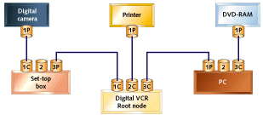
Configuration Step 3

Slide 196
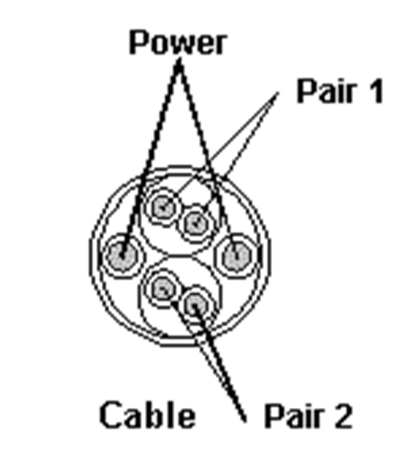
Cable (1394-1995 and 1394a)

Slide 197
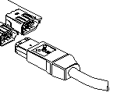
Connector (1394a)

Slide 198
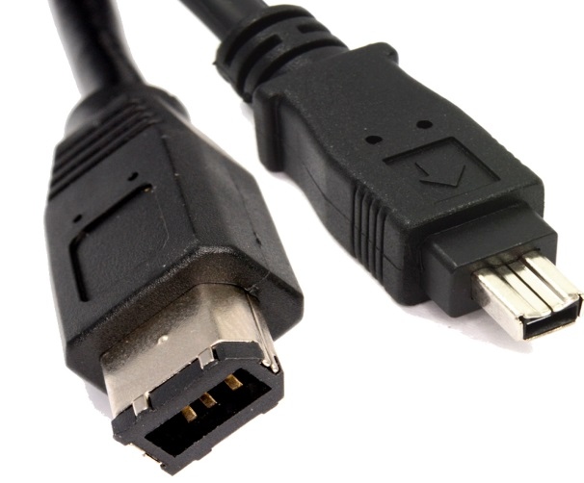
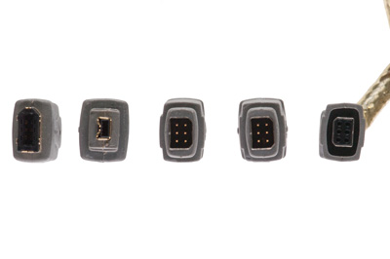
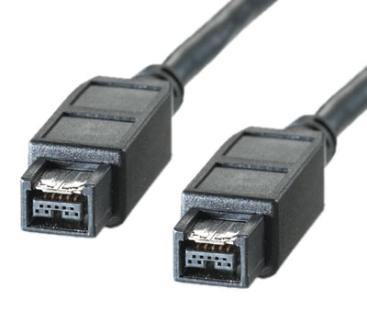
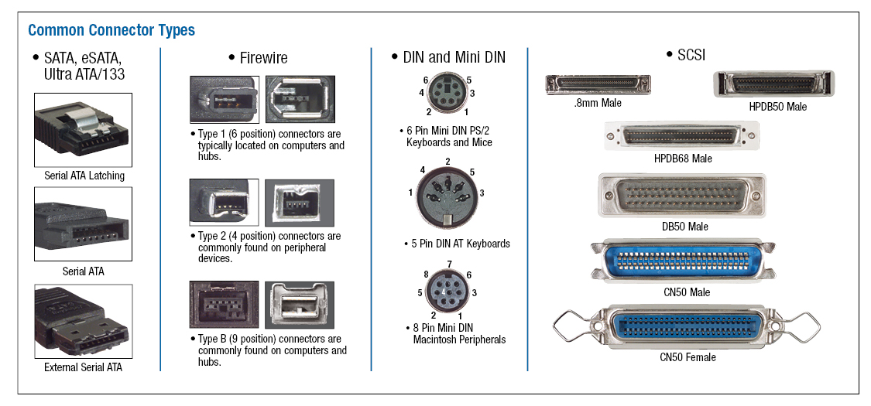
Connector (1394a)

Slide 199
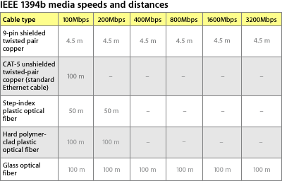
Cable Types and Length(1394b)

Slide 200
References for IEEE 1394
http://www.apple.com
http://www.embedded.com/1999/9906/
http://www.1394ta.org/
http://computer.howstuffworks.com/firewire1.htm

Slide 218
Comparison Table
Name | Sync /Async | Type | Duplex | Max devices | Max speed (Kbps) | Max distance (feet) | Pin count (not including ground)
RS-232 | Async | peer | full | 2 | 115.2 | 30 | 2 (or 4 with HW handshake)
RS-422 | Async | multi-drop | half | 10 | 10000 | 4,000 | 1 (unidirectional only, additional pins for each bidirectional comm.)
RS-485 | Async | multi-point | half | 32 | 10000 | 4,000 | 2
I²C | Sync | multi-master | half | Limitation based on bus capacitance and bit rate | 3400 | <10 | 2
SPI | Sync | multi-master | full | Limitation based on bus capacitance and bit rate | >1000 | <10 | 3+1(Additional pins needed for every slave if slave count is more than one)
Micro wire | Sync | master/slave | full | Limitation based on bus capacitance and bit rate | >625 | <10 | 3+1(Additional pins needed for every slave if slave count is more than one)
1-Wire | Async | master/slave | half | Limitation based on bus capacitance and bit rate | 16 | 1,000 | 1

