Slide 1
EMBEDDED
NETWORKING

Slide 2
EMBEDDED NETWORKING Syllabus
USB AND CAN BUS: USB bus – Introduction – Speed identification on the bus – USB states- USB bus communication: Packets-Data flow types-Enumeration – Descriptors-PIC18 Microcontroller USB interface – C Programs – CAN bus - Introduction - Frames - bit stuffing – types of errors- nominal bit timing-PIC controller CAN Interface – A simple application with CAN.

Slide 3
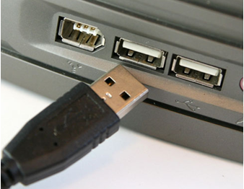
USB(Universal Serial Bus) Bus
Universal Serial Bus is a new synchronous serial protocol for low to medium speed data transmission
External Bus Standard.
Allows connection of peripheral devices.
Connects Devices such as keyboards, mouse, scanners, printers, joysticks, audio devices, disks.
Facilitates transfers of data at 480 (USB 2.0 only), 12 or 1.5 Mb/s (mega-bits/second).
Developed by a Special Interest Group including Intel, Microsoft, Compact, DEC, IBM, Northern Telecom and NEC originally in 1994

Slide 4
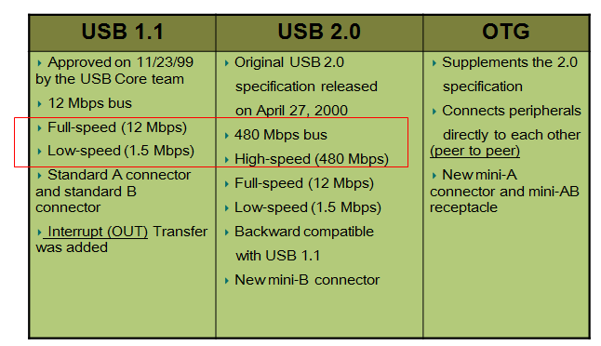
USB- A Brief History

Slide 5
USB Terms
Host — computer that controls the interface
Function — device that provides a capability to the host
Hub — device with one or more connections to USB devices plus hardware to enable communications with each device
Device — something that attaches to a USB port (sometimes synonymous with a function)
Port — a connector on the USB Host bus
Suspend — Device enters Suspend after 3mS of inactivity on the bus to minimize power consumption. Host uses timing packet to keep Peripherals active.

Slide 6
USB Terms
Enumeration — Initialization sequence to inform the host what device was attached to the bus. Device parameters are conveyed at this point.
Descriptors — List of tables that identify the capabilities of the device
Endpoint — All transmissions travel to/from and endpoint which is just a block of memory or a register. Endpoint 0 is the control endpoint which is the only bi-directional endpoint typically used for enumeration.

Slide 7
Evolution
USB 1.0 specification introduced in 1994
USB 2.0 specification finalized in 2001
Became popular due to cost/benefit advantage
Three generations of USB
1. USB 1.0
2. USB 2.0
3. USB 3.0 and WUSB

Slide 8
USB 2.0
USB 1.0 – 1.1
Maximum transfer rate of 12 mbps
First appeared on market in 1995 and 1998
A USB 2.0 requires a similar engineering effort to USB 1.1
Backwards and forwards compatible
Old devices work with new hosts
New devices work with old hosts
The only difference is really the addition of a 40x high-speed mode and the inclusion of a more complicated external bus interface

Slide 9
USB 3.0
Also referred to as SuperSpeed USB
Speeds 10x faster than 2.0 (5 Gbps in controlled test environment)
1. Transfer of 25 GB file in approx. 70 seconds (see chart)
Extensible – Designed to scale > 25Gbps
Optimized power efficiency
1. No device polling (asynchronous notifications)
2. Lower active and idle power requirements
Backward compatible with USB 2.0
1. USB 2.0 device will work with USB 3.0 host
2. USB 3.0 device will work with USB 2.0 host

Slide 10
USB Speeds

Slide 11
USB Speeds
Low-Speed: 10 – 100 kb/s
1.5 Mb/s signaling bit rate
Full-Speed: 500 kb/s – 10 Mb/s
12 Mb/s signaling bit rate
High-Speed: 400 Mb/s
480 Mb/s signaling bit rate
NRZI with bit stuffing used
SYNC field present for every packet

Slide 12
Feature Set
Common protocol to interface various components and manufacturers.
Provides support for real-time data.
Allows Flexibility to send real-time (Isochronous/periodic) and non-real-time (Asynchronous) data over a common link.
Wide range of packet sizes
In High speed mode, a 1/8th of a 1 ms “micro frame” can be specified to keep buffers small at high transfer rates

Slide 13
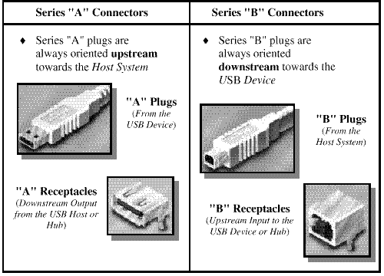
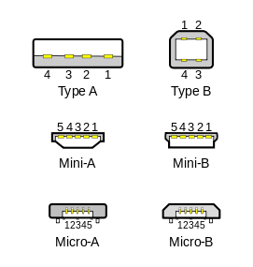
USB Connectors
There exist two pre-defined connectors in any USB system - Series “A” and Series “B” Connectors.
Series “A” cable: Connects USB devices to a hub port. Type A connectors on host devices that supply power
Series “B” cable: Connects detachable devices (hot-swappable). Type B connectors on target devices that receive power.

Slide 14
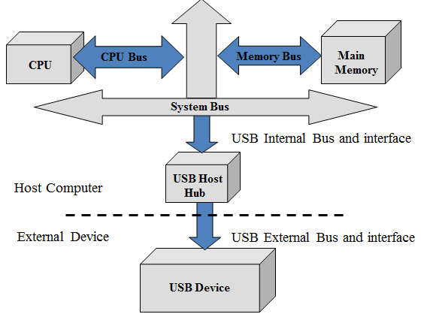
Bus Hierarchy

Slide 15
Bus Topology
Connects computer to peripheral devices.
Ultimately intended to replace parallel and serial ports
Tiered Star Topology
All devices are linked to a common point referred to as the root hub.
Specification allows for up to 127 (2⁷ -1) different devices.
Four wire cable serves as interconnect of system - power, ground and two differential signaling lines.
USB is a polled bus - all transactions are initiated by the host.
Host
Root Hub
Hub
Hub
Hub
Functional Device
Functional Device
Functional Device

Slide 16
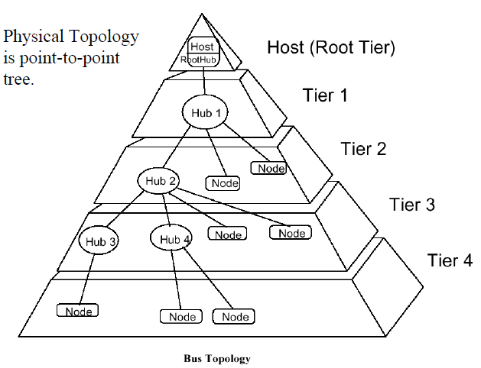
Bus Topology

Slide 17
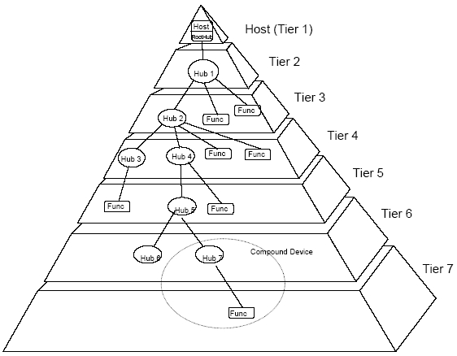
Bus Topology

Slide 18
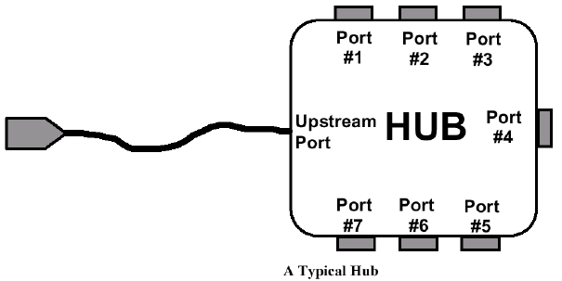
USB System
Root: primary controller
Hub: allows the connection of multiple USB devices
Endpoint: Source or sink of information within a USB device
A USB device that contains an ENDPOINT (source/sink of data) is called a ‘function’.
A USB device can be just a function, just a hub, or both a hub and a function.

Slide 19
USB Host
Device that controls entire system usually a PC of some form. Processes data arriving to and from the USB port.
Contains a sophisticated set of software drivers.
Drivers schedule and compose USB transactions.
Access individual devices to obtain configuration information.
Software dependence of USB systems make it difficult to use on standalone systems without OS support
Physical interface to USB Root Hub is referred to as the USB Host Controller.

Slide 20
USB Hub
Tests for new devices and maintains status information of child devices.
Serve as repeaters, boosting strength of up and downstream signals.
Electrically isolates devices from one another - allowing an expanded number of devices.
Allows slower devices to be places on a faster branch. i.e. allows a 1.5 Mb/s device may be connected to a 12 Mb/s line
Allows malfunctioning devices to be removed
May be integrated into various components or purchased as stand alone devices.

Slide 21
USB Devices
All functional devices are slaves - only responding to data reads or writes, never initiating any.
Many indicate a need to transmit or receive data through polling.
Contain registers that identify relevant configuration information.
Exist in conjunction with corresponding set of software drivers inside the host system.
Examples include joysticks, keyboards, printers, etc.

Slide 22
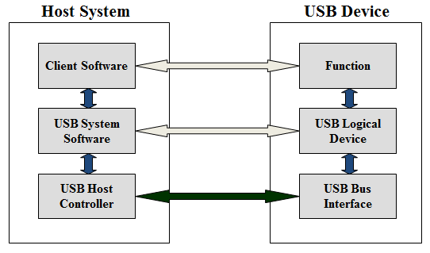
USB Software Interfaces

Slide 23
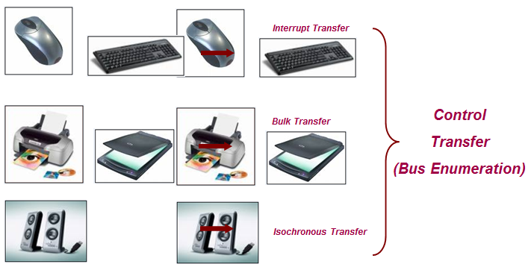
USB Applications

Slide 24
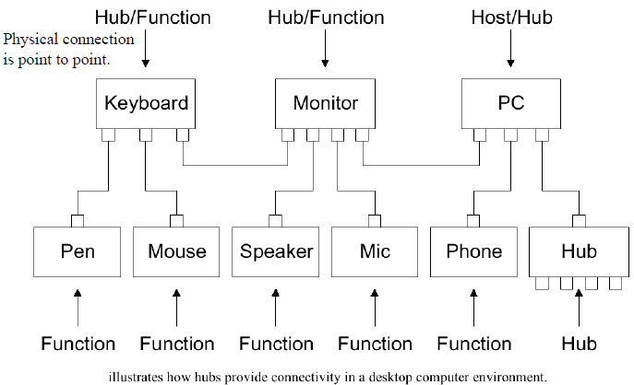
Hubs in a Desktop Computer Environment

Slide 25
Basic Definitions
Device Endpoints
Pipes
Stream Pipes
Message Pipes
Packets
Burst Transaction
Streaming
Polling

Slide 26
Device Endpoints
Uniquely identifiable portion of USB
Use for Communication flow b/w Host and device
Simplex connection, support data in one direction
Logical device is composed of collection of independent endpoints
End point has unique - device - determined identifier called end point number.
End point descriptor { Device address, Endpoint No, Direction}
End point characteristics( Max packet size, Burst Size, Transfer type, direction, bus access frequency)

Slide 27
Device Endpoints
Two types of endpoints
Endpoint zero
Default endpoint, use both input, output endpoint
Use to provide access to device’ configuration information and allow generic USB status and control access.
Non-endpoint zero
Additional endpoints required for implementation
In an unknown state before being configured and not accessible.

Slide 28
Pipes
The logic communication between the client software on the host and the function on the device is done through pipes
Association b/w endpoint and software
Are able to move data b/w host and device
Pipe consist of two endpoints with endpoint zero is called default control pipe
Default control pipe also used by device specific software
Two type of Pipes
Stream Pipes
Message pipes

Slide 29
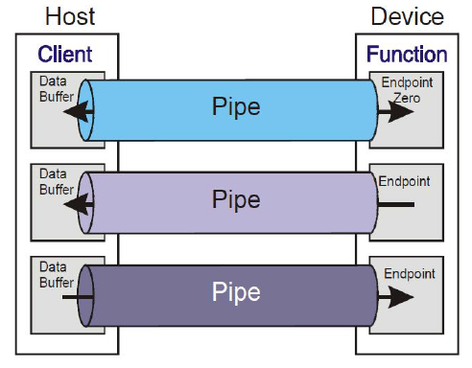
Pipes communication

Slide 30
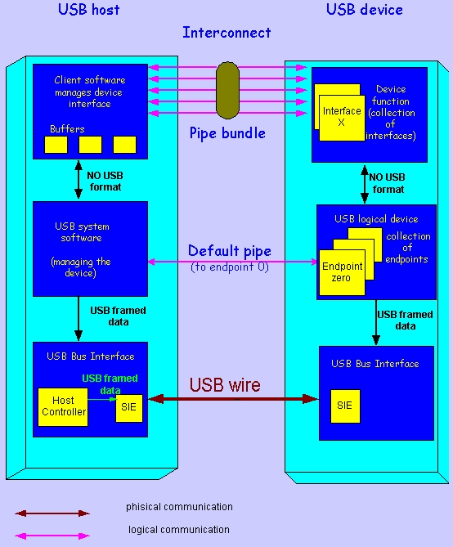
Pipes communication

Slide 31
Pipe types
1. Stream Pipes
No USB- required structure
Unidirectional
Data transfer is in sequential order
Is bounded to a single device endpoint No. in appropriate direction.
Support bulk, isochronous, interrupt transfer type
2. Message Pipes
Has USB defined structure
Bidirectional
Default control pipe is always a message pipe
Device can service only a single message request at a time per message pipe
Support control transfer type

Slide 32
USB Software Interfaces
Client software determines what transactions are required with a given device.
What data is to be transferred?
Scheduling and configuration of data transfers is completed in USB system software level.
When and how often is data is to be transferred?
Data transfers are composed and regulated at the USB Host Controller level.
How is data to appear to the functional device?
How does system keep track of data that has been sent and received?

Slide 33
Basic Definitions cont.
Packets
Sequence of data bytes with specific control sequence.
Burst Transaction
Allow host to continuously send or receive data
No. of packets send/ receive without intermediate ACK packet reported by device .
Streaming
Transmission of digital audio or video, or the listening and viewing of such data without first storing it.
Require some mechanism for establishing a channel b/w sender and receiver.
Polling
A polling model is a system of multiple queues accessed by a single server in cyclic order.

Slide 34
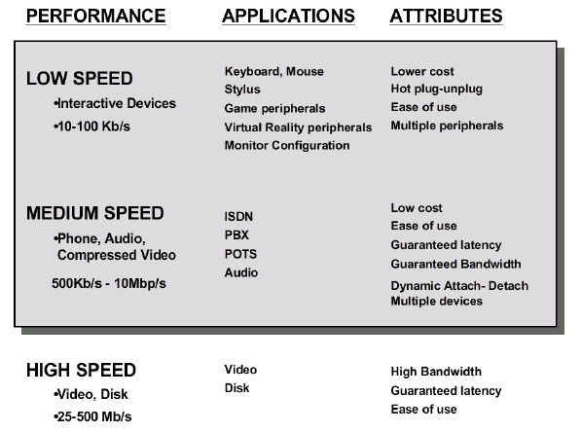
PERFORMANCE-APPLICATIONS -ATTRIBUTES

Slide 35
USB Signaling
The USB cable is 4 wire cable
Signal on the bus is done by signaling over two wires ( D₊ and D_ )
Data encoding and decoding is done using NRZI ( Non Return to Zero Inverted )
a 0 bit is transmitted by toggling the data lines
a 1 bit is transmitted by leaving the data lines as-is.

Slide 36
USB Data states

Slide 37
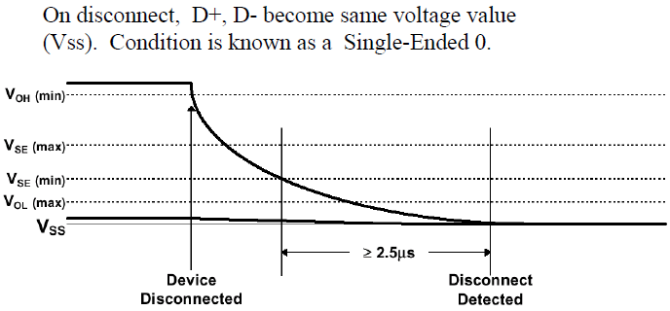
USB Data states

Slide 38
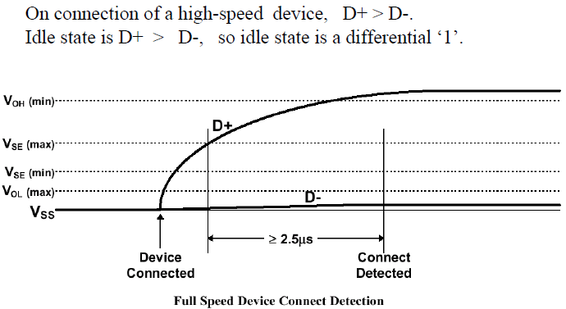
USB Data states

Slide 39
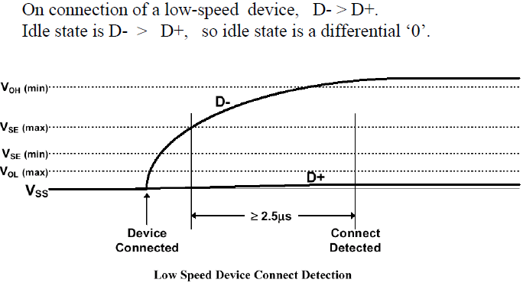
USB Data states

Slide 40
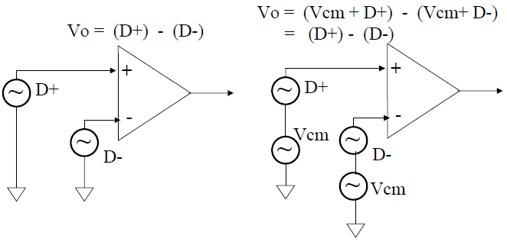
Why differential signalling??
Differential signalling very good at rejecting common-mode noise. If noise is coupled into a cable, then usually it is coupled into all wires in the cable. This ‘common-mode’ noise (Vcm) can be rejected by input amplifier.

Slide 41
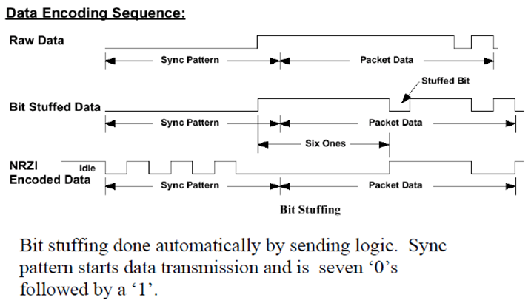
Bit Stuffing
Bit Stuffing – a ‘0’ is inserted after every six consecutive ‘1’s in order to ensure a signal transition so that receiver clock can remain synchronized to the bit stream.

Slide 42
Enumeration
The computer would decided which kind of data the device uses
Interrupt - low data transfer - keyboard or mouse
Bulk - large amounts of data - printer or external hard drive
Isochronous - streamed data - microphones or speakers
The activity that identifies and assigns unique addresses to devices attached to a bus
Makes USB devices hot pluggable
The host is always checking the bus for new devices via Interrupt transfers
The host cannot communicate with a USB device until that device has been properly enumerated
Invisible to user

Slide 43
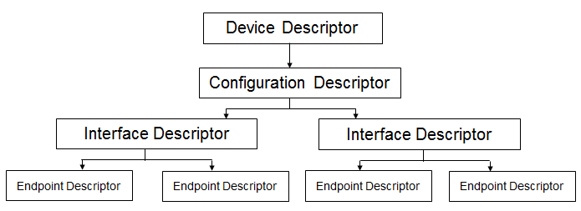
Descriptors
Data Structure with a defined format that enables a host to learn about a device and its capabilities.

Slide 44
Descriptors types
Device descriptor
General info about a USB device (vendor ID, etc.)
Contains info that applies globally to the device
Only one device descriptor
Configuration descriptor
USB devices can have multiple configurations
Each configuration contains one or more interfaces
All associated interface and endpoint descriptors get loaded with a request from the host for the configuration descriptor
Contains fields like remote wake-up capability and max power requirements

Slide 45
Descriptors types
Interface descriptor
Lists the endpoint descriptors for the interface
Identifies if the interface belongs to a predefined Class (such as the Human Interface Device or HID)
Endpoint descriptor
Info required by host to determine bandwidth requirements
Describes endpoint number and address, IN or OUT endpoint and the transfer types requested

Slide 46
Transfer Types
There exists four basic types of transfers:
1) Control Transfers
2) Bulk Transfers
3) Polling (Interrupt)
4) Isochronous (real-time) Transfers

Slide 47
Transfer Types
Control transfers are used in configuration transfers.
Assignment of endpoints and address fields.
Mandatory in all devices.
Control transfers are guaranteed 10% of bus bandwidth.
Setup stage of 8 bytes and data payload limited to 64 bytes.

Slide 48
Transfer Types
Bulk transfers are used in non-real time transfers of large chunks of data.
Scanners, printers, digital cameras
Allows data transfers to be spread over a number of frames.
Use bandwidth remaining after all other transfers have been scheduled.
Data payload is limited to 64 bytes.

Slide 49
Transfer Types
Polling transfers are use to transfer small amounts of real-time data, such as a request to send data.
Chiefly used to poll interrupts, access devices such as mouse and keyboards.
Scheduled to occur periodically.
Data payload limited to 64 bytes.

Slide 50
Transfer Types
Isochronous transfers involve the movement of a large amount of real-time data and generally assume the greatest part of the USB bandwidth.
Digital telephones, speakers, CD-ROMs
Error detection and recovery is not supported.
Transfers are scheduled to occur every frame.
Data Payload limited to 1023 bytes

Slide 51
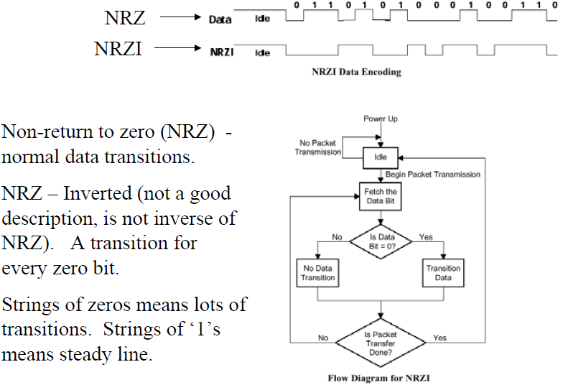
NRZI Encoding

Slide 52
USB Data Format
USB data is sent in packets Least Significant Bit (LSB) first.
There are 4 main USB packet types
Token, Data, Handshake and Start of Frame.
Each packet is constructed from different field types, namely SYNC, PID, Address, Data, Endpoint, CRC and EOP.
The packets are then bundled into frames to create a USB message.

Slide 53
Packet Types
There are three basic types of packets:
Token- OUT, IN, SOF, Setup
Data - Data0, Data1
Handshake - ACK, NAK, Stall

Slide 54
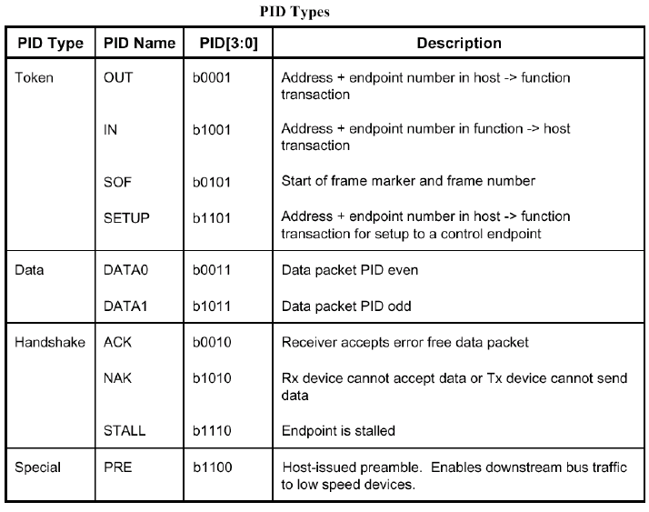

Slide 55
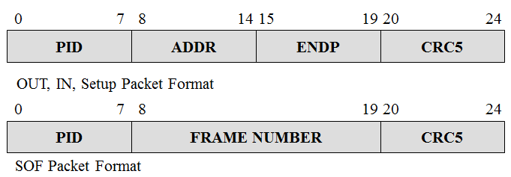
Token Packets
Token Packets
Use to establish parameters of a data transfer

Slide 56
Data Packets
Actual transfer of requested information
Two types of data packets - Data0 and Data1 are used to facilitate handshaking procedures (Alternating Bit Protocol)

Slide 57
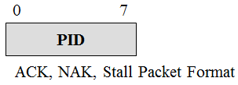
Handshaking Packets
ACK - Data received without error
NAK - Device is temporarily unable to return/accept data
Stall - A catastrophic error has occurred

Slide 58
Field Types
PID - Packet Identifier
Indicates type of packet.
ADDR - Device Address
Indicates device being accesses
ENDP - Destination Endpoint
Indicates which set of registers within given device.
CRC5 and CRC16 - A Cyclic Redundancy Check field is affixed to end of packets to check for data errors
a 16 bit field is used for data, and a 5 bit field is used for all other packets

Slide 59
Field Types
Frame Number - Identifies Frame Number
11 bit field uniquely identifying the given frame
Data - Information to be transmitted
Must be an integral number of bytes.

Slide 60
USB Packet Encoding
Bit Ordering
Bits are sent onto the bus LSB first
SYNC fields
Appears on the bus as IDLE followed by the binary sequence “00000001” in the NRZI encoding
Packet Identifier Fields (PID)

Slide 61
USB Packet Encoding
Address Fields
7-bit field, specifies source or destination of data packet
Endpoint Fields
4-bit field, permits more flexible addressing of functions in which more than one endpoint is required
Frame Number Field
11-bit field that is incremented by the host on a per-frame basis.
Rolls over upon reaching its maximum value of 0x7FFH

Slide 62
USB Packet Encoding
Data Fields
Ranges from 0 to 1023 bytes and must have an integral number of bytes.
Data bits within each byte are shifted out LSB first
End of Packet Fields
Both differential lines are driven to ‘0’ for two lock cycles and then one of them to ‘1’ for one clock cycle

Slide 63
Transfer Formats
In order to maintain synchronization, a ‘0’ is inserted after every seven consecutive ‘1’s.
referred to as bit stuffing
A SYNC pattern, composed of seven ‘0’s and a ‘1’ is sent before every packet.
An EOP is use to signal the last bit of the packet has been sent.
The bus may is placed in an idle state while the device controlling the line is switched.

Slide 64
USB Packet Encoding

Slide 65
Advantages of USB
Ease of Use
One interface for many devices
Hot pluggable
Automatic configuration
No power supply required
Devices can pull up to 500 mA from the bus
Reliability
Lossless data transfers
Speed
Three transfer speeds
Low Speed – 1.5 Mbps (USB 1.1 and 2.0)
Full Speed – 12 Mbps (USB 1.1 and 2.0)
Hi-Speed – 480 Mbps (USB 2.0 only)

Slide 66
Advantages of USB
Low Power Consumption
Suspend mode
Devices consume 500 uA or less (USB 2.0)
Devices consume 2.5 mA or less (USB 3.0)
Availability
Microsoft and Intel’s PC 2001 System Design Guide requires that all new PC’s have two user accessible USB ports

Slide 67
Comparison
Interface | Format | Number of Devices (maximum) | Length (maximum, feet) | Speed (maximum, bits/sec.) | Typical Use
USB | asynchronous serial | 127 | 16 (or up to 96 ft. with 5 hubs) | 1.5M, 12M, 480M | Mouse, keyboard, disk drive, modem, audio
RS-232 (EIA/TIA-232) | asynchronous serial | 2 | 50-100 | 20k (115k with some hardware) | Modem, mouse, instrumentation
Parallel Printer Port | parallel | 2 (8 with daisy-chain support) | 10–30 | 8M | Printers, scanners, disk drives
IEEE-1394 (FireWire) | serial | 64 | 15 | 400M (increasing to 3.2G with IEEE-1394b | Video, mass storage

Slide 68
CAN (CONTROLLER AREA NETWORK)
Introduction
CANBUS or CAN bus – Controller Area Network bus
CAN bus is a vehicle bus standard designed to allow microcontroller and devices to communicate with each other in vehicle.
It is a message based protocol. Highest Baud Rate is 1Mbit.
It is present in both physical and data link layer of OSI layers.
It is a multi-master serial bus .

Slide 69
Introduction
An automotive serial bus system developed to satisfy the following requirements
Network multiple microcontrollers with 1 pair of wires.
Allow microcontrollers communicate with each other.
High speed, real-time communication.
Provide noise immunity in an electrically noisy environment.
Low cost

Slide 70
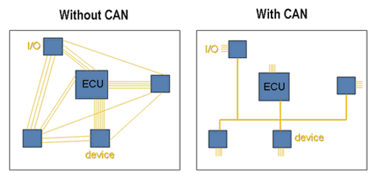
What is CAN and what are some of its features?
Serial communication
Multi-Master Protocol
Compact
Twisted Pair Bus line
1 Megabit per second

Slide 71
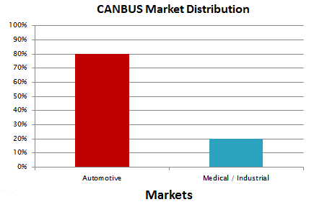
Who uses CANBUS?
Designed specifically for automotive applications
Today - industrial automation / medical equipment

Slide 72
CANBUS History
First idea - The idea of CAN was first conceived by engineers at Robert Bosch in Germany in the early 1980s.
Early focus - Develop a communication system between a number of ECUs (electronic control units).

Slide 73
CANBUS Timeline
1983 : First CANBUS project at Bosch
1986 : CAN protocol introduced
1987 : First CAN controller chips sold
1991 : CAN 2.0A specification published
part 2.0A - 11-bit identifier;
part 2.0B - 29-bit identifier.
1992 : Mercedes-Benz used CAN network
1993 : ISO 11898 standard
1995 : ISO 11898 amendment
Present : The majority of vehicles use CAN bus.

Slide 74
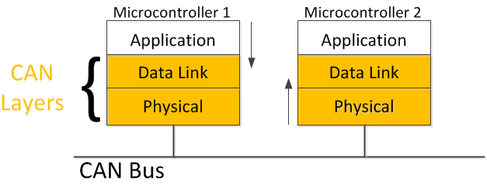
CAN BUS and the OSI Model
CAN is a closed network
no need for security, sessions or logins.
no user interface requirements.
Physical and Data Link layers.

Slide 75
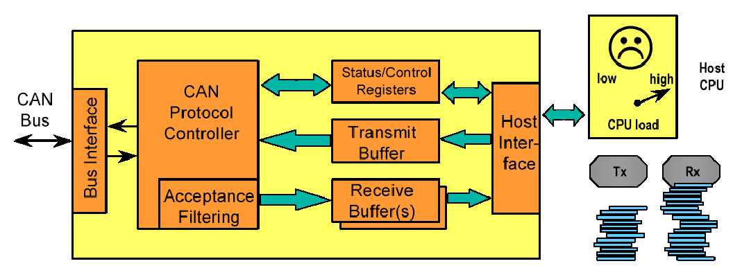
CAN Controller Diagram

Slide 76
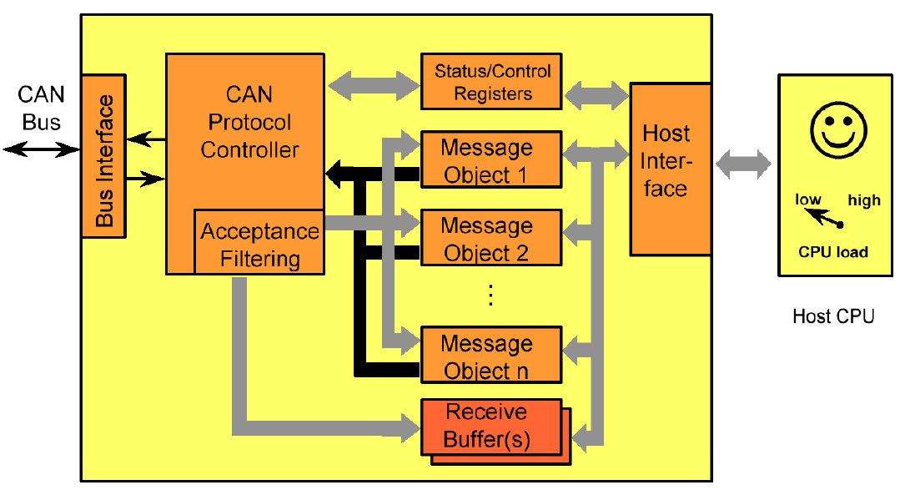
FULL CAN Controller Diagram
Hardware message filters sort & filter messages without interrupting CPU

Slide 77
CAN Bus Characteristics

Slide 78
CAN Bus Characteristics

Slide 79
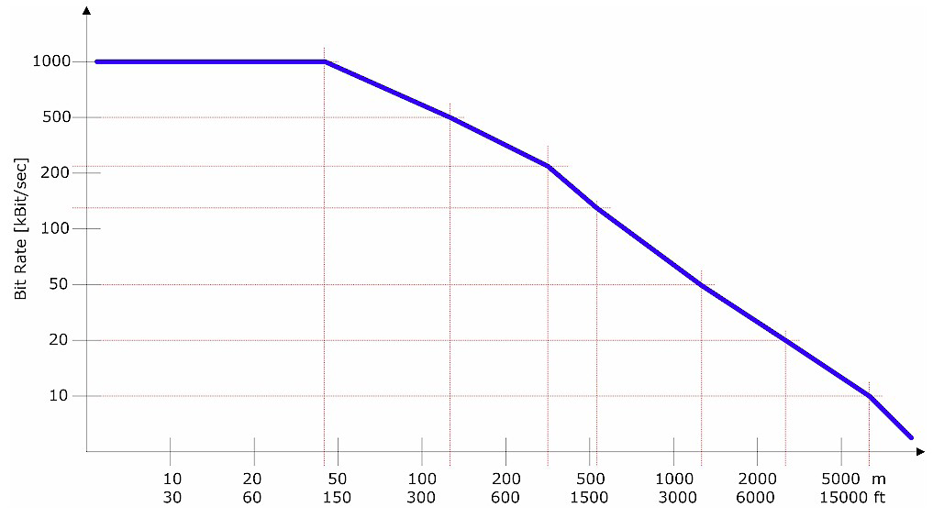
Transmission Characteristics
Up to 1 Mbit/sec.
Common baud rates: 1 MHz, 500 KHz and 125 KHz
All nodes – same baud rate
Max length:120’ to 15000’ (rate dependent)

Slide 80
Message Oriented Transmission Protocol
Each node – receiver & transmitter
A sender of information transmits to all devices on the bus
All nodes read message, then decide if it is relevant to them
All nodes verify reception was error-free
All nodes acknowledge reception
CAN bus

Slide 81
CAN Implementation
Stand alone CAN Controller.
Integrated CAN Controller.
Single-Chip CAN Controller.

Slide 82
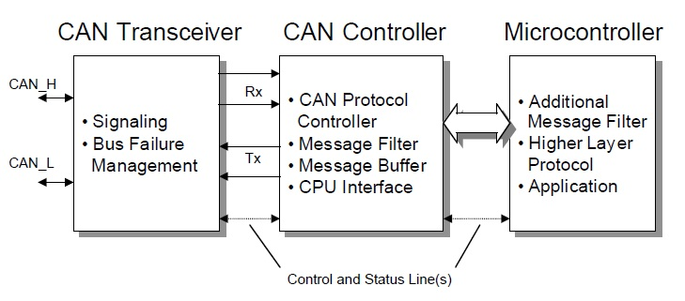
Stand alone CAN Controller

Slide 83
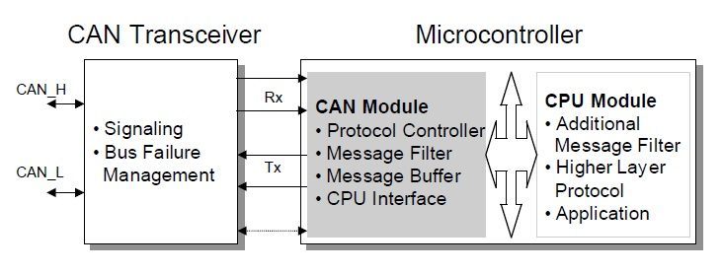
Integrated CAN Controller

Slide 84
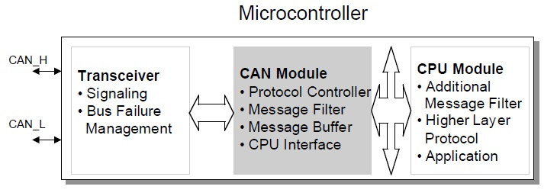
Single-Chip CAN Controller

Slide 85
CAN Controller Architecture

Slide 86
Before CAN

Slide 87
After CAN

Slide 88
Data Information – Frame Format
SOF – Start of Frame
Identifier – Tells the content of message and priority
RTR – Remote Transmission Request
IDE – Identifier extension (distinguishes between CAN standard,11 bit identifier, and CAN extended, 29 bit identifier.)
R0 –Reserved bit

Slide 89
Data Information – Frame Format
DLC – Data Length Code
Data – holds up to 8 bytes of data
CRC – “Cyclic Redundant Check” sum
ACK – Acknowledge
EOF – End of Frame
IFS – Intermission Frame Space. Minimum number of bits separating consecutive messages.

Slide 90
Message Frame
Start of Frame.
Arbitration Field.
Control Field.
Data Field.
CRC Field.
Acknowledgement bits.
End of Frame.

Slide 91
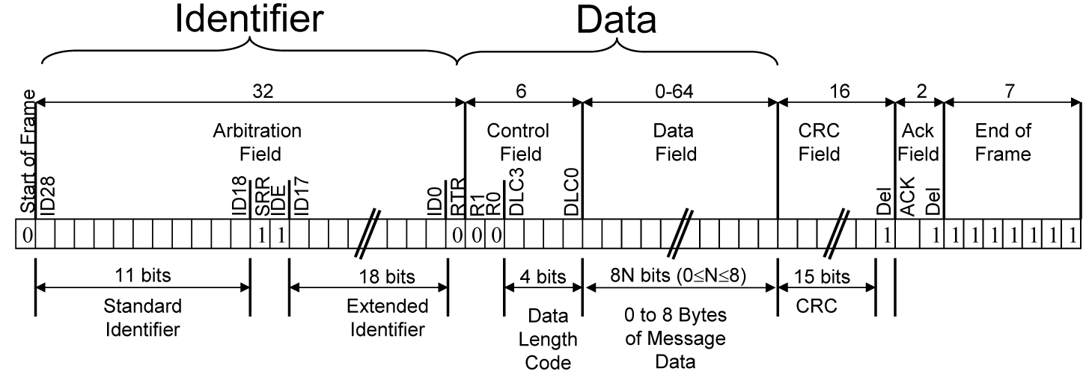
Message Format
Each message has an ID, Data and overhead.
Data –8 bytes max
Overhead – start, end, CRC, ACK
Bit stuffing - any sequence of 5 bits of the same type requires the addition of an opposite type bit by the TRANSMITTER (and removal from the receiver)

Slide 92
Message Frame Structure
Standard Data Frame
Extended Data Frame

Slide 93
CAN Data Frames
CAN 2.0A (“standard CAN” 11-bit ID) Data Frame.
CAN 2.0B (“extended CAN” 29-bit ID) Data Frame.

Slide 94
CAN bus Frame types
DATA FRAME - Carries regular data
REMOTE FRAME - Used to request the transmission of a DATA FRAME with the same ID
ERROR FRAME - Transmitted by any unit detecting a bus error
OVERLOAD FRAME - Used to force a time interval in between frame transmissions

Slide 95
CAN bus Frame types
Data Frame
The data frame is the most common message type, and comprises the Arbitration Field, the Data Field, the CRC Field, and the Acknowledgment Field.
Remote Frame
The remote frame is similar to the data frame, with two important differences. First, this type of message is explicitly marked as a remote frame by a recessive RTR bit in the arbitration field, and secondly, there is no data.

Slide 96
CAN bus Frame types
Error Frame
The error frame is a special message that violates the formatting rules of a CAN message. It is transmitted when a node detects an error in a message, and causes all other nodes in the network to send an error frame as well.
Overload Frame
The overload frame is mentioned for completeness. It is similar to the error frame with regard to the format, and it is transmitted by a node that becomes too busy. It is primarily used to provide for an extra delay between messages.

Slide 97
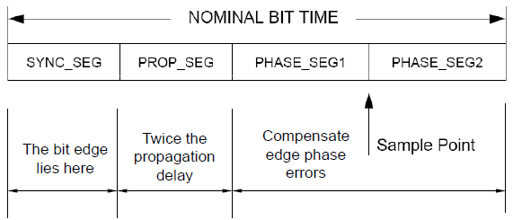
NIMINAL BIT TIMING

Slide 98
NOMINAL BIT TIMING
The CAN bit time is made up of non-overlapping segments. Each of these segments are made up of integer units called Time Quanta (TQ). The base TQ equals twice the oscillator period.
The Nominal Bit Rate (NBR) is defined in the CAN specification as the number of bits per second transmitted by an ideal transmitter with no resynchronization and can be described with the equation:

Slide 99
NOMINAL BIT TIMING
SYNCHRONIZATION SEGMENT
The Synchronization Segment (SyncSeg) is the first segment in the NBT and is used to synchronize the nodes on the bus. Bit edges are expected to occur within the SyncSeg. This segment is fixed at 1TQ.
PROPAGATION SEGMENT
The Propagation Segment (PropSeg) exists to compensate for physical delays between nodes. The propagation delay is defined as twice the sum of the signal’s propagation time on the bus line, including the delays associated with the bus driver. The PropSeg is programmable from 1 - 8TQ.

Slide 100
NOMINAL BIT TIMING
PHASE SEGMENT 1 AND PHASE SEGMENT 2
The two phase segments, PS1 and PS2 are used to compensate for edge phase errors on the bus. PS1 can be lengthened or PS2 can be shortened by resynchronization. PS1 is programmable from 1 - 8TQ and PS2 is programmable from 2 - 8TQ

Slide 101
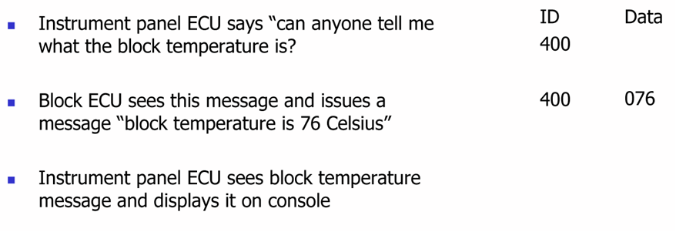
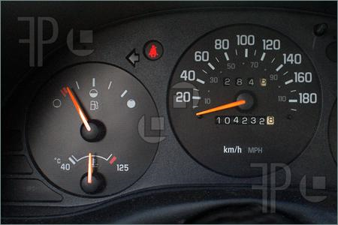
Example of Message Transaction

Slide 102
Bus Arbitration
Arbitration – needed when multiple nodes try to transmit at the same time
Only one transmitter is allowed to transmit at a time.
A node waits for bus to become idle
Nodes with more important messages continue transmitting
CAN bus

Slide 103
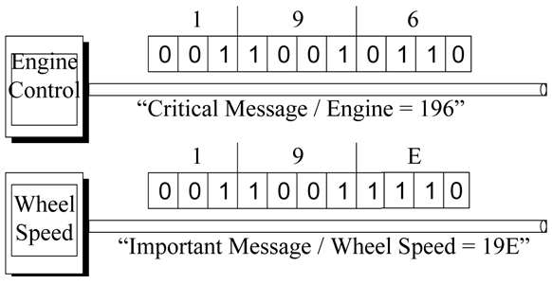
Bus Arbitration
Message importance is encoded in message ID.
Lower value = More important
As a node transmits each bit, it verifies that it sees the same bit value on the bus that it transmitted.
A “0” on the bus wins over a “1” on the bus.
Losing node stops transmitting, winner continues.

Slide 104
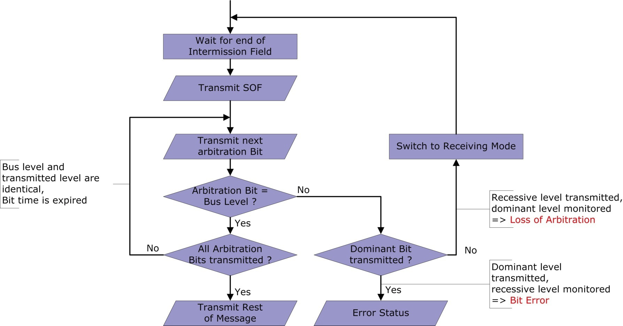
Bus Arbitration Flowchart

Slide 105
CAN bus Error and fault containment
There are 5 types of error:
BIT ERROR - The sender monitors the bus. If the value found on the bus is different from the one that is sent, then a BIT ERROR is detected
STUFF ERROR - Detected if 6 consecutive bits of the same type are found.
CRC ERROR - Detected by the receiver if the received CRC field does not match the computed value
FORM ERROR - Detected when a fixed format field contains unexpected values.
ACKNOWLEDGEMENT ERROR - Detected by the transmitter if a dominant value is not found in the ack slot.

Slide 106
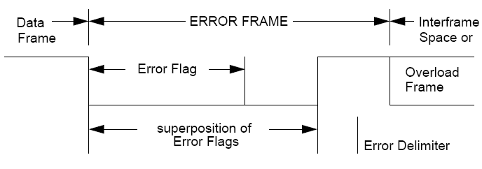
CAN bus Error
An ERROR FRAME is simply the superposition of ERROR.
FLAGS from different nodes, plus an ERROR DELIMITER
There are two types of error flags:
An ACTIVE ERROR flag consists of 6 consecutive dominant bits
A PASSIVE ERROR flag consists of 6 consecutive recessive bits
The superposition of all the error flags goes from 6 to 12 bits.
The error delimiter consists of 8 recessive bits

Slide 107
Fault containment
Each node can be in 3 states:
Error active
Error passive: limited error signalling and transmission features
Bus off: cannot influence the bus

Slide 108
Fault containment
Each node has two counters:
TRANSMIT ERROR COUNT:
increased – (list) by 8 when the transmitter detects an error …
decreased – by 1 after the successful transmission of a message (unless it is 0)
RECEIVE ERROR COUNT:
increased – (list) by 1 when the node detects an error, by 8 if it detects a dominant bit as the first bit after sending an error flag …
decreased – (if between 1 and 127 by 1, if >127 set back to a value between 119 and 127) after successful reception of a message

Slide 109
CAN bus Error and fault containment
A station detecting an error transmits an ERROR FLAG.
For BIT, STUFF, FORM, ACKNOWLEDGEMENT errors, it is sent in the immediately following bit.
For CRC it is sent after the ACK DELIMITER
The ERROR FLAG is part of an ERROR FRAME

Slide 110
Advantages
High throughput under light loads
Local and global prioritization possible
Limitations
Unfair access - node with a high priority can "hog" the network.
Poor latency for low priority nodes.

Slide 111
Applications
Automobiles & Auto-motive industry
Factory Automation
Aerospace
Maritime
Industrial auto machine & Factory Automation
Machine Control
Medical equipment
And more….

Slide 112
Manufacturers
Over 20 different chip manufacturers produce microcontrollers with on-chip CAN interfaces.
Some more notable ones are:
Cygnal
Intel
Motorola
NEC
Phillips
Toshiba

Slide 113
END
OF
UNIT - II

