Slide 1
EMBEDDED
NETWORKING

Slide 2
EMBEDDED NETWORKING Syllabus
ETHERNET BASICS: Elements of a network – Inside Ethernet – Building a network: Hardware options – Cables, Connections and network speed- Design choices: Selecting components- Ethernet controllers- Using the internet in logical and internet communications- Inside the Internet protocol

Slide 3
Basic Networking Concepts
What Is a Network?
A network is a transmission system that connects two or more applications running on different computers.

Slide 4
Basic Networking Concepts
Client/Server Applications
Most Internet applications are client/server applications
Clients receive service from servers
The client is often a browser

Slide 5
Elements of a network
A computer network is any combination of computers and other devices that are connected by a central Internet signal.
Below are the basic elements of a computer network,
Modem
Router
Ethernet cords
Devices

Slide 6
Elements of a network
Modem: The first thing you need to start a network is a modem that’s connected to an ISP (Internet Service Provider). A central Internet connection is the foundation of a network.
Router: While the Internet service provides you with the means to create a network, the next step is to hook up the modem to a router, which serves as a hub that distributes the Internet connection.

Slide 7
Elements of a network
In business environments, the router would be replaced by switches, which allow you to multiply the amount of connections you distribute, or by a server, which becomes the mainframe for storing data from all connected hardware.
Ethernet cords: If you are using wired connections, you need Ethernet cords to connect the router to computers, printers, or other devices Network adapters.

Slide 8
Elements of a network
Once your devices are connected to the router, they can read the internet signal because they have a network adapter.
Most of today’s computers have network adapters built in, whether they are compatible with wired or wireless Internet connections.
If you don’t use Ethernet cords to connect one or more of your devices, then you need wireless adapters that enable them to pick up the wireless signal from the router.

Slide 9
Elements of a network
Devices: The last step to creating a network is assembling the actual devices.
The hardware you use can include desktop computers, laptops, netbooks, TVs, gaming systems, stereos, and even cell phones and tablets.
If your cell phone or tablet connects to your wireless Internet at home, then you can technically consider it as part of your network.

Slide 10
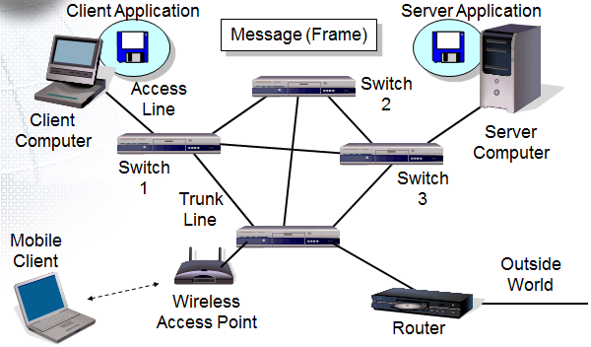
Nine elements of a network

Slide 11
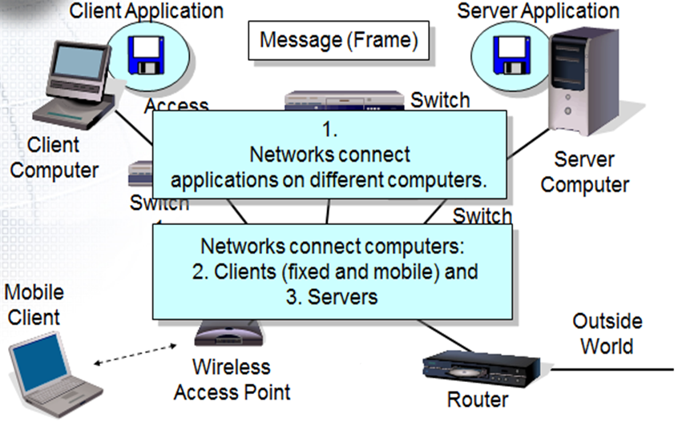
Nine elements of a network

Slide 12
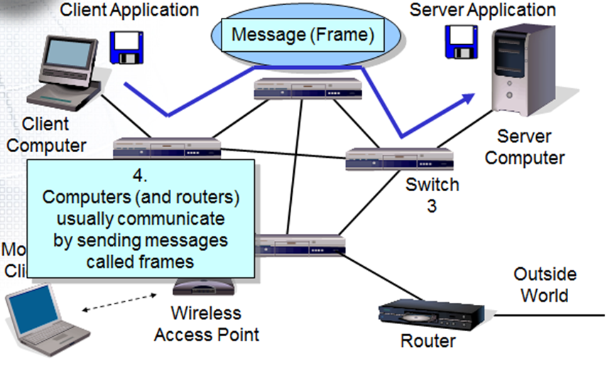
Nine elements of a network

Slide 13
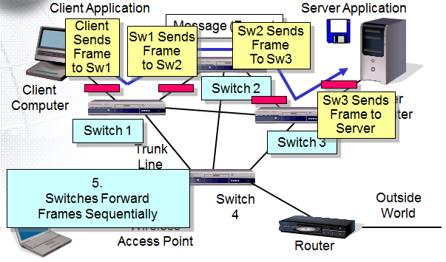
Nine elements of a network

Slide 14
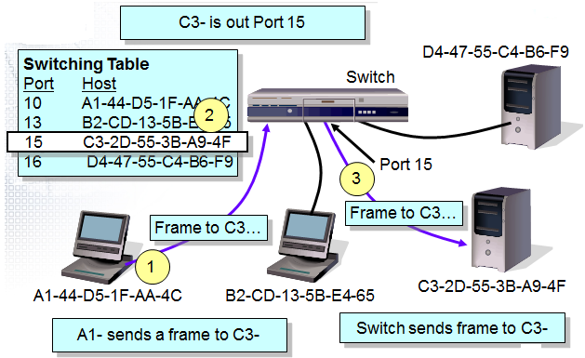
Nine elements of a network

Slide 15
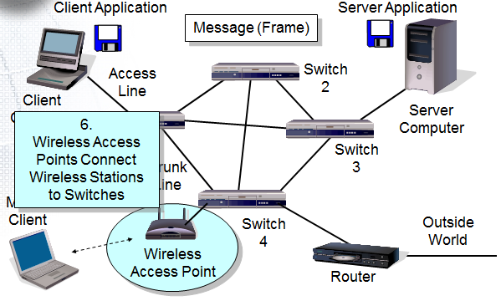
Nine elements of a network

Slide 16
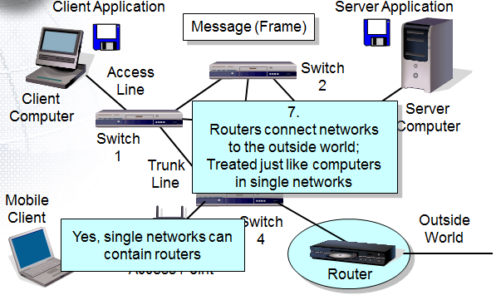
Nine elements of a network

Slide 17
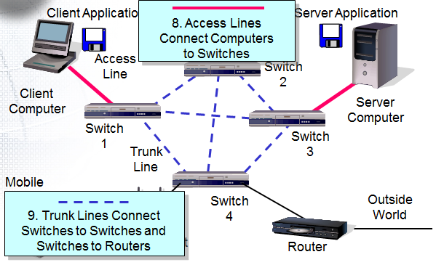
Nine elements of a network

Slide 18
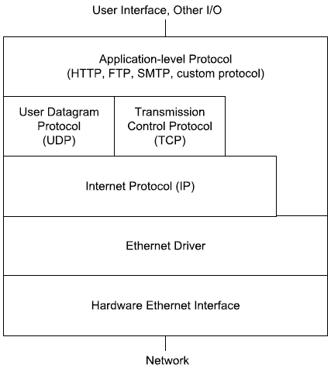
Network Protocol Stack

Slide 19
Functionality of Network Components
Server
Client
Workstation

Slide 20
Server
A network server or server is a computer that offers its services and/or its resources to clients, workstations, and other servers over a computer network.
A server commonly has multiple processors, large hard drives, and large amounts of RAM.
A server provides centralized management of resources, security, and expanded access to networked resources in a network.

Slide 21
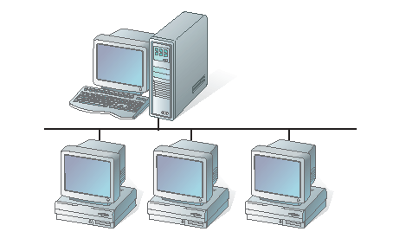
Server and clients

Slide 22
Client
A network client or client is a device on a computer network that requests services or resources from a server.
Clients can be printers, workstations, servers, or any other device connected to the computers on a network.
The most common network clients are workstations.

Slide 23
Workstation
A workstation is a computer that operates independently of the network.
It manages its own files and processing.
Workstations connect to the network for the purpose of security and centralized management of networked resources.

Slide 24
Network Connectivity
Communication medium.
Network interface card (NIC).
Concentrators.

Slide 25
Communication Medium
A communication medium is the physical path between the networked resources.
The medium used is either a coaxial cable or a twisted-pair wire.
Fiber-optic cabling and wireless medium have gained widespread acceptance as a network communication medium.

Slide 26
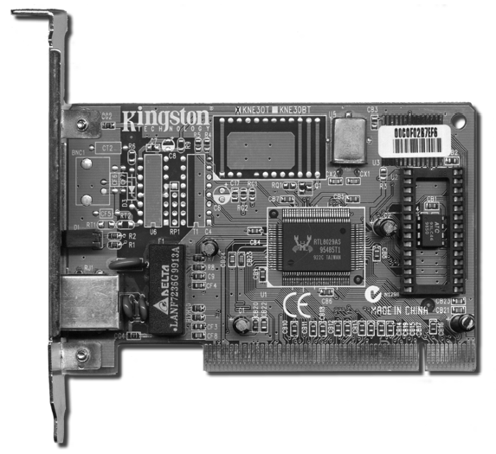
Network Interface Card (NIC)
A NIC, also known as the network board, is used to connect the networked components to the physical cable.
The NIC provides a physical connection to the device and also creates and sends signals from one networked device to another.

Slide 27
Concentrators
Network concentrators allow users to connect multiple cables together to enable numerous connections to networked resources.
Hub:
A hub is the central meeting point where cables join to carry information to other resources through a network.
It contains several wiring ports that can be used to receive data and pass on the same to any other device on a network.
Hubs have a simple design and they rarely wear out.
They provide the additional connections necessary, but end up using much of the network capacity.

Slide 28
Concentrators
Switches:
Switches, like hubs, provide a centralized connection.
They include network monitoring and selective configuration capabilities, thereby reducing network traffic.
Shared data can directly be sent to an individual resource instead of every networked resource.
Switches are more economical to use.

Slide 29
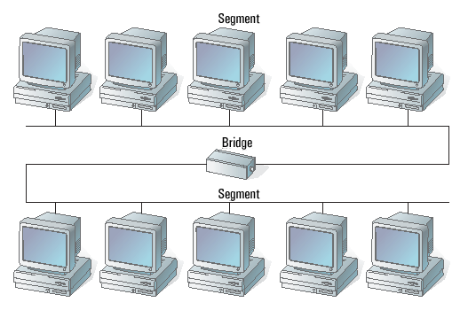
Concentrators
Bridges:
A bridge connects dissimilar networks together.
The basic function of a bridge is to join two or more separate networks that use the same networking language, called protocol.
A bridge segments a network

Slide 30
Concentrators
Routers:
A router is used to send specific portions of messages directly to the intended destination in a separate network.
Information is directly transmitted between the networks without causing any network traffic.
Networks served by a router are not required to use the same protocol.
Routers are frequently used to place additional security on sensitive networked resources.

Slide 31
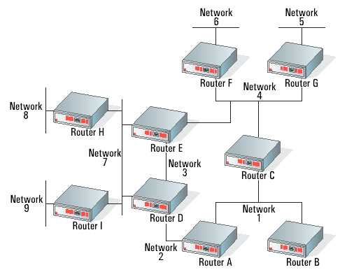
Concentrators
Networks are separated by routers

Slide 32
Different Types of Cabling
Network cabling is the physical connection that runs between networked resources.
The four basic types of networking medium are coaxial cable, twisted-pair cable, fiber-optic cable, and wireless.

Slide 33
Coaxial Cable
The term coaxial is derived from the terms, ‘Co’ and ‘axial’, where ‘Co’ refers to the two conductors and axial refers to the same axis.
The two coaxial conductors cannot be separated easily.
Thick coax cable or thicknet was the first widely used network-cabling medium.
Thicknet cables are approximately half an inch in diameter and carry Ethernet signals reliably for up to 500 meters (1,650 feet).

Slide 34
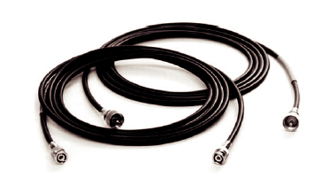
Coaxial Cable
Thin coax cables came into use shortly after thicknet.
They weigh less and are also significantly less expensive.
A thinnet cable is approximately a quarter of an inch in diameter and carries an Ethernet signal reliably for up to 185 meters (610 feet).
Both ends of a thinnet coaxial cable.

Slide 35
Coaxial Cable
A coaxial cable is used to connect computers in a line from one to another, called daisy chaining.
At each end of a thinnet coax cable, there is a twisted barrel-like connection called a BNC connector (Bayonet Neill–Concelman).
At each network interface card, a separate T-connector is inserted into the BNC connector.

Slide 36
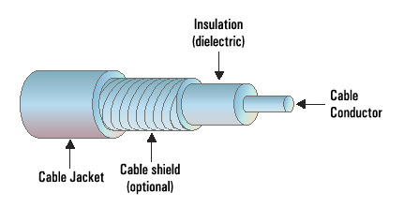
Coaxial Cable
At both ends of the daisy chain, a connector is twisted into the T-connector to terminate signals.
The terminator is a device that absorbs any residual signal at the end of the network and ensures that it does not bounce back over the cable medium.
A cross-section of a coaxial cable shows its layers

Slide 37
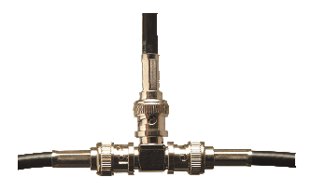
Coaxial Cable
A BNC T-connector showing a terminator and typical wiring connector.

Slide 38
Twisted-Pair Cable
A twisted-pair (TP) cable has eight individually insulated wires bundled together.
The cable is constructed such that the eight wires are grouped as four pairs inside a protective casing.
There are two types of twisted-pair cables – shielded twisted pair (STP) and unshielded twisted pair (UTP).
Both types of cable are easy to maintain and are inexpensive.
UTP is the most commonly used network-cabling medium.

Slide 39
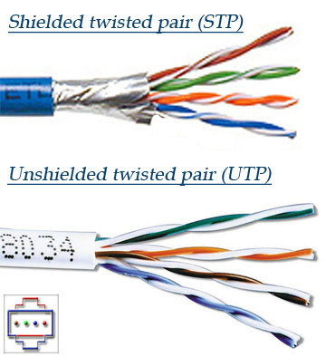
Twisted-Pair Cable

Slide 40
Fiber-Optic Cable
A fiber-optic cable consists of a central fiber-optic core surrounded by a cladding material and coated with a protective plastic covering.
The central fiber-optic core is highly refined plastic or glass that has a high degree of light transmission capability.
Fiber-optic cables use light signals for data transmission.
Either laser or other light producing mechanism, such as light emitting diodes (LEDs), are used as the source of light.
Using a laser is more dependable, but more costly, so most fiber-optic networks use LEDs as the source of light.

Slide 41
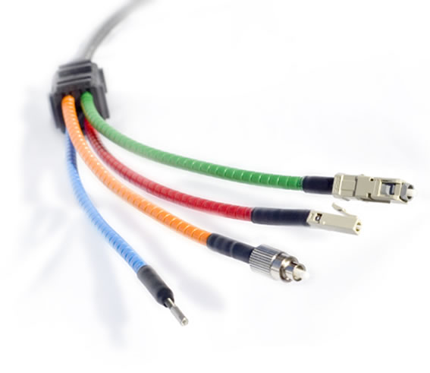
Fiber-Optic Cable

Slide 42
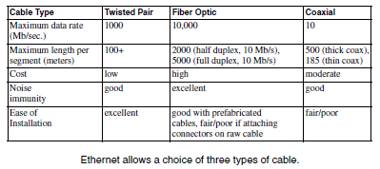
Comparison

Slide 43
Wireless
Wireless networking is used very frequently since it is mobile and convenient.
Most wireless networks use infrared or radio waves, while others use microwave and satellite networks.
Physical connections, such as wiring, are not found in locations where mobile users are connected.

Slide 44
Installation and Configuration of a Network Interface Card
The following components are required for installing a NIC:
One NIC per computer or networked device.
A computer running Windows 98 or higher.
A crossover network cable.
An appropriate driver for the NIC.

Slide 45
Installation and Configuration of a Network Interface Card
The following things must be ensured before installing the NIC:
The computer must be turned off, and the unit must be unplugged from its power source.
All cables connected to the system unit must be disconnected.
Only insulated or nonconductive tools must be used.

Slide 46
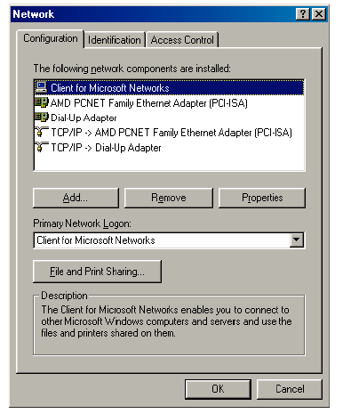
Installation and Configuration of a Network Interface Card
Network Properties
dialog box

Slide 47
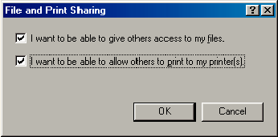
Installation and Configuration of a Network Interface Card
File and Print Sharing dialog box

Slide 48
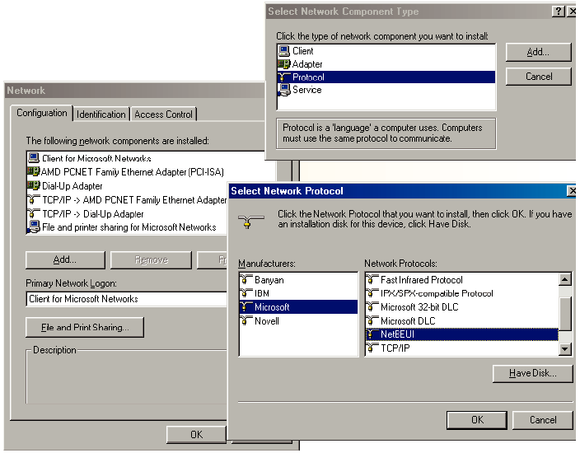
Installation and Configuration of a Network Interface Card
Network Protocol
Installation
window

Slide 49
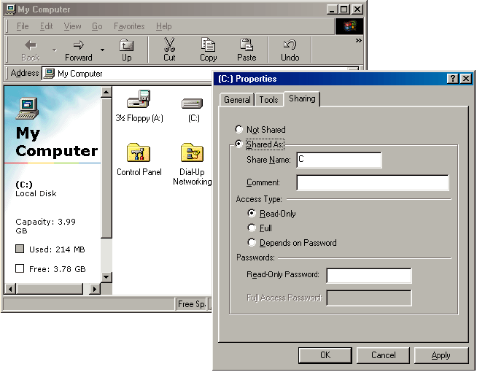
Installation and Configuration of a Network Interface Card
Sharing tab

Slide 50
Transmission Speed
Measuring Transmission Speed
Measured in bits per second (bps)
In metric notation:
Increasing factors of 1,000 … Not factors of 1,024
Kilobits per second (kbps)-note the lowercase k
Megabits per second (Mbps)
Gigabits per second (Gbps)
Terabits per second (Tbps)

Slide 51
Transmission Speed
Measuring Transmission Speed
What is 23,000 bps in metric notation?
What is 3,000,000,000 in metric notation?
What is 15,100,000 bps in metric notation?
Occasionally measured in bytes per second
If so, written as Bps
Usually seen in file download speeds

Slide 52
Transmission Speed
Writing Transmission Speeds in Proper Form
The rule for writing speeds (and metric numbers in general) in proper form is that there should be 1 to 3 places before the decimal point
23.72 Mbps is correct (2 places before the decimal point).
2,300 Mbps has four places before the decimal point, so it should be rewritten as 2.3 Gbps (1 place).
0.5 Mbps has zero places to the left of the decimal point. It should be written as 500 kbps (3 places).

Slide 53
Transmission Speed
Writing Transmission Speeds in Proper Form
How to convert 1,200 Mbps to proper form
Divide the number 1,200 by 1000
Move decimal point three places to the left: 1.200
Multiply the metric suffix Mbps by 1,000
Gbps
Result:
1.2 Gbps

Slide 54
Transmission Speed
Writing Transmission Speeds in Proper Form
How to convert 0.036 Mbps to proper form
Multiply the number 0.036 by 1000
Move decimal point three places to the right: 36
Divide the metric suffix Mbps by 1,000
kbps
Result:
36 kbps

Slide 55
Transmission Speed
Writing Transmission Speeds in Proper Form. How should you write the following in proper form?
549.73 kbps
0.47 Gbps
11,200 Mbps
0.0021 Gbps

Slide 56
Transmission Speed
Rated Speed : The speed in bits per second that you should get (advertised or specified in the standard).
Throughput
The speed you actually get
Almost always lower than the rated speed
On Shared Transmission Lines
Aggregate throughput—total throughput for all users
Individual throughput—what individual users get

Slide 57
Inside Ethernet
Advantages
It’s Versatile: Ethernet is versatile enough to suit many purposes.
It’s Easy to Use: All of the computers in the network follow standard Ethernet specifications for interconnecting, managing network traffic, and exchanging data.
A Wide Selection of Products Is Available: Hardware, software, and debugging tools for Ethernet are readily available.

Slide 58
Inside Ethernet
The Hardware Controls Network Access: With Ethernet, the hardware manages the network traffic, so there’s no need for software to control network access.
It’s Fast: Ethernet is fast. It supports speeds from 10 Megabits per second (Mb/s) to 10 Gigabits per second (Gb/s). Ten Mb/s is adequate for many embedded systems.

Slide 59
Inside Ethernet
It Can Span Long Distances: A single twisted-pair cable between two computers or between a repeater hub or switch and a computer can be 100 meters. A half-duplex segment of fibre-optic cable in a 10-Mb/s system can be as long as 2000 meters, while a full-duplex segment can be as long as 5 kilometres.
Interfaces are Electrically Isolated: Every Ethernet interface must be electrically isolated from its network cable.

Slide 60
Inside Ethernet
Limits
Ethernet isn’t the answer for every embedded system’s communications needs. For some systems, there are simpler, cheaper, or otherwise more appropriate ways to network.
Cost: If keeping the cost to an absolute minimum is essential, there are cheaper interfaces that are suitable for some applications.
Real-time Limits: Ethernet alone doesn’t guarantee real-time transfers, or transfers that will occur with minimal delay or at precise times or intervals.

Slide 61
Inside Ethernet
Efficiency: Ethernet isn’t very efficient when transferring small amounts of data. All Ethernet data travels in structures called frames. Each frame must have between 46 and 1500 data bytes. Along with the data, each frame includes 26 bytes of synchronizing, addressing, error-detecting, and other identifying information.
Power Consumption: Ethernet isn’t the best solution if your device must be extremely low power. Power consumption for an Ethernet controller chip can be 50 milli amperes or more at 5 volts.

Slide 62
The IEEE 802.3 Standard
The Institute of Electrical and Electronics Engineers (IEEE) is responsible for the specification popularly known as Ethernet.
Ethernet originated at Xerox Corporation in the 1970s. An early description appeared in the article Ethernet: Distributed Packet Switching for Local Computer Networks, in the July 1976.
In 1980, Digital Equipment Corporation (DEC), Intel Corporation, and Xerox Corporation formalized Ethernet’s description in a document titled The Ethernet, a Local Area Network: Data Link Layer and Physical Layer Specifications. (DIX Ethernet)

Slide 63
The IEEE 802.3 Standard
In 1985, the IEEE released its own edition of the standard. The interface described in the IEEE standard is very similar to the DIX interface and is backward-compatible with it, so networks that comply with the DIX standard also comply with the IEEE standard.
The Ether in Ethernet refers to luminiferous ether, which is the name given to a hypothetical medium that was once thought to serve as the propagation medium for electromagnetic waves.

Slide 64
The 802.x Series
CSMA/CD is the method Ethernet uses for sharing the network.
Ethernet is one in a group of IEEE standards that describe technologies for use in local and metropolitan area networks.
A local network typically exists in a single room or building, while a metropolitan area network (MAN) might span a campus or city.
Ethernet’s main use is in local networks, though recent standards and usage have expanded its scope to larger networks such as MANs and Wide Area Networks (WANs).

Slide 65
The 802.x Series
The Ethernet standard is one of several 802-series standards that define alternate approaches for a network’s physical layer and method of media-access control, which defines how computers share a network.
The physical layer described in the standard includes the electrical specifications of the transceivers and the electrical and physical specifications of the connectors and cables.
Media-access control includes how each computer knows when it can transmit and how the computers identify the intended receiver of a transmission.

Slide 66
Frames
All data in an Ethernet network travels in structures called frames.
An Ethernet frame has defined fields for data and other information to help the data get to its destination and to help the destination computer determine whether the data has arrived intact.
The Ethernet controller’s hardware places information to be sent in frames for transmitting, and extracts and stores the information in received frames.

Slide 67
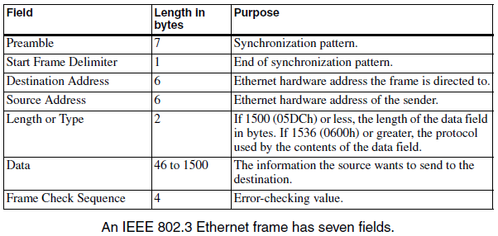
Frames

Slide 68
Frames
Preamble and Start Frame Delimiter
The Preamble and Start Frame Delimiter fields function together.
They provide a predictable bit pattern that enables the interfaces on a 10-Mb/s network to synchronize to, or match the timing of, a new frame being transmitted.
The Preamble and Start of Frame Delimiter fields provide pattern as below (next slide).

Slide 69
Frames
The Preamble consists of seven identical bytes, each with the value 10101010.
The Start Frame Delimiter follows the Preamble, and consists of the byte 10101011.
After detecting the first transition in the Preamble, a receiving interface uses the transitions of the following bits to synchronize to the timing of the transmitting interface.
The final two bits in the Start Frame Delimiter indicate the end of the Preamble.

Slide 70
Frames
The faster Ethernet interfaces use different methods to synchronize, but include the Preamble for compatibility.
In the earlier DIX standard, the Preamble frame is 64 bits and includes the Start-of-Frame byte, while the 802.3 standard defines the Start of Frame as a separate field.

Slide 71
Frames
Destination Address
Every Ethernet interface has a 48-bit physical, or hardware, address that identifies the interface on the network.
The Destination Address field contains the physical address of the intended receiver of the frame.
The receiver may be an individual interface, a group of interfaces identified by a multicast address, or a broadcast address to all interfaces in the network.

Slide 72
Frames
The first two transmitted bits in the address have special meanings.
The first bit is 0 if the address is for a single interface, and 1 if the address is a multicast or broadcast address.
A broadcast address is all 1s and is directed to every interface in the network.
Multicasting provides a way for an interface to communicate with a selected group of interfaces.
The interfaces in the multicast group are configured to accept frames sent to a specific multicast address.

Slide 73
Frames
The second bit of the destination address is zero if the address was assigned by the manufacturer of the interface, which is the usual case.
In the 802.3 standard, the second bit is 1 if the address is administered locally.
In the DIX standard, the second bit is always zero.

Slide 74
Frames
Source Address
The Source Address field contains the 48-bit physical address of the transmitting interface.
Length/Type
The Length/Type field is 16 bits that can have one of two meanings.
The field can indicate the number of bytes of valid data in the data field or the protocol used by the data in the field that follows.

Slide 75
Frames
If the value is less than or equal to 1500 decimal (5DCh), the value indicates length.
The data field must contain between 46 and 1500 bytes.
If there are less than 46 bytes of valid, or usable, data, the length field can indicate how many of the bytes are valid data.
If the value is greater than or equal to 1536 decimal (600h), the Length/Type field indicates the protocol that the contents of the data field use.

Slide 76
Frames
Values from 1501 to 1535 decimal are undefined.
The DIX standard defined this field as a type field only.
The original IEEE 802.3 standard defined the field as a length field only.
The current 802.3 standard allows either use.
Data
The data is the information that the transmitting interface wants to send.

Slide 77
Frames
The data field must be between 46 and 1500 bytes.
If there are fewer than 46 bytes of data, the field must include pad bytes to increase the size to 46 bytes.
If the transmitting interface has more than 1500 bytes to send, it uses multiple frames.
The data field often contains additional information besides the raw data being sent. This information is typically in headers that precede the data.

Slide 78
Frames
Another term for the contents of the data field is the message. The data payload, or message body, is the message minus any headers or other supplemental information in the data field.
An Ethernet frame must be at least 512 bits (64 bytes) not including the Preamble and Start-of-Frame bits.
This is the size of a frame with the minimum 46 data bytes. Receiving interfaces ignore frames that are shorter than this minimum size.

Slide 79
Frames
Frame Check Sequence
The Frame Check Sequence (FCS) field enables the receiving interface to detect errors in a received frame.
Electrical noise or other problems in the network can corrupt a frame’s contents.
A receiving interface can detect corrupted data by using the 32-bit cyclic redundancy check (CRC) value in the frame check sequence field.

Slide 80
Frames
The transmitting interface performs a calculation, called the cyclic redundancy check, on the bytes to be sent and places the result in the frame check sequence field.
The receiving interface performs the same calculation on the received bytes. If the results match, the frame’s contents are almost certain to be identical to what was sent.
The Ethernet controller’s hardware typically performs the CRC calculations on both ends. On detecting an error in a received frame, the controller typically sets a bit in a status register.

Slide 81
Media Access Control: Deciding When to Transmit
The Ethernet standard refers to the method of deciding who gets to transmit as media access control.
There are several ways to achieve media access control. In some networks, one computer is the master, and the other computers transmit only after receiving permission from the master.
The USB interface uses this type of media-access control.

Slide 82
Media Access Control
In a token-passing network, the computers take turns. The token can be as basic as a register bit or sequence of bits that a computer sets to indicate possession.
Only the computer holding the token can transmit. When a computer finishes transmitting, it passes the token to another computer.
The token-ring network described in IEEE standard 802.5 is an example of a token-passing network.

Slide 83
Media Access Control
Ethernet uses a media-access control method called carrier sense multiple access with collision detection, or CSMA/CD. This method allows any interface to attempt to transmit any time the network is idle.
If two or more interfaces try to transmit at the same time, both wait a bit, then retry.
Carrier sense means that an interface that wants to transmit must monitor the network and sense, or detect, when the network is idle, indicated by the absence of a carrier.

Slide 84
Media Access Control
Multiple access means that no single interface controls the network traffic. Any interface can attempt to transmit on a network that has been idle for at least the amount of time defined as the interframe gap (IFG).
In a 10Mb/s network, the IFG equals 96 bit times, or 9.6 microseconds.
The Ethernet controller’s hardware normally handles the sending and receiving of frames, including detecting collisions and deciding when to try again after a collision.

Slide 85
Media Access Control
Responding to Collisions
A collision results when two interfaces in the same collision domain try to transmit at the same time.
In half-duplex Ethernet networks, the computers connect to repeater hubs that provide attachment points for multiple interfaces.
All of the interfaces that connect via repeater hubs share a collision domain, which means that every network transmission goes out to all of the interfaces.

Slide 86
Media Access Control
Interfaces that connect directly via coaxial cable also share a collision domain.
Another option for connecting interfaces is to use switching hubs, popularly called Ethernet switches, or just switches.
Like repeater hubs, Ethernet switches provide attachment points for multiple interfaces, but interfaces that connect via switches don’t share a collision domain.

Slide 87
Media Access Control
On detecting a collision, the transmitting interface doesn’t stop transmitting immediately.
Instead, it continues long enough to be sure that the other transmitting interface(s) have time to detect the collision.
A transmitting interface that has detected a collision always finishes sending the 64 bits of the Preamble and Start of Frame Delimiter if these haven’t transmitted yet.

Slide 88
Media Access Control
The interface sends an additional 32 bits called the jam signal, then stops transmitting.
The jam signal can be any arbitrary data except the previous frame’s CRC value.
Delaying before Retransmitting
After an interface stops transmitting due to a collision, the next task is deciding when to try again.
If two interfaces wait the same amount of time and then retry, another collision will occur.

Slide 89
Media Access Control
Instead, the Ethernet standard defines a back-off process where each interface selects a randomly chosen delay time before attempting to retransmit.
This reduces the chance that two interfaces will retry at the same time, although multiple retries may be needed at times.
The delays before retrying are multiples of the interface’s slot time, which is specified in units of bit times.

Slide 90
Media Access Control
For 10-Mb/s and Fast Ethernet, the slot time is 512 bit times, which works out to 51.2 microseconds at 10 Mb/s and 5.12 microseconds at 100 Mb/s.
For Gigabit Ethernet, the slot time is 4096 bit times, or 4.096 microseconds.
The formula for determining the number of slot times to choose from is 2^{x} , where x is the number of the retry.

Slide 91
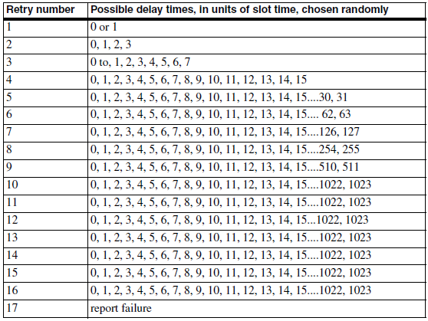
Media Access Control

Slide 92
Design Choices
Selecting Components
On the software side, both C and Java are popular languages for programming networked embedded systems.
On the hardware side, if you have experience with a particular CPU family, it often makes sense to stay with it if possible as well.
Some products are complete solutions that provide both the hardware and program code for Ethernet and Internet communications.

Slide 93
Design Choices
The hardware typically includes a circuit board with a CPU, Ethernet controller, and related components.
The program code includes support for Ethernet, TCP/IP, and other Internet protocols.
Different products use different CPUs, and the type and amount of memory and I/O options vary.
A product may support programming in assembler, C, Java, or a combination of languages.

Slide 94
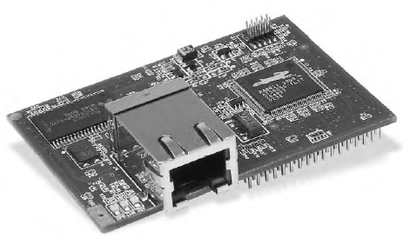
Rabbit Semiconductor RCM3200
At a glance: A fast Z80-derivative CPU with plenty of I/O, low EMI, and a complete development system, including a C compiler.
Ethernet support: 10BASE-T and 100BASE-TX.
Source: Rabbit Semiconductor (www.rabbitsemiconductor.com).

Slide 95
Rabbit Semiconductor RCM3200
RCM3200 Rabbit Core C-programmable Module with Ethernet is a circuit board that contains Rabbit Semiconductor’s Rabbit 3000 microprocessor, which is a much improved and enhanced derivative of ZiLOG, Inc.’s venerable Z80 microprocessor.
The Rabbit 3000 microprocessor has seven 8-bit I/O ports.
Six serial ports for asynchronous and synchronous communications and Infrared Data Association (IrDA) protocols.
A bidirectional parallel port.

Slide 96
Rabbit Semiconductor RCM3200
Two input-capture channels,
Four pulse-width-modulation (PWM) outputs, and two quadrature decoder units with inputs for optical incremental encoder modules.
In addition to the I/O ports, there is an external memory bus with 8 data bits and 20 address lines.
The power supply can range from +3.6V to as low as +1.8V.
The RCM3200 module contains a Rabbit 3000 clocked at 44.2 Megahertz along with memory and components to support Ethernet communications.

Slide 97
Rabbit Semiconductor RCM3200
There are 512 kilobytes of Flash memory for storing programs, 512 kilobytes of fast RAM for loading code for execution, and 256 kilobytes of RAM for storing data.
The module’s Ethernet controller is an ASIX AS88796 3-in-1 Local Bus Fast Ethernet Controller, which interfaces to the CPU’s external data bus.
The module has an RJ-45 connector for 10BASE-T and 100BASE-TX Ethernet media systems.

Slide 98
Rabbit Semiconductor RCM3200
Rabbit Semiconductor’s Dynamic C is a complete environment for writing and editing code, compiling and linking, loading compiled code into the RCM3200’s RAM or Flash memory, and debugging.
Dynamic C includes drivers for the Ethernet controller and libraries that support TCP/IP communications and other networking protocols.
The libraries provide support for an HTTP server, an FTP client and server, and sending and receiving e-mail with SMTP and POP3.

Slide 99
Dallas Semiconductor DSTINIm400 (TINI)
At a Glance: A fast microcontroller with an enhanced 8051 architecture, plenty of I/O, an operating system, and a Java virtual machine (JVM).
Ethernet support: 10BASE-T, 100BASE-TX.
Source: Dallas Semiconductor (www.dalsemi.com).
TINI stands for Tiny InterNet Interface.
Technically, the TINI isn’t a CPU or a circuit board, but a platform that consists of a CPU and related components, support for networking, and a Java runtime environment

Slide 100
Dallas Semiconductor DSTINIm400 (TINI)
The DSTINIm400 Networked Microcontroller Evaluation Kit is a module that implements the TINI platform.
The module’s circuit board contains a Dallas Semiconductor DS80C400 Network Microcontroller, high-speed derivative of Intel Corporation’s long-popular 8051 microcontroller.
The chip has eight 8-bit I/O ports.
Many of the port bits can function as data and address lines for an external memory bus with 8 data bits and 22 address bits.

Slide 101
Dallas Semiconductor DSTINIm400 (TINI)
There are three asynchronous serial ports and a programmable output clock for an Infrared Data Association (IrDA) interface.
A 1-Wire-net Master can control communications on a 1-Wire net, or MicroLAN, which connects components using a single data line plus a ground line.
A Controller Area Network (CAN) 2.0B controller enables communicating over a CAN network, which is a serial interface and protocol that’s popular in automotive, industrial, and medical applications.

Slide 102
Dallas Semiconductor DSTINIm400 (TINI)
The ’80C400 chip includes a programmed 64-kilobyte ROM that contains three firmware components.
A pre-emptive task scheduler enables sharing CPU time among multiple tasks.
The chip also contains hardware support for Ethernet, including an Ethernet controller for 10-Mb/s and 100-Mb/s networks.
The DS80C400 chip requires a +1.8V Core Supply Voltage and a +3.3V I/O Supply Voltage.

Slide 103
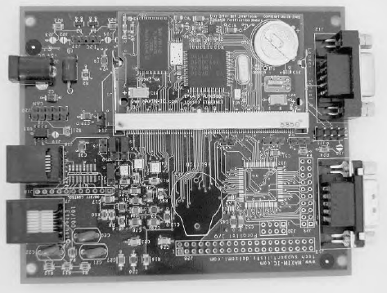
Dallas Semiconductor DSTINIm400 (TINI)

Slide 104
Dallas Semiconductor DSTINIm400 (TINI)
The TINI Software Developers Kit (SDK), available for free downloading from Dallas Semiconductor’s Web site, includes the TINIOS operating system and a Java Virtual Machine (JVM).
The operating system enables running multiple tasks by scheduling the tasks in time slices.
The operating system supports a file system and includes memory and I/O managers.
The JVM contains an interpreter that executes Java programs and communicates with the operating system.

Slide 105
Dallas Semiconductor DSTINIm400 (TINI)
Two useful programs for use in developing TINI applications are the JavaKit utility available from Dallas Semiconductor and a Telnet application.
The JavaKit utility runs on a PC and communicates over a serial-port link with a TINI.
Typing e at the JavaKit prompt causes the TINI to start its JVM and run the slush command shell.

Slide 106
Systronix JStik
At a glance: direct execution of Java bytecodes eliminates the need for an interpreter.
Ethernet support: 10BASE-T
Typical use: Applications that use Java and require speed.
Source: Systronix (www.systronix.com).
The TINI isn’t the only option for Java programmers.
Systronix’s JStik board contains aJ-100 microcontroller from aJile Systems Inc.

Slide 107
Systronix JStik
The aJ-100’s native execution of Java bytecodes results in very fast performance.
The JStik adds a high-speed I/O bus that can operate at bursts of 50 Megabytes per second.
Two RS-232 ports.
SPI and I2C interfaces.
Systronix provides aJile’s Jem Builder tool and Charade debugger for building, loading, and testing applications.

Slide 108
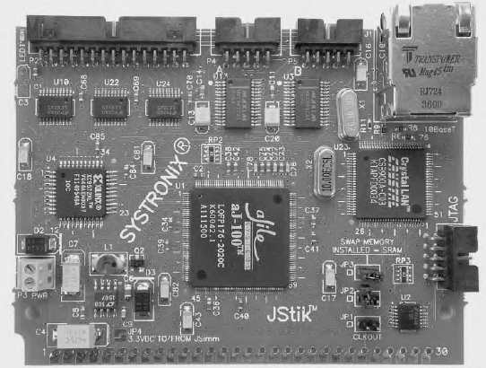
Systronix JStik

Slide 109
Netburner MOD5282 Processor Module
At a glance: Fast Ethernet and a fast 32-bit CPU with lots of memory and I/O.
Ethernet support: 10BASE-T and 100BASE-TX.
Typical use: Applications that need speed and abundant resources.
Source: Netburner, Inc. (www.netburner.com).
Netburner’s MOD5282 Processor Module contains Motorola’s 32-bit ColdFire MCF5282 processor.
The MCF5282 supports a subset of the Motorola 68000 CPU’s instruction set.

Slide 110
Netburner MOD5282 Processor Module
The chip has 512 kilobytes of Flash memory and 64 kilobytes of RAM.
The MCF5282 has three UARTS, a CAN interface, an I2C controller, a queued serial peripheral interface (QSPI) for synchronous serial communications, and an 8-channel, 10-bit analog-to-digital converter.
The MOD5282 includes 8 Megabytes of SRAM and connections for a 16-bit data bus and 16-bit address bus.

Slide 111
Netburner MOD5282 Processor Module
For networking, the board includes a PHY for 10-Mb/s and 100-Mb/s Ethernet and an RJ-45 connector.
The Module 5282 Development Kit are software support for Ethernet and Internet protocols.
An operating system based on the freeware μC/OS, the freeware GNU C/C++ compiler, a debugger, and configuration utilities.

Slide 112
Microchip Technology PICDEM.net Demonstration Board
At a glance: An aid to developing networking applications for Microchip Technology’s PICMicro microcontrollers.
Ethernet support: 10BASE-T
Typical use: Projects that require minimal resources or any PICMicro-based project with an Ethernet interface or support for Internet protocols.
Source: Microchip Technology (www.microchip.com).

Slide 113
Microchip Technology PICDEM.net Demonstration Board
The PICDEM.net Demonstration Board contains a microcontroller, Ethernet controller, related components, and a bread boarding area.
The microcontroller is a PIC16F877, a member of Microchip Technology’s popular PICMicro family.
The PIC16F877 has Flash memory that can store 8192 14-bit words, 368 bytes of RAM, and 192 bytes of EEPROM.
There are 33 I/O bits.

Slide 114
Microchip Technology PICDEM.net Demonstration Board
Many of the bits have alternate functions, including an eight-channel, 10-bit analog-to-digital converter, an asynchronous serial port, a synchronous serial port, and a parallel interface. The clock speed is 19.6608 Megahertz.
The board also contains a 32-kilobyte serial EEPROM for storing Webpages the microcontroller will serve.
The microcontroller comes programmed with firmware to support networking and serve a sample Web page.

Slide 115
Special-Purpose Modules
Lantronix Device Server
At a glance: enables any device with an asynchronous serial port to communicate over a network.
Typical use: any device or system that communicates over a serial port and requires network access.
Ethernet support: 10BASE-T, 100BASE-TX
Source: Lantronix, Inc. (www.lantronix.com)

Slide 116
Special-Purpose Modules
Ubicom IP2022 Wireless Network Processor
At a glance: A CPU optimized for networking with software-configurable
peripherals and wireless support.
Typical use: Web servers and wireless networking
Ethernet support: 10BASE--T
Source: Ubicom, Inc. (www.ubicom.com)

Slide 117
Special-Purpose Modules
Netmedia SitePlayer Ethernet Web Server
At a glance: a very inexpensive module that can serve Web pages and perform UDP communications with a minimum of user programming. Requires a serial link to a CPU to update Web page data and receive data from clients.
Ethernet support: 10BASE-T
Typical use: Basic monitoring and control tasks.
Source: Netmedia (www.netmedia.com)

Slide 118
Special-Purpose Modules
EDTP Electronics Packet Whacker
At a glance: An Ethernet interface on a circuit board with headers for connecting to a CPU.
Typical use: adding Ethernet to any microcontroller circuit.
Ethernet support: 10BASE-T
Source: EDTP Electronics (www.edtp.com)

Slide 119
Special-Purpose Modules
Serial-to-Ethernet Bridge
At a glance: enables RS-232 and RS-485 devices to communicate over networks
Ethernet support: 10BASE-T
Typical use: remote communications with devices with serial interfaces.
Sources: Z-World (www.zworld.com), Netburner (www.netburner.com), R.E. Smith (www.rs485.com).

Slide 120
Ethernet Controllers
An embedded system that supports Ethernet requires Ethernet controller hardware to provide the Ethernet interface.
Ethernet communications are typically handled by a combination of an Ethernet controller chip and device-driver code that communicates with the controller.
Many embedded systems use IP with TCP or UDP, but for some applications, the Ethernet driver can communicate directly with the application layer.

Slide 121
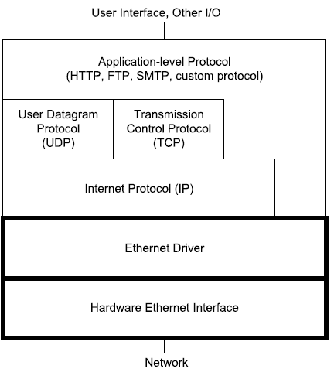
Ethernet Controllers

Slide 122
Ethernet Controllers
The controller chip handles many of the details of sending and receiving Ethernet frames. In sending a frame, a controller typically does all of the following:
Receives the message to send and the destination address from higher-level software.
Calculates the Ethernet frame check sequence.
Places data, addresses, and other information in the frame’s fields.
Attempts to transmit the frame when the network is idle.

Slide 123
Ethernet Controllers
Detects collisions, cancels any transmitted frame with a collision, and retries according to the protocol specified in the IEEE 802.3 standard (half-duplex interfaces only).
Provides an indication of success or failure of a transmission.
In receiving a frame, a controller typically does all of the following:
Detects and synchronizes to new received frames.
Ignores any frames that are less than the minimum size.

Slide 124
Ethernet Controllers
Ignores any frames that don’t contain the interface’s address or a valid multicast or broadcast address in the Destination Address field.
Calculates the frame-check-sequence value, compares the result with the received value, and indicates an error if they don’t match.
Makes the received frame’s data and other information available to the receiving computer. Higher-level software reads the message and does whatever needs to be done with it.

Slide 125
Ethernet Controllers
NE2000-compatible: The NE2000 was an early and popular PC network interface card from Novell.
ASIX AX88796: An Ethernet controller designed for use in embedded systems is the AX88796 3-in-1 Local Bus Fast Ethernet Controller from ASIX Electronics Corporation. Rabbit Semiconductor uses this controller in its RCM3200 module. The controller supports Ethernet communications at 10 and 100 Mb/s.

Slide 126
Ethernet Controllers
Realtek RTL8019AS: one of the most popular controllers has been the RTL8019AS Full Duplex Ethernet Controller with Plug and Play Function from Realtek Semiconductor Corp. This chip has an on-chip 16-kilobyte SRAM and an interface to serial EEPROM.
SMSC LAN91C96: Another Ethernet controller designed specifically for embedded systems is Standard Microsystems Corporation (SMSC)’s LAN91C96 Non-PCI Full Duplex Ethernet Controller with Magic Packet. Dallas Semiconductor’s DS-TINI-1 module uses this controller.

Slide 127
Ethernet Controllers
Cirrus Logic CS8900A : An older ISA-based controller that’s suitable for some embedded systems is Cirrus Logic’s CS8900A Crystal LAN ISA Ethernet controller. The ’8900A is not NE2000-compatible. Instead it defines its own set of registers in on-chip SRAM that it calls Packet Page memory.

Slide 128
Ethernet Controllers

