Slide 1
EMBEDDED
NETWORKING

Slide 2
EMBEDDED NETWORKING Syllabus
EMBEDDED ETHERNET: Exchanging messages using UDP and TCP – Serving web pages with Dynamic data – Serving web pages that respond to user input – Email for Embedded Systems – Using FTP – Keeping Devices and Network Secure.

Slide 3
Exchanging messages using UDP and TCP
Communications that use UDP, TCP, or other Internet protocols must use IP addresses to identify the sender and receiver of the communications (with the exception that a UDP datagram doesn’t have to specify a source address).
Sending a message using IP may require any or all of the following: a netmask value, the IP address of a gateway, or router, and the IP address of a domain-name server.

Slide 4
Exchanging messages using UDP and TCP
Rabbit Configuration
For Rabbit modules, Dynamic C supports several ways for a network interface to obtain an IP address and related values. An application can provide the values or obtain values from a DHCP server.
The program code that specifies the values or how to obtain them can be in the main application or in a macro that the main program calls.

Slide 5
Exchanging messages using UDP and TCP
Dynamic C’s tcp_config.lib file defines constants for use in static configurations and macros for implementing a variety of common configurations.
To specify a configuration macro, the program code must include the following statement:
TCPCONFIG macro_number
where macro_number names the configuration in a configuration file.

Slide 6
Exchanging messages using UDP and TCP
The default macro, TCPCONFIG 0, does no configuring, so with this option, the main program has to provide the configuration information.
To use TCPCONFIG 0 with a static IP address, a program should define values for the constants below, as needed:
#define _PRIMARY_STATIC_IP "192.168.111.7"
#define _PRIMARY_NETMASK "255.255.255.0"
#define MY_NAMESERVER "192.168.111.2"
#define MY_GATEWAY "192.168.111.1"

Slide 7
Exchanging messages using UDP and TCP
To use static values defined in tcp_config.lib, use TCPCONFIG 1 in the application. The tcp_config.lib file defines the four constants above.
Edit the statements with the values your system requires.
The following code in tcp_config.lib configures the interface using the values stored in _PRIMARY_STATIC_IP and _PRIMARY_NETMASK:

Slide 8
Exchanging messages using UDP and TCP
#if TCPCONFIG == 1
#define USE_ETHERNET 1
#define IFCONFIG_ETH0 \
IFS_IPADDR,aton(_PRIMARY_STATIC_IP), \
IFS_NETMASK,aton(_PRIMARY_NETMASK), \
IFS_UP
#endif.
The USE_ETHERNET macro is set to 1 to specify that the interface uses the system’s first Ethernet port.

Slide 9
Exchanging messages using UDP and TCP
The IFS_IPADDR and IFS_NETMASK macros set the interface’s IP address and netmask using the values defined earlier.
The aton function converts strings in dotted- quad format to the binary values required by the macros. The IFS_UP macro brings up, or enables, the interface.
In a similar way, tcp_config.lib contains additional macros for other common configurations.

Slide 10
Exchanging messages using UDP and TCP
For example, TCPCONFIG 3 specifies that the first Ethernet interface will obtain its IP address and other configuration values from a DHCP server.
TCPCONFIG values greater than 99 must be in a file called custom_config.lib. Create this file if you want to store custom configurations in your own file, rather than using tcp_config.lib.

Slide 11
Exchanging messages using UDP and TCP
ifconfig() function enables firmware to set and retrieve various network values at runtime. Calls to ifconfig() can contain varying numbers of parameters.
longword my_ip_address;
char redirect_to[127];
char ip_dotted_quad[16];
ifconfig(IF_DEFAULT, IFG_IPADDR, &my_ip_address, IFS_END);
sprintf(redirect_to, "http://%s/index.shtml",
inet_ntoa(ip_dotted_quad, my_ip_address));

Slide 12
Exchanging messages using UDP and TCP
In the example above, the IFG_IPADDR macro returns the IP address for the default interface (IF_DEFAULT) in the variable my_ip_address.
A sprintf() statement stores a URL containing the retrieved IP address in the character array redirect_to.
The inet_ntoa() function converts the binary IP address returned by IFG_IPADDR to dotted-quad format.

Slide 13
Exchanging messages using UDP and TCP
For debugging applications that use networking functions, the following directives are useful:
#define DCRTCP_DEBUG
#define DCRTCP_VERBOSE
DCRTCP_DEBUG enables debugging within the TCP/IP libraries.
DCRTCP_VERBOSE prints debugging messages to Dynamic C’s STDIO window.

Slide 14
Exchanging messages using UDP and TCP
The global variable debug_on controls the number of messages, To set debug_on from 0 (few messages) to 5 (maximum messages), set the third parameter in this ifconfig() statement:
ifconfig(IF_ANY, IFS_DEBUG, 5, IFS_END);

Slide 15
Exchanging messages using UDP and TCP
Sending UDP Datagrams
A UDP communication takes place between two sockets. A socket is one end of a communication path on a network. Each socket has an IP address and a port number.
In the application, the firmware specifies the IP addresses and port numbers to use and sends a datagram periodically.

Slide 16
Exchanging messages using UDP and TCP
In the application, must set REMOTE_IP and REMOTE_PORT to appropriate values for your remote computer.
#define TCPCONFIG 1
#define LOCAL_PORT 5551
#define REMOTE_IP "192.168.111.5"
#define REMOTE_PORT 5550

Slide 17
Exchanging messages using UDP and TCP
The MAX_UDP_SOCKET_BUFFERS constant sets the maximum number of socket buffers for the application. This application, which communicates with a single host, requires just one buffer:
#define MAX_UDP_SOCKET_BUFFERS 1

Slide 18
Exchanging messages using UDP and TCP
The main() Function
The application’s main() function begins by calling sock_init() to initialize the TCP/IP stack.
This call is required before calling any functions in dcrtcp.lib, including any functions that use UDP or IP. If successful, the function returns zero. If the function doesn’t return zero, the network isn’t available and the program ends.

Slide 19
Exchanging messages using UDP and TCP
main()
{
int return_value;
sequence = 255;
return_value = sock_init();
if (return_value == 0)
{
printf("Network support is initialized.\n");
}
else {
printf("The network is not available.\n");
exit(0);
}

Slide 20
Exchanging messages using UDP and TCP
A call to udp_open() opens the specified UDP socket, enabling communications.
if(!udp_open(&my_socket, LOCAL_PORT,
resolve(REMOTE_IP), REMOTE_PORT, NULL))
{
printf("udp_open failed.\n");
exit(0);
}
else {
printf("udp_open succeeded.\n");
}

Slide 21
Exchanging messages using UDP and TCP
The call requires a pointer to the local socket (&my_socket), a local port number (LOCAL_PORT), a remote IP address (resolve(REMOTE_IP)) and port number (REMOTE_PORT) to communicate with, and either a function to call on receiving data or NULL to place received data in the socket’s receive buffer.
This application doesn’t receive datagrams, so the parameter is null.

Slide 22
Exchanging messages using UDP and TCP
Sending a Datagram
The send_packet() function creates and sends a datagram. The send_buffer array holds the data to send.
For each send, the application increments the sequence number and places the number in the first byte of the send_buffer array. The sequence number resets to zero after sending 255.

Slide 23
Exchanging messages using UDP and TCP
int send_packet(void)
{
char send_buffer[2];
int buffer_length;
int return_value;
int test_bit;
sequence++;
if (sequence > 255)
{
sequence = 0;
}
send_buffer[0] = (char)sequence;

Slide 24
Exchanging messages using UDP and TCP
udp_send() function sends the datagram. The function call requires a pointer to the local socket (&my_socket), a buffer with data to send (send_buffer), and the number of bytes in the buffer to send (sizeof(send_buffer).
On success, udp_send() returns the number of bytes sent. On failure, the program closes and attempts to reopen the socket. If the call to udp_open() fails, the application ends.

Slide 25
Exchanging messages using UDP and TCP
return_value = udp_send(&my_socket, send_buffer,
sizeof(send_buffer);
if (return_value < 0) {
printf("Error sending datagram. Closing and reopening socket.\n");
sock_close(&my_socket);
if(!udp_open(&my_socket, LOCAL_PORT,
resolve(REMOTE_IP), REMOTE_PORT, NULL))
{
printf("udp_open failed.\n");
exit(0);
}
}
else {
printf("Sent: Message number %d \n", sequence);
}
return 1;
} // end send_packet()

Slide 26
Exchanging messages using UDP and TCP
Receiving UDP Datagrams
Initial Defines and Declarations
A TCPCONFIG 1 macro selects a network configuration from the tcp_config.lib file.
The MAX_UDP_SOCKET_BUFFERS macro specifies the number of socket buffers to allocate for UDP sockets. This application requires one socket buffer.

Slide 27
Exchanging messages using UDP and TCP
LOCAL_PORT specifies the port that the Rabbit will receive datagrams on. Generally, any port over 1023 is acceptable. The remote host will need to know this value when sending datagrams.
REMOTE_IP is the IP address of the host to receive datagrams from. Set this value to the IP address of the sending host.
To accept datagrams from any host, set REMOTE_IP to zero. To accept only broadcast packets, set REMOTE_IP to 255.255.255.255.

Slide 28
Exchanging messages using UDP and TCP
#define TCPCONFIG 1
#define MAX_UDP_SOCKET_BUFFERS 1
#define LOCAL_PORT 5550
#define REMOTE_IP "192.168.111.5“
The receive_packet() function checks for a received datagram and if there is one, writes its contents to Dynamic C’s STDIO window. The received_data array holds the contents of the received datagram.

Slide 29
Exchanging messages using UDP and TCP
int receive_packet()
{
static char received_data[128];
The GLOBAL_INIT section executes only once. The memset() function initializes the block of memory that will hold a received datagram.
#GLOBAL_INIT
{
memset(received_data, 0, sizeof(received_data));
}

Slide 30
Exchanging messages using UDP and TCP
The udp_recv() function receives a datagram from the host specified in datagram_socket. The datagram is stored in received_data. If the return value is -1, there is no datagram and the function returns.
if (-1 == udp_recv(&datagram_socket, received_data,
sizeof(received_data)))
{
return 0;
}

Slide 31
Exchanging messages using UDP and TCP
The main() Function
The main() function calls sock_init() to initialize the TCP/IP stack. If the return value isn’t zero, the network isn’t available.

Slide 32
Exchanging messages using UDP and TCP
main()
{
int return_value;
return_value = sock_init();
if (return_value == 0) {
printf("Nework support is initialized.\n");
}
else {
printf("The network is not available.\n");
exit(0);
}
printf("Opening UDP socket\n");

Slide 33
Exchanging messages using UDP and TCP
A call to udp_open() opens the specified UDP socket, enabling communications.
The call requires a pointer to the local socket (&datagram_socket) and a local port number (LOCAL_PORT). The socket connects to the remote IP address in resolve(REMOTE_IP). The fourth parameter is zero to indicate that the socket will accept datagrams from any port on the remote host.
The final parameter is either a function to call on receiving data or NULL to place received data in the socket’s receive buffer.

Slide 34
Exchanging messages using UDP and TCP
if(!udp_open(&datagram_socket, LOCAL_PORT,
resolve(REMOTE_IP), 0, NULL))
{
printf("udp_open failed!\n");
exit(0);
}

Slide 35
Exchanging messages using UDP and TCP
An endless while loop calls the tcp_tick() function to process network packets and the receive_packet() function to check for received datagrams.
while(1)
{
tcp_tick(NULL);
receive_packet();
}
} // end main()

Slide 36
Exchanging messages using UDP and TCP
Exchanging Messages using TCP
With UDP, you can send a message at any time, to any computer, without first finding out if the remote computer is available to receive the message.
With TCP, before exchanging data, one computer must request a connection to the other computer.
The connection is between two sockets, with each socket defined by an IP address and port number.

Slide 37
Exchanging messages using UDP and TCP
The remote computer must respond to the request and the requesting computer must acknowledge receiving the response.
When these events have occurred, a connection has been established and the computers can exchange other data.
In a similar way, to close a connection, each computer sends a request to close and acknowledges the request to close received from the remote computer.

Slide 38
Exchanging messages using UDP and TCP
In the examples below, the embedded system’s program waits for and responds to a request for a connection.
When the connection has been established, the embedded system waits to receive data, reads a byte, increments it, sends it back to the remote host, and closes the connection.

Slide 39
Exchanging messages using UDP and TCP
Rabbit Code
A Dynamic C application performs the TCP communications in the Rabbit module.
As in the Rabbit UDP example, the code begins by specifying a network configuration macro with TCPCONFIG and a local port for network communications.
In this application, the Rabbit module accepts connection requests from any host and port, so there is no need to specify a remote IP address or port.

Slide 40
Exchanging messages using UDP and TCP
The dcrtcp.lib file is the Dynamic C library that supports TCP/IP communications.
#define TCPCONFIG 1
#define LOCAL_PORT 5551
#memmap xmem
#use "dcrtcp.lib"
char server_buffer[255];
int bytes_read;
int return_value;

Slide 41
Exchanging messages using UDP and TCP
The server_socket variable is a Dynamic C tcp_Socket structure that specifies the socket to use for TCP communications.
tcp_Socket server_socket;
The function prototype for service_request() enables the main() function to call service_request() before it has been compiled.
void service_request();

Slide 42
Exchanging messages using UDP and TCP
The main() Function
The main() function begins by calling sock_init() to enable using TCP/IP functions.
main()
{
int data_available;
return_value = sock_init();
if (return_value == 0) {
while(1) {

Slide 43
Exchanging messages using UDP and TCP
In the costatement, Dynamic C’s tcp_listen() function begins waiting for a connection request from a remote host to the specified local port. The call to tcp_listen() requires several parameters:
A pointer to a TCP socket (&server_socket).
The port number to listen on (LOCAL_PORT).
The remote computer’s IP address (0 to accept requests from any IP address).
The port on the remote computer to communicate with (0 to communicate with any port).

Slide 44
Exchanging messages using UDP and TCP
Either a function to call when data is received or NULL to place received data in the socket’s receive buffer (NULL).
Reserved parameter (0).
A waitfor() statement calls the application’s connection_established() function. If a connection has been established with a remote host, the function returns 1 and program execution continues with the statements that follow.
If there is no connection, the function returns 0 and program execution jumps to the costatement’s closing brace.

Slide 45
Exchanging messages using UDP and TCP
After a connection is established, a second waitfor() statement calls the application’s check_for_received_data() function.
The function returns 1 if there is a byte waiting to be read from the remote computer.
The DelaySec() function ensures that the waitfor statement eventually times out in case a remote host fails to send a data byte.
If a byte is available, a call to the application’s service_request() function reads the byte and returns a response.

Slide 46
Exchanging messages using UDP and TCP
This completes the communication, so the sock_close() function closes the connection and the costatement ends.
If the call to sock_init() fails, the application ends without entering the while(1) loop.

Slide 47
Exchanging messages using UDP and TCP
costate {
tcp_listen(&server_socket,LOCAL_PORT,0,0,NULL,0);
printf("Waiting for connection...\n");
waitfor (connection_established());
printf("Connection established. \n");
waitfor (check_for_received_data() ||
DelaySec(20));
data_available = check_for_received_data();
if (data_available > 0) {
service_request();
}
else {
printf("Timeout: the remote host provided no data. \n");
}
sock_close(&server_socket);
printf("The connection is closed. \n");
} // end costate

Slide 48
Exchanging messages using UDP and TCP
Establishing a Connection
The connection_established function called in the costatement checks for a connection to a remote host.
sock_established() function returns 1 if a connection has been established to the specified socket and 0 if there is no connection.
If sock_established returns 1 or if sock_bytesready() returns a value other than -1, connection_established() returns 0, indicating that either the connection is established or that the connection is now closed but there is at least one byte ready to be read. Otherwise the function returns 1.

Slide 49
Exchanging messages using UDP and TCP
Dynamic C’s tcp_tick() function processes network packets and must be called periodically.
int connection_established()
{
tcp_tick(NULL);
if (!sock_established(&server_socket) && sock_bytesready(&server_socket) == -1)
{
return 0;
}
else {
return 1;
}
} // end connection_established()

Slide 50
Exchanging messages using UDP and TCP
Checking for Received Data
The check_for_received_data() function called in the main() function’s costatement finds out if there is data available to be read from an existing connection.
The sock_bytesready() function returns the number of bytes waiting to be read or -1 if no bytes are available.
The check_for_received_data() function returns 1 if a byte is available and 0 if there are no bytes.
A call to tcp_tick() processes network packets.

Slide 51
Exchanging messages using UDP and TCP
int check_for_received_data()
{
tcp_tick(&server_socket);
If (sock_bytesready(&server_socket) == -1)
{
return 0;
}
else
{
return 1;
}
} // end check_for_received_data

Slide 52
Exchanging messages using UDP and TCP
Reading and Responding to Received Data
The service_request() function reads a received byte and returns a response to the remote host.
sock_fastread() function reads bytes from a socket into a buffer and returns the number of bytes read or -1 on error.
The function requires a pointer to a socket to read from (&server_socket), the byte array to place the data in (server_buffer), and the maximum number of bytes to read (sizeof(server_buffer)).

Slide 53
Exchanging messages using UDP and TCP
void service_request() {
bytes_read = sock_fastread(&server_socket,
server_buffer, sizeof(server_buffer));
If a byte was received, the code increments it, resetting to 0 on receiving a byte of 255.
if (bytes_read > 0) {
printf("Byte received = %d \n", server_buffer[0]);
if (server_buffer[0] == 255) {
server_buffer[0] = 0;
}
else {
server_buffer[0]=server_buffer[0] + 1;
}

Slide 54
Exchanging messages using UDP and TCP
sock_write() function writes the incremented byte to the socket, which causes the byte to be sent on the network to the remote host.
return_value = sock_write(&server_socket, server_buffer, 1);
if (return_value != -1) {
printf("Byte sent = %d \n", server_buffer[0]);
}
else {
printf("Error writing to socket. \n");
}
} // end if (bytes_read > 0)
else {
printf("Error reading from socket. \n");
}
} // end service_request()

Slide 55
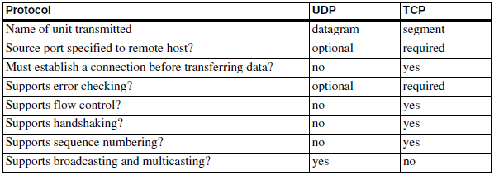
Exchanging messages using UDP and TCP
UDP and TCP are two popular protocols for exchanging data over local networks and the Internet.

Slide 56
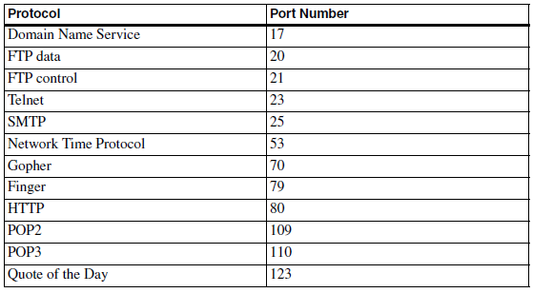
Exchanging messages using UDP and TCP
Examples of standard protocols and their assigned port numbers.

Slide 57
Exchanging messages using UDP and TCP
Supporting UDP in Embedded Systems
To send a datagram using UDP, a computer in an Ethernet network must do the following:
Place the destination port number and datagram length in the appropriate locations in the UDP header. The source port number and checksum in the header are optional. Computing the checksum requires knowing the IP addresses of the source and destination.
Append the data to send to the header.

Slide 58
Exchanging messages using UDP and TCP
Place the UDP datagram in the data portion of an IP datagram. The IP datagram requires source and destination IP addresses and a checksum computed on the header.
Pass the IP datagram to the Ethernet controller’s driver for sending on the network.

Slide 59
Exchanging messages using UDP and TCP
To receive a datagram using UDP, a computer in an Ethernet network must do the following:
Receive an IP datagram from the Ethernet controller’s driver.
Strip the IP header from the datagram. Calculate the IP checksum and compare the result with the received value.
If the checksums match, strip the header from the UDP datagram. If using the UDP checksum, calculate its value and compare it to the received checksum.
Use the destination port number to decide where to pass the received data.

Slide 60
Exchanging messages using UDP and TCP
Supporting TCP in Embedded Systems
To send a message using TCP, a computer in an Ethernet network must do the following:
Establish a connection using the 3-way handshake.
Use the received Window size to determine how much data the remote computer can accept.

Slide 61
Exchanging messages using UDP and TCP
Place the source and destination port numbers, sequence number, acknowledgment number, header length, source window size, and checksum in the appropriate locations in the TCP header. Computing the checksum requires knowing the source and destination IP addresses.
Place the data to send in the data portion of the segment.
Place the TCP segment in the data portion of an IP datagram. The IP datagram requires source and destination IP addresses and computing a checksum on the header.

Slide 62
Exchanging messages using UDP and TCP
Pass the IP datagram to the Ethernet controller’s driver for sending on the network and start a timeout timer.
Wait to receive an acknowledgment number that indicates that the remote computer received the data. If the acknowledgment doesn’t arrive before a timeout, resend the segment.

Slide 63
Exchanging messages using UDP and TCP
To receive a datagram using TCP, a computer in an Ethernet network must do the following:
Establish a connection using the 3-way handshake.
Receive an IP datagram from the Ethernet controller’s driver.
Strip the IP header from the datagram. Calculate the checksum and compare with the received value.
If the checksums match, strip the header from the TCP segment. Calculate the checksum and compare it to the received value.

Slide 64
Exchanging messages using UDP and TCP
Examine the received acknowledgment number to find out if the segment is acknowledging receipt of previously sent data and if so, delete the acknowledged data from the retransmission queue.
Compare the received sequence number to the expected value. If the numbers match, set the acknowledgment number to return to the sender in a TCP segment.
Use the destination port number to decide where to pass the data.

Slide 65
Serving web pages with Dynamic data
A Web browser such as Microsoft’s Internet Explorer is a client application that uses HTTP to request Web pages from servers on the Internet or in a local network.
One of the most popular of these is the hypertext transfer protocol (HTTP), which enables a computer to serve Web pages on request.
The computers that request Web pages typically have full-screen displays, but for some applications, an embedded system with limited display capabilities can function as an HTTP client.

Slide 66
Serving web pages with Dynamic data
An embedded system that functions as a Web server generally has all of the following:
Non-volatile memory to hold pages to be served.
Support for TCP and IP. Requests for Web pages and the pages sent in response travel in the data portion of TCP segments.
Support for HTTP. The server must be able to understand and respond to received requests for Web pages. The HTTP standard specifies the format for the requests and replies.

Slide 67
Serving web pages with Dynamic data
A local-network or Internet connection. To serve pages on the Internet, the Web server must have an Internet connection. Any firewalls must be configured so the system can receive HTTP requests.
One or more pages to serve. The Web pages are files or blocks of text that use a form of encoding called hypertext markup language (HTML).

Slide 68
Serving web pages with Dynamic data
Many Web pages are static, where the information on the page doesn’t change unless someone edits the page’s HTML file and uploads the new file to the server.
Static Web pages are useful for presenting product information, articles, or other information that remains constant.
But most embedded systems have little use for static pages, other than possibly presenting a home page with links to other pages.

Slide 69
Serving web pages with Dynamic data
An embedded system that functions as a Web server will almost certainly want to display real-time information.
Dynamic, or real-time, data includes any data that can change over time and can be different each time the page is served.
Dynamic data may also include sensor or switch readings and time and date information.

Slide 70
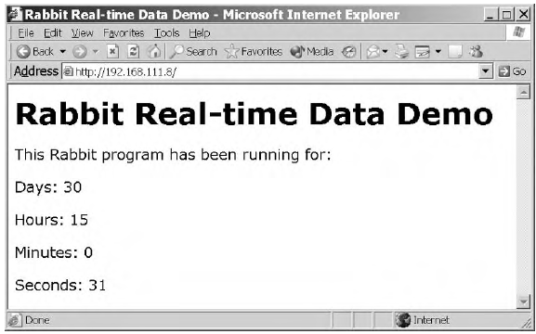
Serving web pages with Dynamic data
The embedded system stores the number of days, hours, minutes, and seconds in variables.

Slide 71
Serving web pages with Dynamic data
Rabbit Real-time Web Page
The page uses HTML tags to advise the browser how to display the page’s contents. Each tag consists of text enclosed by angle brackets < >.
A paragraph tag (<p>) tag tells the browser to display the information that follows in a new paragraph.

Slide 72
Serving web pages with Dynamic data
The first paragraph tag causes the browser to display the text, “This Rabbit program has been running for:”.
Each of the four lines that follow contains a Server Side Include #echo directive that inserts the value of a variable on the page.

Slide 73
Serving web pages with Dynamic data
A comment, which is text that the browser ignores and doesn’t display, is enclosed by <!-------- and -------->.
The #echo directive tells the server to replace the comment tag and its contents with the value of the named variable.
For example, in the first directive, the server replaces <!--#echo var="days"--> with the value of the variable days on the server. If days equals 5, the browser receives and displays Days: 5.

Slide 74
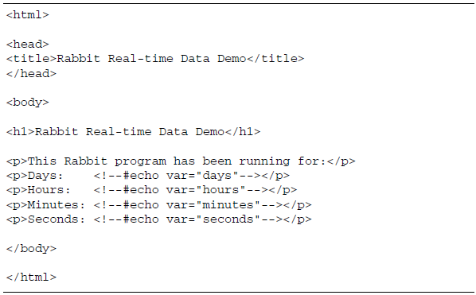
Serving web pages with Dynamic data

Slide 75
Serving web pages with Dynamic data
#use "dcrtcp.lib"
#use "http.lib"
#ximport "c:/rabbitserver/index.shtml" index_html
Four variables store the values for the units of time the Web page will display.
unsigned long days;
unsigned long hours;
unsigned long minutes;
unsigned long seconds;

Slide 76
Serving web pages with Dynamic data
The HttpType structure below associates .shtml with the Multipurpose Internet Mail Extension (MIME) type text/html, which is a text file that uses HTML encoding.
const HttpType http_types[] =
{
{ ".shtml", "text/html", shtml_handler}
};

Slide 77
Serving web pages with Dynamic data
The HttpSpec structure contains information about the files, variables, and structures that the Web server can access.
const HttpSpec http_flashspec[] =
{
{ HTTPSPEC_FILE, "/", index_html, NULL, 0, NULL, NULL},
{ HTTPSPEC_FILE, "/index.shtml", index_html, NULL, 0, NULL, NULL},
{ HTTPSPEC_VARIABLE, "days", 0, &days, INT32, "%d", NULL},
{ HTTPSPEC_VARIABLE, "hours", 0, &hours, INT32, "%d", NULL},
{ HTTPSPEC_VARIABLE, "minutes", 0, &minutes, INT32, "%d", NULL},
{ HTTPSPEC_VARIABLE, "seconds", 0, &seconds, INT32, "%d", NULL},
};

Slide 78
Serving web pages with Dynamic data
Type. Indicates whether the entry is for a file, variable, or function. HTTPSPEC_FILE specifies that the entry is for a file.
Name. Names a file the Web server can access. This example has one file, index.shtml, with two entries to enable browsers to request the file by name ("index.shtml") or as the default file to serve when no name is specified ("/").

Slide 79
Serving web pages with Dynamic data
Data. Specifies the file’s physical address. Both HTTPSPEC_FILE entries point to index_html, where the file index.shtml is stored.
Addr. Unused (NULL) for files.
Vartype. Unused (zero) for files.
Format. Unused (NULL) for files.
Realm. Names an HttpRealm structure that identifies a name and password required to access the file. NULL if unused.

Slide 80
Serving web pages with Dynamic data
The four HTTP_VARIABLE entries specify variables for the different units of time. These are the parameters for an HTTP_VARIABLE entry:
Type. Indicates whether the entry is for a file, variable, or function. HTTPSPEC_VARIABLE specifies that the entry is for a variable.
Name. Provides the name of a variable the Web server can access. The server’s Web page displays the values of four variables: "days", "hours", "minutes", and "seconds".
Data. Unused (zero) for variables.

Slide 81
Serving web pages with Dynamic data
Addr. A short pointer to the variable.
Vartype. The type of variable. The options are 8-bit integer (INT8), 16-bit integer (INT16), 32-bit integer (INT32), 16-bit pointer (PTR16), and 32-bit floating-point value (FLOAT32). The PTR16 type is useful for displaying strings.
Format. The printf specifier to use when displaying the variable. The specifier %d causes the variable to display as a decimal value.
Realm. Identifies a name and password to access the variable. NULL if unused.

Slide 82
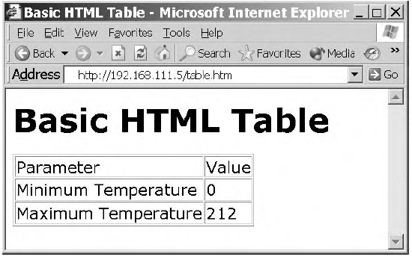
Serving web pages with Dynamic data

Slide 83
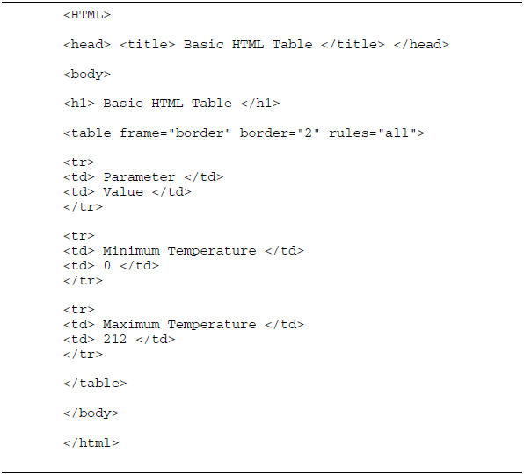
Serving web pages with Dynamic data

Slide 84
Serving web pages that respond to user input
‘Two technologies for enabling Web pages to respond to user input are common gateway interface (CGI) programming and Java servlets. CGI programs and Java servlets can do the following:
Retrieve the current values of variables and place them on a Web page to return to a client.
Receive and act on data provided by a client who clicks a hyperlink or submits an HTML form.
Do just about anything that an ordinary program is capable of, including making calculations, performing logical operations, and accessing I/O ports.

Slide 85
Serving web pages that respond to user input

Slide 86
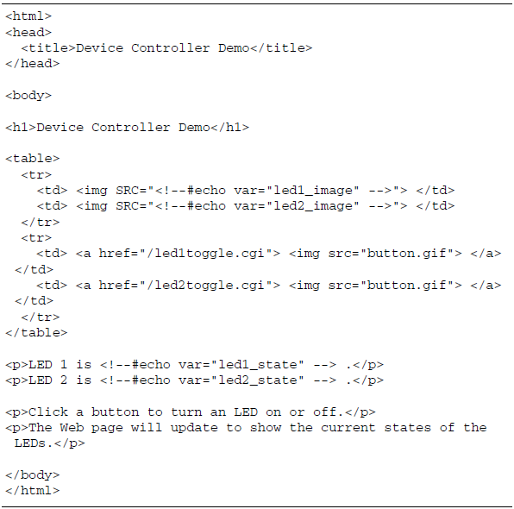
Serving web pages that respond to user input

Slide 87
Serving web pages that respond to user input
The dcrtcp.lib library supports TCP/IP. The http.lib library supports HTTP functions.
#memmap xmem
#use "dcrtcp.lib“
#use "http.lib“
#ximport "c:/rabbitserver/index.shtml" index_html
#ximport "c:/rabbitserver/ledon.gif" ledon_gif
#ximport "c:/rabbitserver/ledoff.gif" ledoff_gif
#ximport "c:/rabbitserver/button.gif" button_gif

Slide 88
Serving web pages that respond to user input
const HttpType http_types[] =
{
{ ".shtml", "text/html", shtml_handler},
{ ".html", "text/html", NULL},
{ ".cgi", "", NULL},
{ ".gif", "image/gif", NULL}
};

Slide 89
Serving web pages that respond to user input
const char ledon_image[] = "ledon.gif";
const char ledoff_image[] = "ledoff.gif";
char led1_image[15];
char led2_image[15];
char led1_state[4];
char led2_state[4];

Slide 90
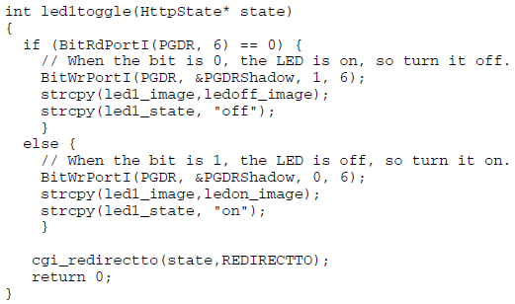
Serving web pages that respond to user input
Controlling the LEDs: This is the code for LED1:

Slide 91
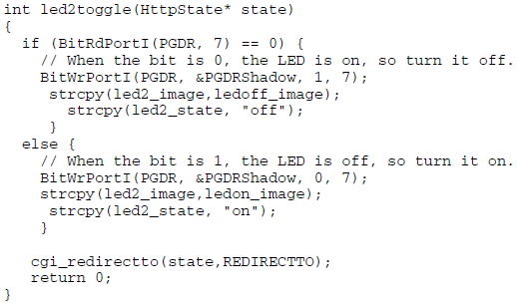
Serving web pages that respond to user input
The routine for LED2 is the same as the routine for LED1, except that it references LED2’s port bit and variables:

Slide 92
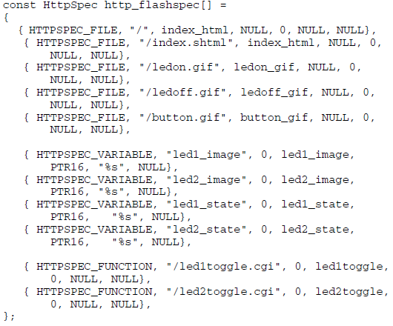
Serving web pages that respond to user input

Slide 93
Serving web pages that respond to user input
main()
{
WrPortI(PGDDR, NULL, 0xC0);
if (BitRdPortI(PGDR, 6) == 0) {
strcpy(led1_image,ledon_image);
strcpy(led1_state, "on");
} else {
strcpy(led1_image,ledoff_image);
strcpy(led1_state, "off");
}
if (BitRdPortI(PGDR, 7) == 0) {
strcpy(led2_image,ledon_image);
strcpy(led2_state, "on");
} else {
strcpy(led2_image,ledoff_image);
strcpy(led2_state, "off");
}

Slide 94
Serving web pages that respond to user input
sock_init();
http_init();
tcp_reserveport(80);
The main program loop has just one task, calling http_handler(). In a real-world application, the main program loop would perform other tasks as well.
while (1) {
http_handler();
// Code to perform other tasks can be placed here.
}
} // end main

Slide 95
E-mail for Embedded Systems
Sending an E-mail from a Rabbit
Dynamic C’s smtp.lib library contains functions that greatly simplify the code required to program a Rabbit module to send e-mail.
The firmware defines strings for the sender’s e-mail address, the recipient’s e-mail address, the Subject line, and the message body.
The smtp_sendmail() function then uses these values in initializing the data structures used in sending the e-mail in the format expected by the SMTP server.

Slide 96
E-mail for Embedded Systems
The smtp_mailtick() function handles communications with the mail server,
And smtp_status() returns a status code when the e-mail has been sent or an error occurs.
#define TCPCONFIG 1
#define SENDER "rabbit1@Lvr.com"
#define SMTP_SERVER "mail.example.com"

Slide 97
E-mail for Embedded Systems
For communicating with these servers, SMTP_DOMAIN can set a domain name to send.
#define SMTP_DOMAIN "Lvr.com“
#memmap xmem
#use dcrtcp.lib
#use smtp.lib

Slide 98
E-mail for Embedded Systems
Creating the Message
The create_message() function sets the contents of these elements for the e-mail to be sent.
char recipient[64];
char subject[64];
char body[256];

Slide 99
E-mail for Embedded Systems
void create_message() {
strcpy(recipient, "jan@lvr.com");
strcpy(subject, "Hello from Rabbit");
strcpy(body, "Rabbit test message.");
}

Slide 100
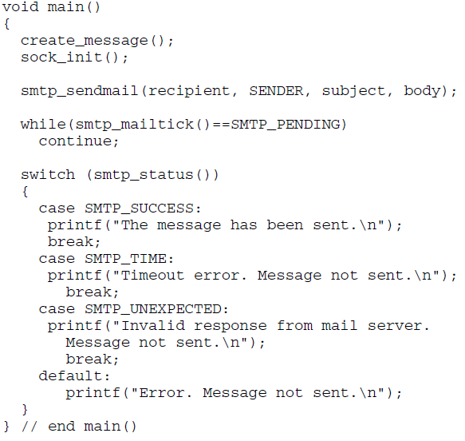
E-mail for Embedded Systems
Sending the Message

Slide 101
E-mail for Embedded Systems
Receiving E-mail on a Rabbit
#define TCPCONFIG 1
#define POP_HOST "mail.example.com"
#define POP_USER "rabbit1"
#define POP_PASS "embedded“
The POP_PARSE_EXTRA macro is optional, but convenient. It performs additional processing of received messages, storing the contents of the To, From, and Subject fields and the message body in separate strings.
#define POP_PARSE_EXTRA

Slide 102
E-mail for Embedded Systems
#memmap xmem
#use "dcrtcp.lib"
#use "pop3.lib“
int current_message;
Processing and Displaying Messages
The store_message() function is a callback function that receives and processes downloaded messages.

Slide 103
E-mail for Embedded Systems
int store_message(int message_number, char *to,char *from,
char *subject, char *body_line, int body_length)
{
#GLOBAL_INIT
{
current_message = -1;
}

Slide 104
E-mail for Embedded Systems
if(current_message != message_number)
{
current_message = message_number;
printf("MESSAGE <%d>\n", current_message);
printf("FROM: %s\n", from);
printf("TO: %s\n", to);
printf("SUBJECT: %s\n", subject);
}

Slide 105
E-mail for Embedded Systems
How E-mail Works
To send and receive e-mails on the Internet, an embedded system (or any computer) must have the following:
A connection to the Internet.
An e-mail account with an address in the form user_name@domain. In the e-mail address rabbit1@Lvr.com, Lvr.com is the domain that hosts the e-mail account and rabbit1 is the user name that identifies the owner of the account in the domain. The user also selects a password required to gain access to the account’s mailbox.

Slide 106
E-mail for Embedded Systems
Access to incoming and outgoing mail servers. The incoming mail server accepts and stores e-mail addressed to the account and enables the user to retrieve received messages. The outgoing mail server accepts and delivers or forwards any mail the user sends.
Support for TCP/IP and the protocols used by the mail servers in sending and retrieving e-mail. Two widely supported protocols are the Simple Mail Transfer Protocol (SMTP) for sending e-mail to a server that will forward the e-mail toward its recipient and the Post Office Protocol Version 3 (POP3) for retrieving received e-mail from a mailbox on a server.

Slide 107
FILE TRANSFER PROTOCOL
Dynamic C’s ftp.lib and ftp_server.lib libraries provide functions for transferring information in files.
For the TINI, TINI’s FTPClient and FTPserver classes.

Slide 108
FILE TRANSFER PROTOCOL
Rabbit FTP Client
A Dynamic C application can use one of two sources for files to send and receive.
Many basic applications can store the files in buffers in root memory.

Slide 109
FILE TRANSFER PROTOCOL
Retrieving a File
#define TCPCONFIG 1
#define REMOTE_HOST "ftp.example.com"
#define REMOTE_PORT 0
#define REMOTE_USERNAME "embedded"
#define REMOTE_PASSWORD "ethernet"

Slide 110
FILE TRANSFER PROTOCOL
REMOTE_HOST is the domain name or IP address of the remote FTP server.
REMOTE_PORT is the port on the FTP server to connect to. Set this value to zero to connect to the default port for the FTP control connection .
REMOTE_USERNAME and REMOTE_PASSWORD are the user name and password that enable access to a user area on the FTP server.

Slide 111
FILE TRANSFER PROTOCOL
#define REMOTE_DIR "/usr/embedded/"
#define REMOTE_FILE "testfile.txt
#define USE_PASSIVE
#ifdef USE_PASSIVE
#define PASSIVE_FLAG FTP_MODE_PASSIVE
#else
#define PASSIVE_FLAG 0
#endif

Slide 112
FILE TRANSFER PROTOCOL
#memmap xmem
#use "dcrtcp.lib"
#use "ftp_client.lib“
char file_buffer[2048];
The main() Routine
main(),
sock_init(),
retrieve_file()

Slide 113
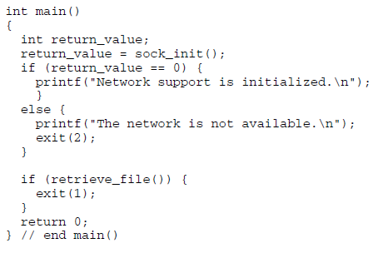
FILE TRANSFER PROTOCOL

Slide 114
END OF UNIT-IV

